Slide 1
Position Budgeting in Workday
Workday Training

Slide 2
Course Overview
WSU
Position Budgeting in Workday
This training will provide information on how to carry out the position budget functions in Workday. We will demonstrate how to perform business processes and where you can find reporting resources for budget management.
Audience
Position Budget Specialist
Position Budget Manager

Slide 3
Ground Rules
WSU
To ensure a positive, productive environment, please adhere to the following guidelines throughout the duration of the session:
1
2
Keep your microphone muted unless prompted by your trainer or moderator, and use the Zoom Chat feature to ask questions.
If you have a question you would prefer not be discussed during the session, or a highly detailed or individual use-case based question, please submit a ticket to support.workday.wsu.edu.

Slide 4
Agenda
WSU
Position Budgeting in Workday
Position Budget Overview
Create Position Budget
Create Position Budget Amendment
Position Budget Reports

Slide 5
Course Objectives
WSU
Position Budgeting in Workday
After completing this course, you will be able to:
Create Position Budgets
Create Position Budget Amendments
Identify reports for Position Budget management

Slide 6
Section 1: Position Budget Overview

Slide 7
Position Budget Overview
WSU
A Position Budget represents the budgeted compensation and fringe amounts for an individual position in Workday.
Position Budgets are:
Created for filled and unfilled Positions
Budgeted on a fiscal year basis
Include Salary and Fringe (optional)
Include Position Budget lines that represent the allocation to different combinations of Worktags
Position Budgets may also need to be amended for various reasons.
Similar to Financial Budgets, approved Position Budgets can only be changed via Position Budget Amendment.
Position Budget policy is set by area leadership, please contact your AFO with questions regarding your area’s approach for position budgeting

Slide 8
Position Budget Overview
WSU
Initiator:
Who creates
Position Budgets & Amendments:
Approver:
Who approves
Position Budgets & Amendments:
Position Budget Specialist
Position Budget Manager
Note: The Position Budget Manager must approve Position Budgets and Position Budget Amendments that they do not initiate.

Slide 9
Section 2: Create Position Budget

Slide 10
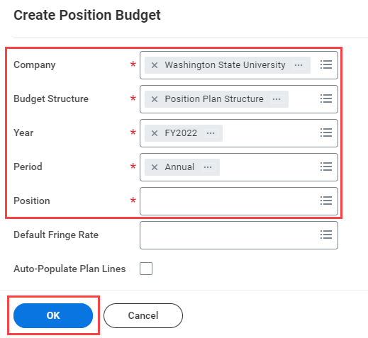
Create Position Budget
WSU
To create a new position budget as a Position Budget Specialist, access the Create Position Budget task using the Workday search bar
Select the appropriate criteria to establish the new position budget.
Company, Budget Structure and Period will be standard
Fiscal Year – enter the fiscal year you are budgeting for, typically current year.
Position – find the position you are looking to create a budget for. Search using position# or worker name.
Default Fringe Rate (optional) – enter a fringe rate percentage if desired. This can also be added later.
Auto-Populate Plan Lines (optional) – this will populate budget lines based on existing payroll commitment lines

Slide 11
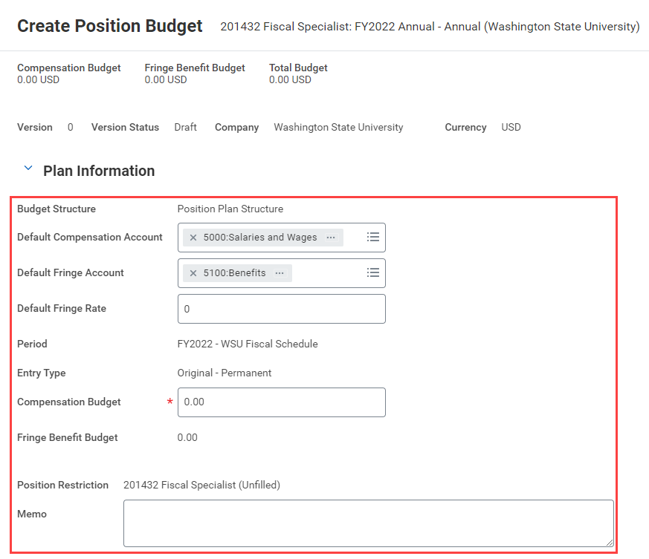
Create Position Budget
WSU
Enter Plan Information to form the budget header
Compensation and Fringe Account – select the ledger accounts for each portion of budget
Default Fringe Rate – Set a default fringe rate percentage, if applicable
Compensation Budget – Set the total budget value for the position
Memo – Add any notes or information relevant to this budget creation.

Slide 12
Create Position Budget
WSU
Enter worktags and values to build the Plan Line details
Worktags – enter the applicable financial worktags to build out line detail for the position
Values – enter the line value for each set of worktags for compensation and fringe (if applicable).
Values can be entered using a percentage of the total, or as a whole value amount.
Splits – add lines to split the budget as needed. Lines must sum to the total compensation budget listed in the Plan Information (header)

Slide 13
Create Position Budget
WSU
Submit Position Budget for approval
Once all relevant information has been completed, submit the budget for approval. You can also;
Save for Later – this will save a draft of the budget, which can be further edited or submitted at a later time
Cancel – this will return you to the Workday home screen
Approvals
Position budgets submitted by Position Budget Specialists will route to the Position Budget Manager for approval
If the Specialist also holds the Manager role for all Cost Centers, budget will auto-approve

Slide 14
Section 3: Amend Position Budgets

Slide 15
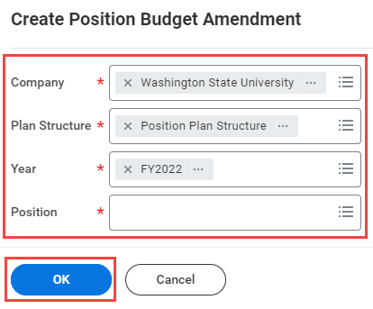
Create Position Budget Amendment
WSU
To amend a position budget as a Position Budget Specialist, access the Create Position Budget Amendment task using the Workday search bar
Select the appropriate criteria to create the amendment
Company and Plan Structure will be standard
Fiscal Year – enter the fiscal year you are budgeting for, typically current year.
Position – find the position you are looking to create an amendment for. Search using position# or worker name.

Slide 16
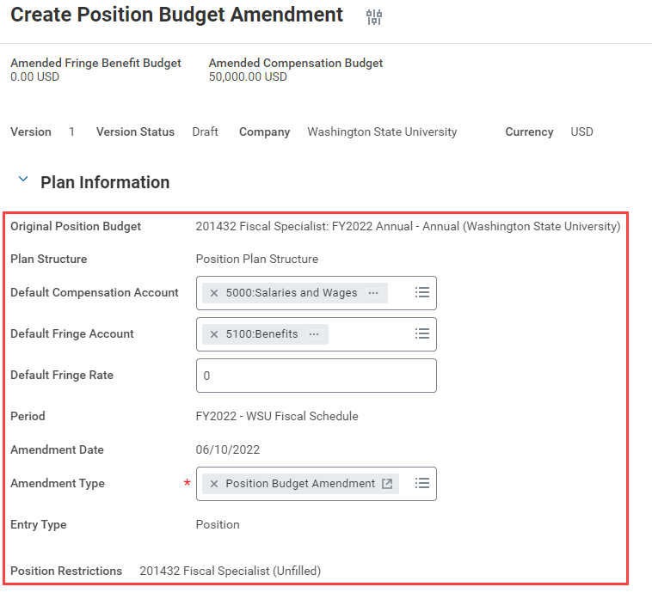
Create Position Budget Amendment
WSU
Enter Plan Information to amend the budget header
Compensation and Fringe Account – select the ledger accounts for each portion of budget
Default Fringe Rate – Set a default fringe rate percentage, if applicable
Amendment Type – Select Position Budget Amendment

Slide 17
Create Position Budget Amendment
WSU
Enter Amendment Summary details to change budget value
Amendment – enter the net change in total value for the position budget
Amended Budget – enter the new total value of the position budget
Note – only one of these fields needs to be filled out. Workday will adjust the other value based on your inputs. For example – if you input a $5,000 “amendment” amount, the amended budget will adjust to reflect the increase, and vice versa
Memo – Add any notes or information relevant to this budget amendment

Slide 18
Create Position Budget Amendment
WSU
Enter worktags and values to build the Budget Amendment Lines
Worktags – enter the applicable financial worktags to build out line detail for the amendment
Values – enter the line value for each set of worktags for compensation and fringe (if applicable).
Values can be entered using a percentage of the total, or as a whole value amount.
Splits – add lines to split the budget as needed. Lines must sum to the total compensation budget listed in the Plan Information (header)

Slide 19
Create Position Budget Amendment
WSU
Notes about position budget amendment line details
If the overall value of the budget is the only thing changing, there are no changes needed in this section. Workday will calculate new line values using the existing split percentage.
Budget Amendment Lines must equal the total amended budget amount
To end an existing line, set the value to $0. An existing line cannot be removed.
Version History – there is a version history tab available on this screen which will show the original version of the budget, as well as an amendment history for reference

Slide 20
Create Position Budget Amendment
WSU
Submit Position Budget Amendment for approval
Once all relevant information has been completed, submit the amendment for approval. You can also;
Save for Later – this will save a draft of the amendment, which can be further edited or submitted at a later time
Propose Amendment – allows you to review the amendment details you have entered before submitting to workflow
Cancel – this will return you to the Workday home screen
Approvals
Position budgets amendments submitted by Position Budget Specialists will route to the Position Budget Manager for approval
If the Specialist also holds the Manager role for all Cost Centers, amendment will auto-approve

Slide 21
Section 4: Position Budget Reporting

Slide 22
Position Budget Reporting
WSU
Find Position Budgets and Amendments – Workday delivered report to find individual position budgets. Also useful for finding draft/saved for later budgets and amendments.
CR FIN Position Budget Lines by Worktag – Custom report that returns all position budget line detail for the prompted organization (CC/CCH/Sup Org) or position.
CR FIN Position Budget Balance Summary – Custom report which compares position budget to payroll accounting detail. Intended to help identify variances between budgeted and actual expenses for a position by worktags.
CR FIN Financial and Position Budget Comparison Summary – Custom report which compares position budget to financial budget details. Intended to identify variance between amount budgeted for payroll in the financial plan structure against amount budgeted to positions in the position plan structure.

Slide 23
Course Summary
WSU
Position Budgeting in Workday
You should now be able to:
Create Position Budgets
Create Position Budget Amendments
Identify reports to manage Position Budgets

Slide 24
Course Evaluation
WSU
Position Budgeting in Workday
Please take a moment to complete a brief survey providing us feedback on today’s training session. Your feedback will help us improve Workday training materials.
Suggestions for future trainings?
https://wsu.co1.qualtrics.com/jfe/form/SV_3ql1sztsFwp0zn7

Slide 25
Workday Support
Workday Service Desk
Modernization Website

Slide 26
Success!
WSU
Position Budgeting in Workday
You’ve completed today’s training.
Questions? Please contact support.workday.wsu.edu

Slide 27
Thank you!

