Slide 1
Workday Reporting
December 2020

Slide 2
Reporting Session
for staff involved in reporting

Slide 3
Reporting with Workday at WSU
The financial data warehouse will house historical HR, Payroll and Financial data
No Workday data will be placed in financial data warehouse
Workday in-system tools and functionality will be used to meet reporting and analysis needs of process user, management, and leadership for data

Slide 4
Workday Reporting Strategy
Immediate Post Launch
Over 350 custom WSU reports and dashboards available at launch
This is just the beginning of where we can go by working together
Workday reporting developed and maintained by central report team
Reporting Advisory Workgroup is active in identifying needed reports, prioritizing work and reviewing reports developed.

Slide 5
Workday Reporting Strategy
After initial stabilization of existing custom reports
Introduce new process to intake report requests
Investigate Hybrid Model for report and dashboard development
Work with leadership to identify data needs
Continue build out of improved dashboards and reports
Explore new data warehousing options

Slide 6
Items to Know

Slide 7
1. Supervisory Organization
Grouping of workers into a management hierarchy
Positions are created within a supervisory organization
Workers are hired into positions in a supervisory organization
Assignable roles have responsibilities in a supervisory organization
Exciting to have sup orgs in a central system
Navigate up and down the structure

Slide 8
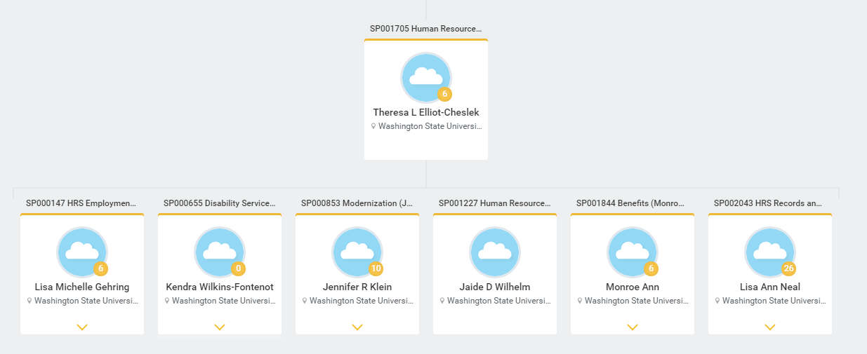
Supervisory Organization

Slide 9
2. Cost Center
Hold financial transactions, budgets and workers
Can compare to a department in legacy
Typically should have
A manager – A financial impact – A budget
Used to report and manage cost but not people
Navigate up and down the structure

Slide 10
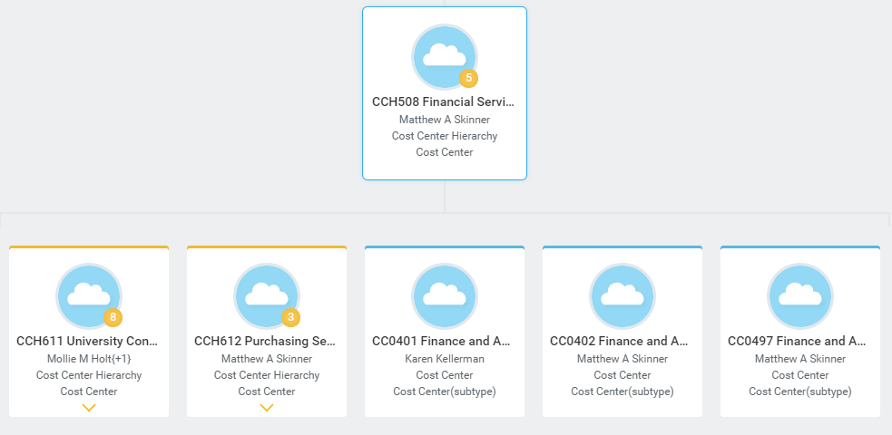
Cost Center

Slide 11
3. Foundation Data Model
Replaces WSU’s Chart of Accounts
Multidimensional data structure using ‘worktags’
Common attributes assigned to transactions
Describe the business purpose
Pull reports based on the worktags
Finance | Human Resources
Cost Center | Supervisory Organization
Grant | Worker Types
Program | Job Classification
Fund

Slide 12
Workday Functionality
Search prefixes - ☺
Staples
What payments were made?
What is the last PO issued?
What invoices are listed?
The related actions button can be your friend!
What are the top suppliers by spend?
Search bar

Slide 13
Reports

Slide 14
Delivered vs Custom
Delivered reports are provided by Workday
Over 4000
Custom reports are written by WSU
Over 350 just migrated into the production tenant
Custom reports look like these
“CR FIN Find Expense Reports”
“CR TTK Direct Report Time Off”
Slide at the end with abbreviations

Slide 15
What Reports Are Available To Me?
HR and Payroll will be live on 12/16
Finance will be live on 1/1
Search Bar
Most Common but requires you to remember portion of name
3 character blocks is sufficient
View, My, Find
Favorites
Manage Favorites reports, custom or delivered
Customize for your personal needs
Save time and customize personal navigation

Slide 16
What Reports Are Available To Me?
Sitemap
Delivered reports and tasks sorted by category
Based on security
Dashboards
Add to home page
Search directly for them
Contain worklets
Report menu

Slide 17
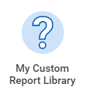
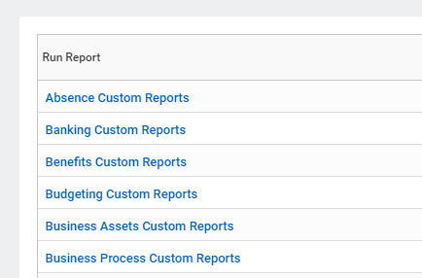
Custom Reports Available To Me
Custom report library
Can add to your home page
Uses report tags
Delivered reports can’t be manually tagged

Slide 18
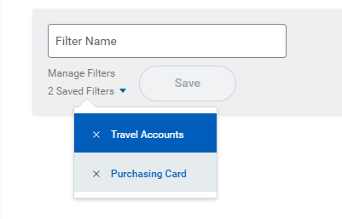
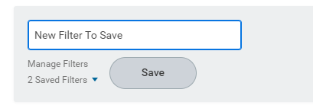
Report Prompt Filters
Reports have 0 to many prompts
You need to manually select the prompts
Can prompt selections be saved an a report? – Yes
Not all reports can save

Slide 19
Report Demos

Slide 20
Custom Report Demos
Budget to Actuals – Ken
Core and noncore
CC financial position
CR GRA Award Financial Summary - Christine
CR FIN Position Budget Balance Summary – Kameron

Slide 21
Delivery & Configuration

Slide 22
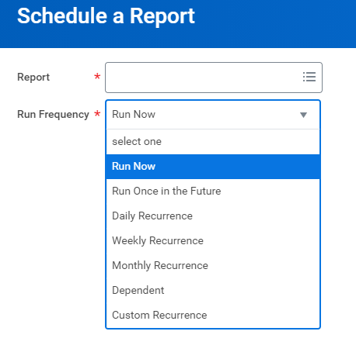
Schedule A Report
InfoBurst will not be used for Workday
Most reports can be scheduled
You can schedule reports to run in workday using the Schedule a Report task

Slide 23
Dashboards
Landing pages for a list of reports related to a role
1 to 6 reports per tab
Starting with 1 tab but can add more
Add to your home page as an application
Some setup might be required
Settings on a worklet are similar to prompts on a report
Worklet = a report displayed in a “tile”
Meant for a collective larger audience and not a personal dashboard

Slide 24
Dashboard Example

Slide 25
Dashboard Configuration
Dashboards are built for a role
Many people will use the same dashboard because they have the same role
Security takes care of most items on HR side
Might be more configuration on Finance side
Due to a more open security model

Slide 26
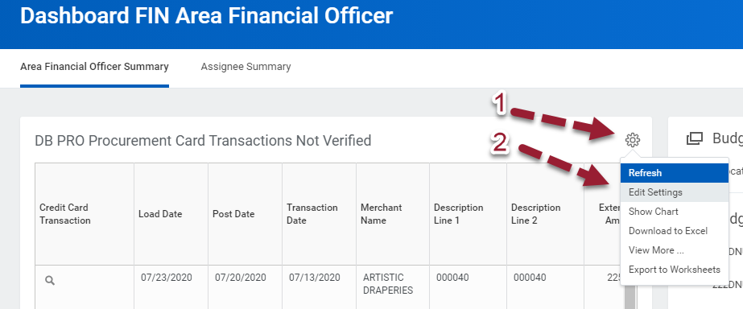
Dashboard Configuration
Some worklets can be configured
Click on the gear icon → Select Edit Settings

Slide 27
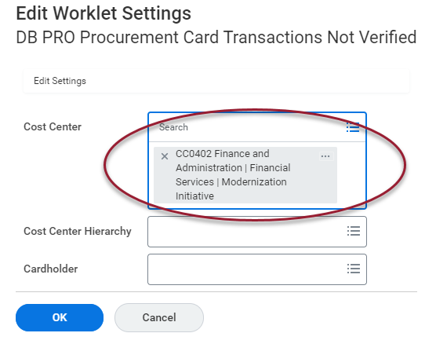
Dashboard Configuration
Worklets have prompts just like reports
Some are preconfigured and others are left open
Prompts will “stick” when you run dashboard again

Slide 28
Support Options

Slide 29
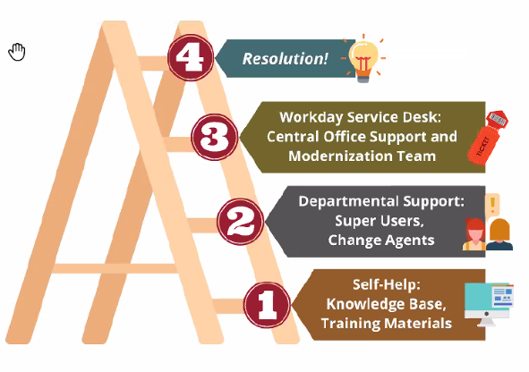
Resources

Slide 30
Resources
Reference guide “Using Workday Reports”
OBIEE crosswalk for Workday values
Terminology Crosswalk
Foundation data model
Support.workday.wsu.edu
Issue or defect with report
General report question
Modernization reporting page

Slide 31
Custom Report Abbreviations
Human Resources | Finance
ABS: Absence | AST: Assets
ACA: Academic | FIN: Budget & General Accounting, Revenue, Expenses
BEN: Benefits | GFT: Gifts
COM: Compensation | GRA: Grants
FAC: Faculty | PAY: Payroll
HCM: Core HCM | PRJ: Project
ORG: Organizations | PRO: Procurement
PER: Personal Information
UNN: Union
REC: Recruitment

Slide 32
Dashboards
 | Finance
ABS Absence Partner | FIN Accounts Receivable
ACA Deans & Associate Deans | FIN Area Financial Officer
ACA Faculty Demographics | FIN Cash & Banking
BEN Benefits Partner | FIN Central Accountant
FAC Faculty | FIN Controller
HCM Core HCM | FIN Cost Center Manager
ORG Organizations | FIN Position Budgeting
PER Personal Information | PRO AP Data Entry Specialists
REC Recruitment | PRO Purchasing Specialist
TTK Timekeeper | GRA Grants Administrator

Slide 33
Questions

