Slide 1
Cost Share Approvals

Slide 2
Ground Rules (1 of 3)
To ensure a positive, productive training environment, please adhere to the following rules throughout the duration of the training session:
Mute your microphones to eliminate distractions.
To ask questions, use the “raise hand” feature or submit your questions via the Zoom chat window. Questions will be moderated and addressed during the training session.

Slide 3
Ground Rules (2 of 3)
If you have a question you would prefer not be discussed during the training, you may submit a ticket to http://support.workday.wsu.edu/.
Please be considerate of the language and tone of Zoom chat interactions and questions. During sessions, aim for an inclusive, positive, and constructive dialogue as we all learn to use Workday together.

Slide 4
Ground Rules (3 of 3)
Please remember that the most important goal of your training session is to learn the material as presented by your trainer.
Keep in mind that Workday business processes were designed and built with standardization in mind. Your trainer does not have control over process design or workflow. If you have questions or concerns about process design please submit a ticket to http://support.workday.wsu.edu/.

Slide 5
Course Overview
Course Description
Audience
This course will provide information on cost share in Workday
This course is for:
Grant Manager

Slide 6
Course Agenda (1 of 2)
Lesson # | Lesson Name | Duration
Lesson 1 | Legacy Process and Workday Equivalent, Key Process Changes | 10 mins
Lesson 2 | Manual Journals, Other Types of Cost Share, Coding a Cost Share Transaction | 20 mins

Slide 7
Course Agenda (2 of 2)
Lesson # | Lesson Name | Duration
Lesson 3 | Approving a Cost Share Transaction | 20 mins
Lesson 4 | Cost Share Reports | 10 mins
Course Wrap-up |  | 10 min

Slide 8
Course Objectives
After completing this course, you will be able to:
List the different transaction types used to record cost share
Request manual journals for recording non transactional cost share
Know what types of cost share will record with no action needed by the Grant Managers
Understand the correct worktag usage for cost share
Know how to approve a cost share transaction
Run various reports to manage cost share obligations

Slide 9
Cost Share in Workday
Lesson 1

Slide 10
Lesson 1 Objectives
After completing this lesson, you will be able to:
Crosswalk a legacy process to the Workday equivalent process
Describe key process changes for recording cost share
Cost Share Reference Guide

Slide 11
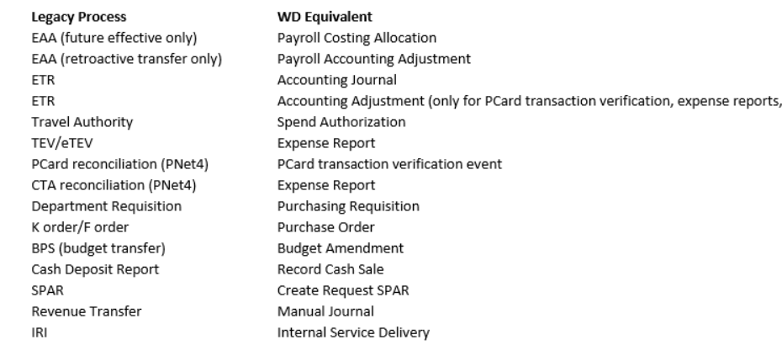
Workday Equivalent Process

Slide 12
Key Process Changes
Cost share expenditures are captured when the transaction is initiated.
Initiators can’t also approve a transaction.
Grant Managers will approve the cost share transactions during the business process approval queue
Manual journals will be used by SPS to capture non transactional cost share.

Slide 13
Manual Journals, Other Types of Cost Share, Coding a Cost Share Transaction
Lesson 2

Slide 14
Lesson 2 Objectives
After completing this lesson, you will be able to:
Know how to request manual journals to record 3rd Party cost share and Tuition Waiver match
Identify other types of non transaction based cost share
Describe the different transaction types used to capture cost share expenditures

Slide 15
Recording Non Transaction Cost Share
Manual Journals entered by SPS:
    3rd Party Match/Subcontract Cost Share
    Tuition Waivers
Other Types of Cost Share:
Waived F&A: SPS records by creating an F&A Exception on the appropriate award line
F&A on Cost Shared Expenditures: SPS sets up the cost share award line with the appropriate F&A rate, cost shared F&A will post automatically
Grant to Grant Match Accounts: SPS will record match from sponsored project using a custom field on the award header (Additional Data tab). This is updated manually, please contact SPS if you see something is incorrect
See Awards Grants Troubleshooting for more information

Slide 16

Demonstration 1.1
Task Name: Create Request 3rd Party Match/Subcontract Cost Share
5 minutes

Slide 17
Recording Cost Share
Transaction Types:
    Supplier Invoices Create Supplier Invoice
    Purchase Orders Create and Change Purchase Order
    Procurement Card Verify Procurement Card Transaction
    Expenses Create Expense Report
    Payroll Costing Allocations Assign Costing Allocation

Slide 18
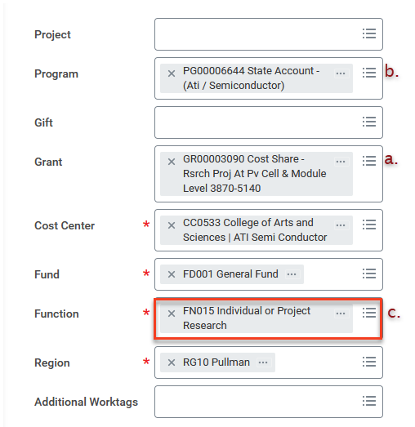
Recording Cost Share
Coding an Expense transaction

Slide 19
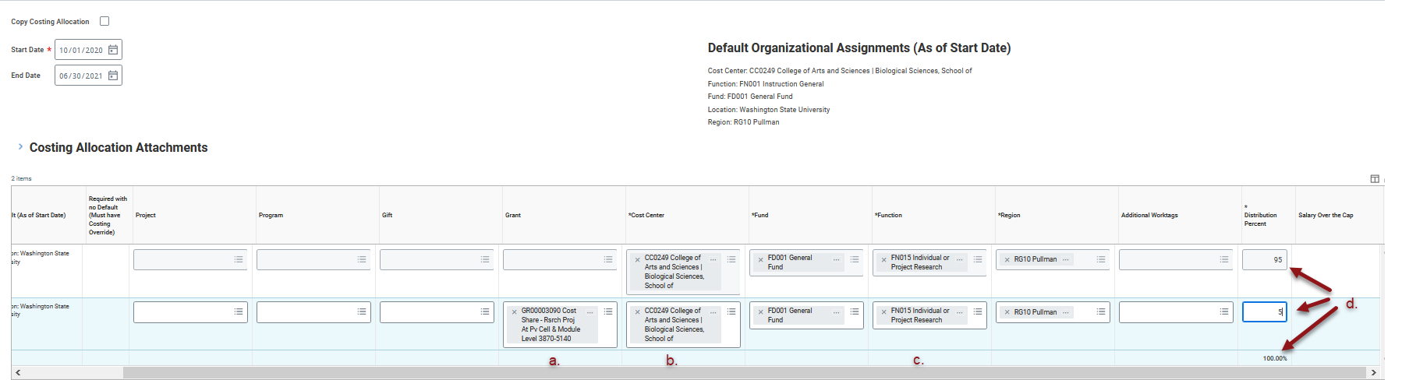
Recording Cost Share
Coding a Costing Allocation

Slide 20
Demonstration 2.1
Task Name: Create a cost share expense
Task Name: Create a Payroll Costing Allocation for cost share
10 minutes

Slide 21
Approving a Cost Share Transaction
Lesson 3

Slide 22
Approving a Cost Share Transaction
    Your request to approve a transaction is located in your Workday inbox
    You will review the worktag usage on the transaction, making sure all appropriate worktags were used
    You have the ability to approve the transaction if correct or send it back to the initiator or reviewer to make corrections
    You may also deny the request

Slide 23
Demonstration 3.1
Task Name: View the different transactions waiting for approval in a grant manager’s inbox
5 minutes

Slide 24
Cost Share Reports
Lesson 4

Slide 25
Useful Reports
CR GRA PI Cost Share Report: By award(s) gives transaction level detail down to the period and journal source.
CR GRA Grant Manager Cost Share Report: Can be selected by period and worktags. This report is summarized at the spend category by grant.
CR GRA Grant Cost Share Status Report (TBA): This report is in the queue for development. It will return total award commitment and expenditures by worktag, along with percentage met of overall commitment.

Slide 26
Course Summary
You should now be able to:
List the different transaction types used to record cost share
Request manual journals for recording non transactional cost share
Know what types of cost share will record with no action needed by the Grant Managers
Understand the correct worktag usage for cost share
Know how to approve a cost share transaction
Run various reports to manage cost share obligations

Slide 27
Additional Resources
Helpful resources are available to perform Workday related tasks:
Modernization Website
Knowledge Base Reference Guides
Workday Grants Guide: Award Budget to Actuals Dashboard Reports
OBIEE Crosswalk Report

Slide 28
You have successfully completed the Workday Grants Cost Share course!
Questions? Please contact Modhelp

