Slide 1
Workday Compensation
HCM105; ILT

Slide 2
Document Information
Document Information
Document Name | Compensation
Program Name | Modernization
Document Author | Sanjana Singh
Document Version | Final
Document Status | Approved
Document Edit History
Version | Date | Summary of Modifications | Prepared / Revised By
1 | 01/31/2020 | Developed First Draft | Jhilik Choudhary
2 | 02/04/2020 | Functional Review | Shawn Ismail
3 | 02/23/2020 | Review and updated | Deepti Sharma

Slide 3
Ground Rules (1 of 3)
To ensure a positive, productive training environment, please adhere to the following rules throughout the duration of the training session:
Mute your microphones to eliminate distractions.
To ask questions, use the “raise hand” feature or submit your questions via the Zoom chat window. Questions will be moderated and addressed during the training session.

Slide 4
Ground Rules (2 of 3)
If you have a question you would prefer not be discussed during the training, you may submit a ticket to support.workday.wsu.edu.
Please be considerate of the language and tone of Zoom chat interactions and questions. During sessions, aim for an inclusive, positive, and constructive dialogue as we all learn to use Workday together.

Slide 5
Ground Rules (3 of 3)
Please remember that the most important goal of your training session is to learn the material as presented by your trainer.
Keep in mind that Workday business processes were designed and built with standardization in mind. Your trainer does not have control over process design or workflow. If you have questions or concerns about process design please submit a ticket to support.workday.wsu.edu.

Slide 6
Course Overview
Course Description
Audience
This course will provide information on how to manage the employee compensation in Workday.
This course is for:
Manager
HR Partner
Compensation Partner
Appointing Authority
VP Spokane
Provost Office
HRS

Slide 7
Course Agenda (1 of 3)
Lesson # | Lesson Name | Duration
Lesson 1 | Compensation Overview | 15 mins
Lesson 2 | Change Default Compensation | 30 mins
Lesson 3 | Propose Compensation Hire | 30 mins

Slide 8
Course Agenda (2 of 3)
Lesson # | Lesson Name | Duration
Lesson 4 | Request Compensation Change | 15 mins
Lesson 5 | Request One-Time Payment | 15 mins
Lesson 6 | Manage Period Activity Pay | 10 mins

Slide 9
Course Agenda (3 of 3)
Lesson # | Lesson Name | Duration
Lesson 7 | Workday Reports | 10 mins
Course Wrap-up |  | 05 mins

Slide 10
Course Objectives
After completing this course, you will be able to:
Explain the Change Default Compensation process
Explain the Propose Compensation Hire process
Explain the Request Compensation Change process
Explain the Request One-Time Payment process
Explain the Manage Period Activity Pay Assignment process
List the compensation-related reports

Slide 11
Lesson One
Compensation Overview
Lesson 1

Slide 12
Lesson 1 Objectives
After completing this lesson, you will be able to:
Explain the key terms used in the Compensation process
Describe the key changes as a result of implementing Workday
Identify the Workday roles in Compensation
List the subprocesses within the Compensation process

Slide 13
Key Terms
Term | Definition
Progression Start Date | This refers to the Periodic Increment Date and only applicable to a classified employee.
Employee Visibility Date | This determines when the employee will be able to view the compensation details in their worker history. If no date is entered the employee will be able to see the change on the effective date in their profile.

Slide 14
Key Process Changes (1 of 2)
  Default compensation will be assigned to a position.
  Period Activity Pay (PAP) is only available for faculty, graduate, and coach employee types and will replace the use of Faculty Time Card and other piece rate for these employee types.
  PAP provides for a lump sum payment spread evenly over the pay period chosen.
  PAP activities, outside of coaching, should be less than 12 months in length.

Slide 15
Key Process Changes (2 of 2)
  PAP will be assigned in Workday.
  The departmental Managers, HR Partners, and Compensation Partners will be responsible for initiating the various compensation processes.

Slide 16
Compensation Roles (1 of 4)
Term | Definition
Manager | Managers perform tasks on members of the assigned supervisory organizations. They also approve the requests for the HCM processes.
HR Partner | HR Partners perform the HR management tasks for the assigned organizations. They also approve the requests for the HCM processes.

Slide 17
Compensation Roles (2 of 4)
Term | Definition
Compensation Partner | A Compensation Partner performs the compensation management tasks for the assigned organizations. They also review the requests within the Compensation and the Staffing processes.
Appointing Authority | An Appointing Authority approves the requests within the Compensation processes.

Slide 18
Compensation Roles (3 of 4)
Term | Definition
Academic Outreach and Innovation | AOI approves summer session PAP assignments and Graduate Summer TA and RA jobs.
VP Spokane | VP Spokane approves compensation process for the VP Spokane reporting units.
Provost Office | The Provost Office approves compensation process for the Provost Office reporting units.

Slide 19
Compensation Roles (4 of 4)
Term | Definition
HRS Employment | HRS Employment approves the requests within the Compensation processes for administrative professional and civil service employees.
HRS Records | HRS Records approves the requests within the Compensation processes for hourly employees, faculty, and coaches.

Slide 20
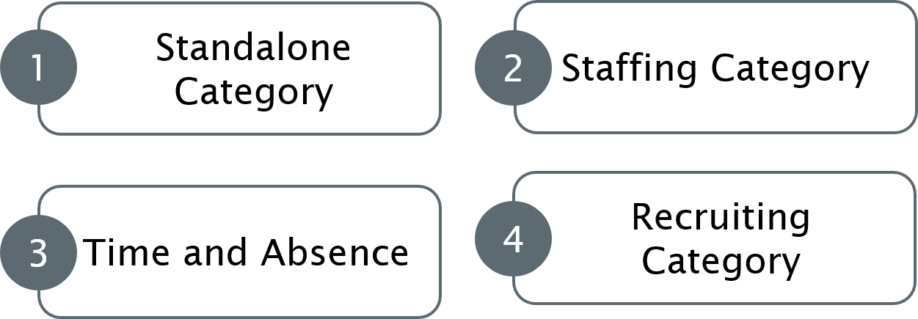
Compensation Processes
Standalone Category
Staffing Category
Time and Absence
Recruiting Category

Slide 21
Standalone Category
The Compensation processes under the Standalone category include:
Change Default Compensation
Request Compensation Change
Request One-Time Payment
Period Activity Pay

Slide 22
Staffing Category
The Compensation subprocesses under the Staffing category include:
Change Default Compensation
Propose Compensation Hire
Propose Compensation Change
Period Activity Pay

Slide 23
Time and Absence or Recruiting
The Compensation subprocesses under the Time and Absence or Recruitment category include:
Request Compensation Change for Leave of Absence
Request Requisition Compensation
Request One-Time Payment Offer/Employment Agreement
Propose Compensation Offer/Employment Agreement

Slide 24
Lesson 1 Summary
Now that you have completed this lesson, you should be able to:
Explain the key terms used in the Compensation process
Describe the key changes as a result of implementing Workday
Identify the Workday roles in Compensation
List the subprocesses within the Compensation process

Slide 25
Lesson Two
Change Default
Compensation
Lesson 2

Slide 26
Lesson 2 Objectives
After completing this lesson, you will be able to:
Explain the Change Default Compensation process

Slide 27
Default Compensation (1 of 7)
This process is used to assign the default compensation to a position.
This business process gets triggered:
  During the Create Position task in Workday
  When the Initiator updates the default compensation assigned to an open position or a filled position

Slide 28
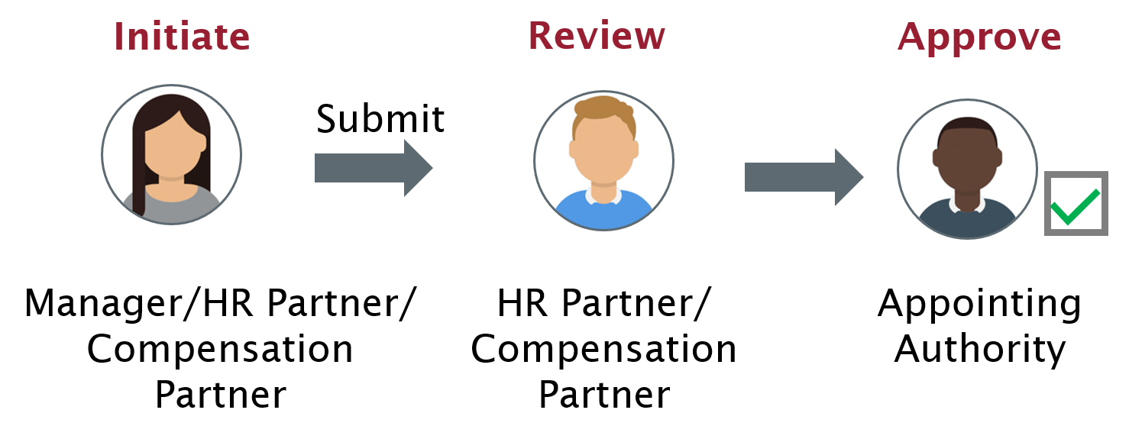
Default Compensation (2 of 7)
Initiate: Manager, HR Partner, or Compensation Partner
Review: HR Partner or Compensation Partner
Approve: Appointing Authority

Slide 29
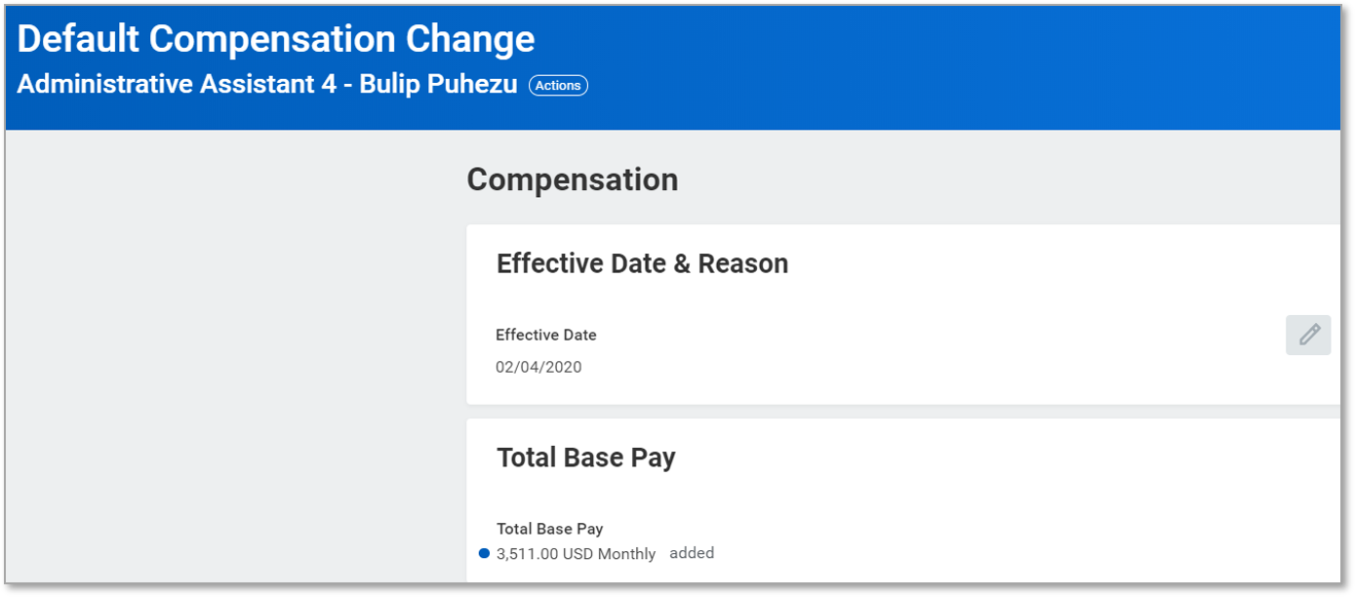
Default Compensation (3 of 7)
Screenshot of the default compensation change. The effective date and reason and total base pay sections are displayed.

Slide 30
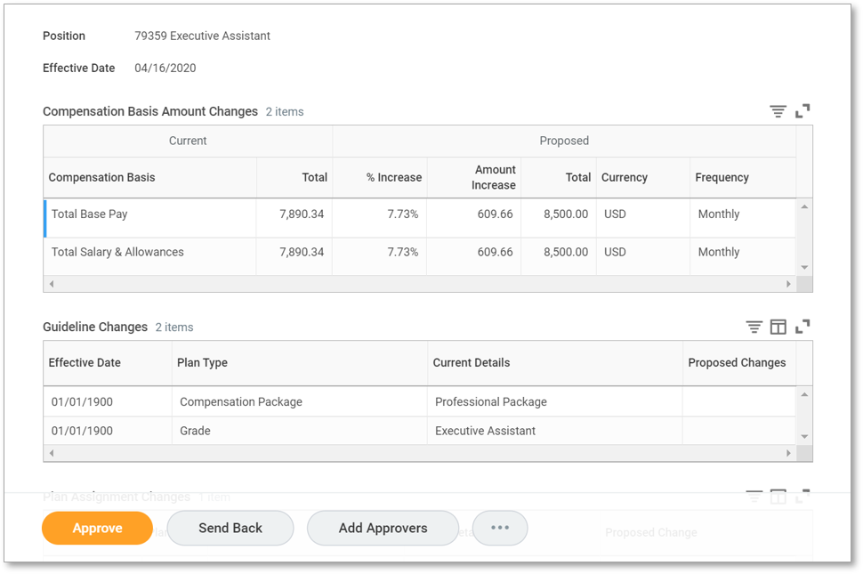
Default Compensation (4 of 7)
Screenshot with the following fields
Position
Effective Date
Compensation Basis Amount Changes
Guideline Changes

Slide 31
Default Compensation (5 of 7)
A Job Profile Code is unique to a job profile. It consists of three components :
Job Code | Overtime Eligibility | Bargaining Unit Coverage
Same as legacy system | Y – Overtime eligible; Employee submits time in Workday | Y – Job Profile is for a position covered by a bargaining unit. For temporary hourly, this code indicates the position may be covered by a bargaining unit.
 | N – Overtime ineligible; Employee does not submit time | N – Job Profile is for a position not covered by bargaining unit

Slide 32

Default Compensation (6 of 7)
  For example, in the case of the Job Profile code 156-NN - Research Associate Professor – Career:
  156 is the unique identifier for a “Research Associate Professor – Career”.
  N indicates this position is not eligible for overtime.
  N indicates this position is not covered by a bargaining unit.

Slide 33

Default Compensation (7 of 7)
  For example, in the case of the Job Profile code 100I-YY – Office Assistant 2:
  100I is the unique identifier for an Office Assistant 2.
  Y indicates this position is eligible for overtime.
  Y indicates this position is covered by a bargaining unit.

Slide 34
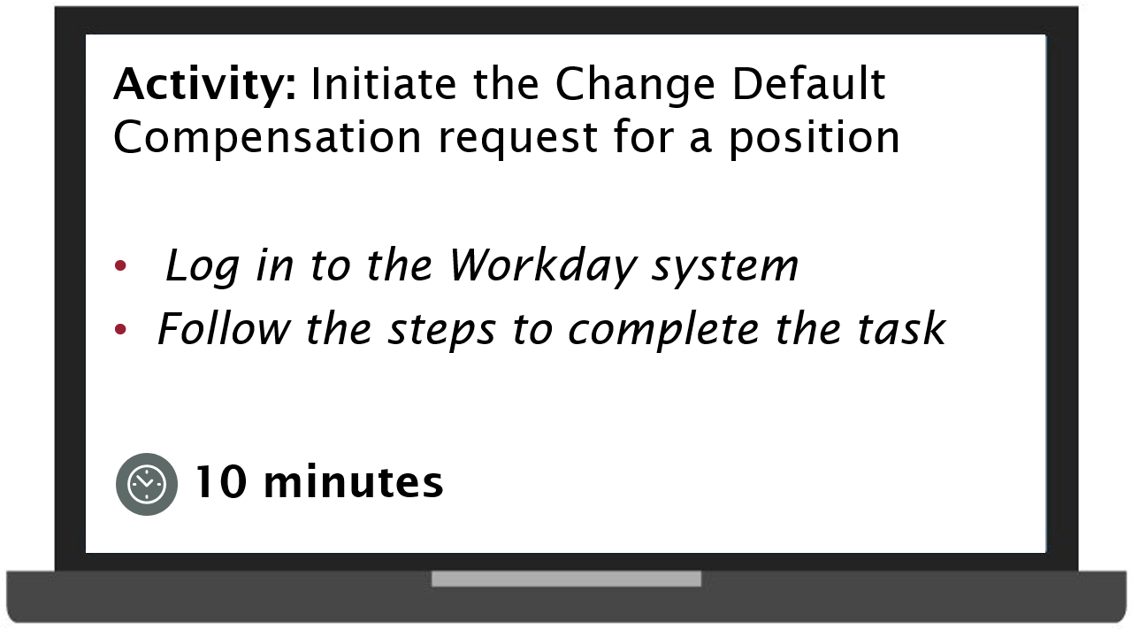
Practice 2.1
Activity: Initiate the change default compensation request for a position
Log in to the Workday system
Follow the steps to complete the task
Duration 10 minutes

Slide 35
Lesson 2 Summary
Now that you have completed this lesson, you should be able to:
Explain the Change Default Compensation process

Slide 36
Lesson Three
Propose
Compensation Hire
Lesson 3

Slide 37
Lesson 3 Objectives
After completing this lesson, you will be able to:
Explain the Propose Compensation Hire process

Slide 38
Propose Compensation Hire (1 of 4)
This process is used to assign compensation elements, such as package, grade, grade profile, and plans to a new hire or to an additional job.
This business process gets triggered with the Hire process and the Add Job process.

Slide 39
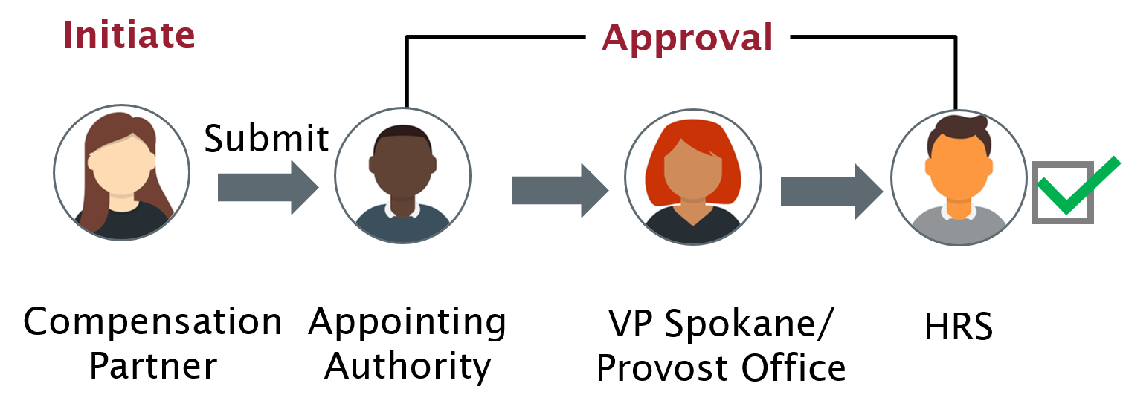
Propose Compensation Hire (2 of 4)
Initiate: Compensation Partner
Approval: Appointing Authority, VP Spokane/Provost Office, or HRS

Slide 40
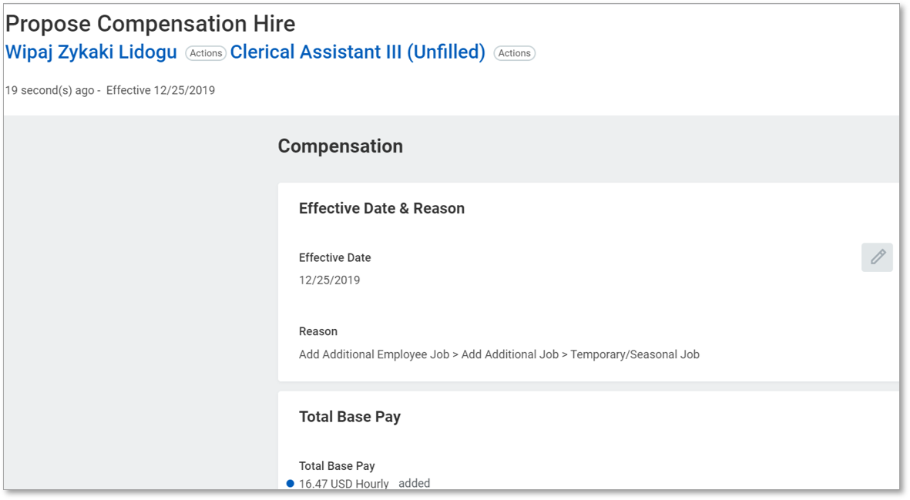
Propose Compensation Hire (3 of 4)
Screenshot of the proposed compensation hire. The compensation section with the effective date & reason and total base pay are displayed.

Slide 41
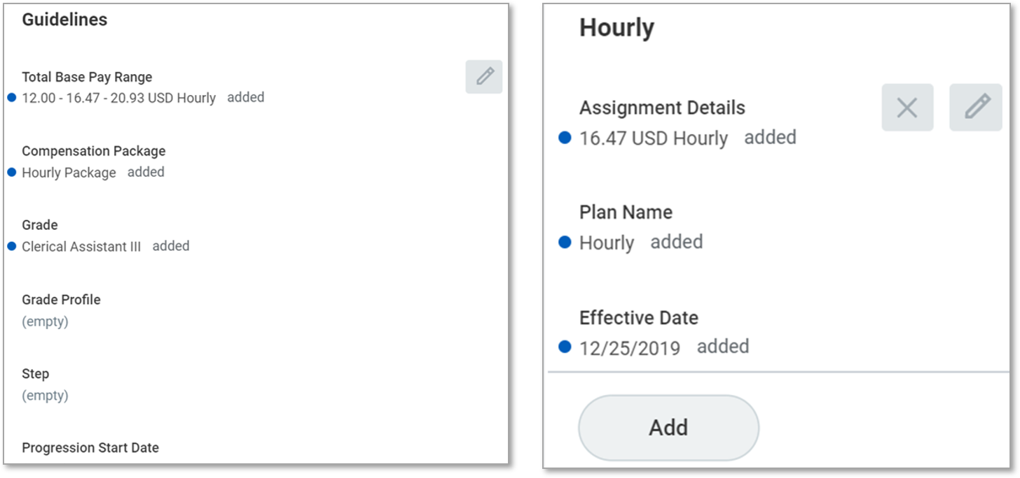
Propose Compensation Hire (4 of 4)
Screenshot of the guidelines section with the following fields displayed
Total base pay range
Compensation package
Grade
Grade profile
Step
Progression start date
Screenshot of the Hourly section with the following fields displayed
Assignment details
Plan name
Effective date

Slide 42
Lesson 3 Summary
Now that you have completed this lesson, you should be able to:
Explain the Propose Compensation Hire process

Slide 43
Lesson Four
Request
Compensation Change
Lesson 4

Slide 44
Lesson 4 Objectives
After completing this lesson, you will be able to:
Explain the Request Compensation Change process

Slide 45
Process Overview
This process is used to make ad-hoc changes to an employee's compensation, including steps, salary, hourly plans, and allowances.
This business process gets triggered when a compensation change is required for an employee.

Slide 46
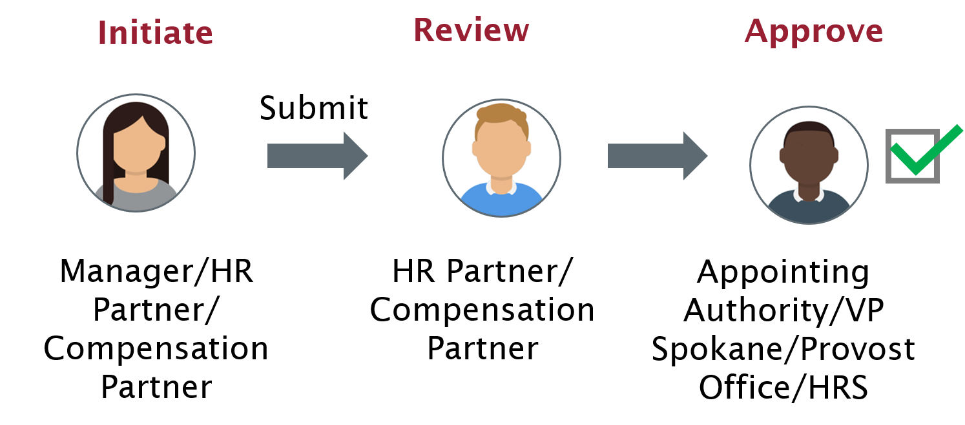
Request Compensation Change
Initiate: Manager, HR Partner, or Compensation Partner
Review: HR Partner or Compensation Partner
Approve: Appointing Authority, VP Spokane, Provost Office, or HRS

Slide 47
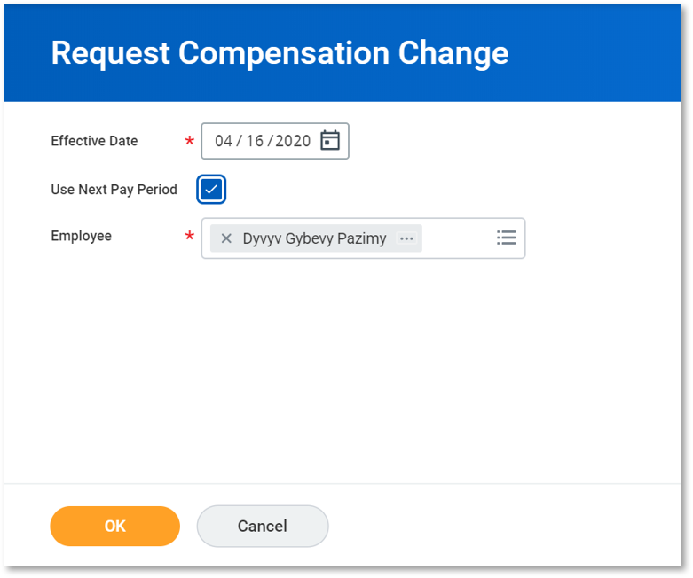
Compensation Change (1 of 4)
Screenshot of the request compensation change. The effective date and employee fields are required.

Slide 48
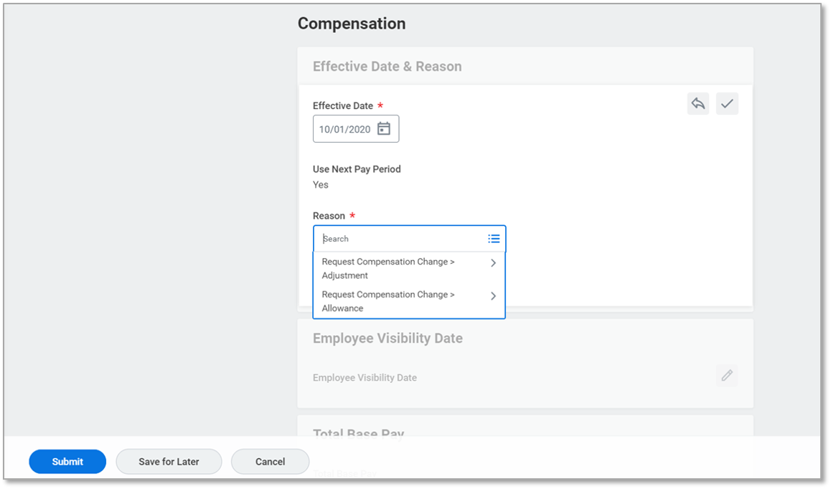
Compensation Change (2 of 4)
Screenshot of the compensation change screen. The compensation section is displayed with the following buttons along the bottom
Submit
Save for later
Cancel

Slide 49
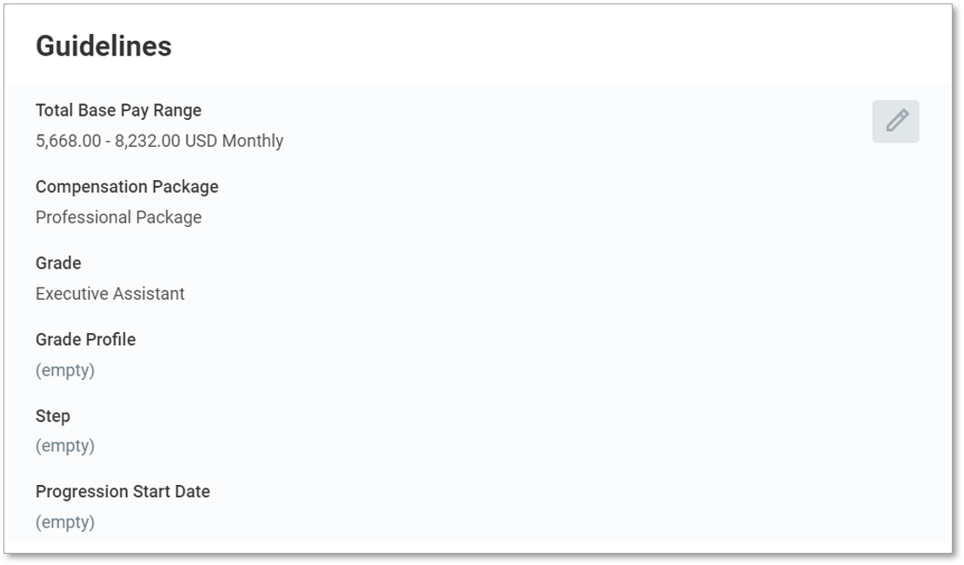
Compensation Change (3 of 4)
Screenshot of the guidelines section. The following information is displayed:
Total base pay range
Compensation package
Grade
Grade profile
Step
Progression start date

Slide 50
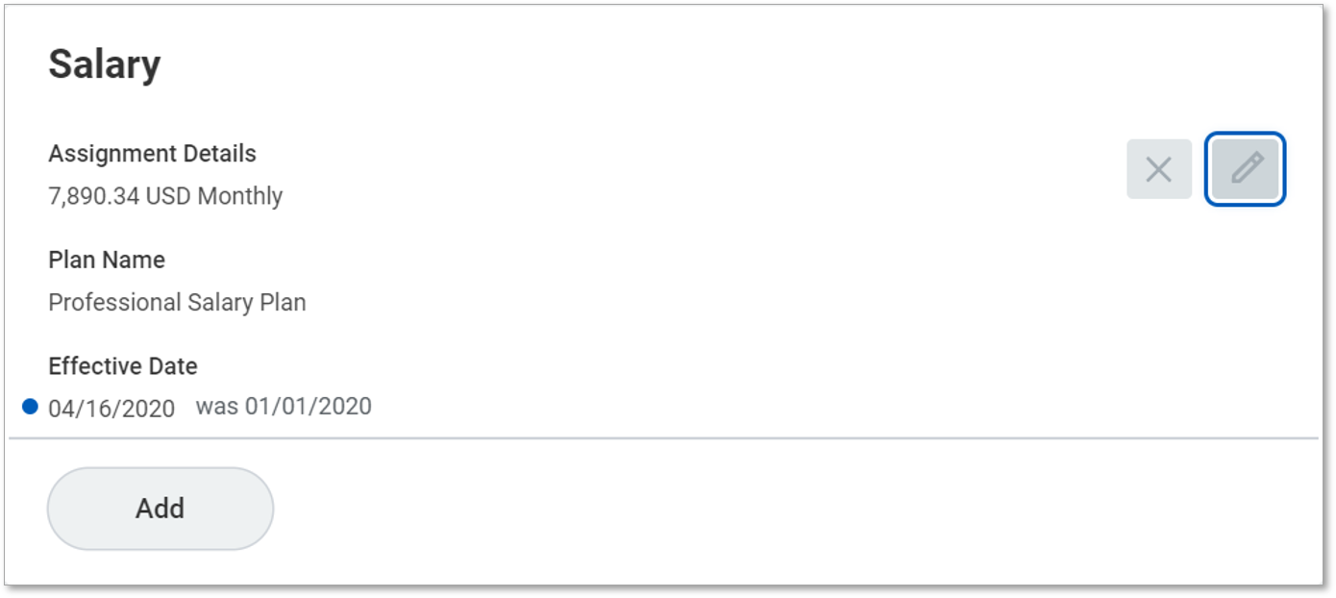
Compensation Change (4 of 4)
Screenshot of the salary section. The following information is shown
Assignment details
Plan name
Effective date

Slide 51
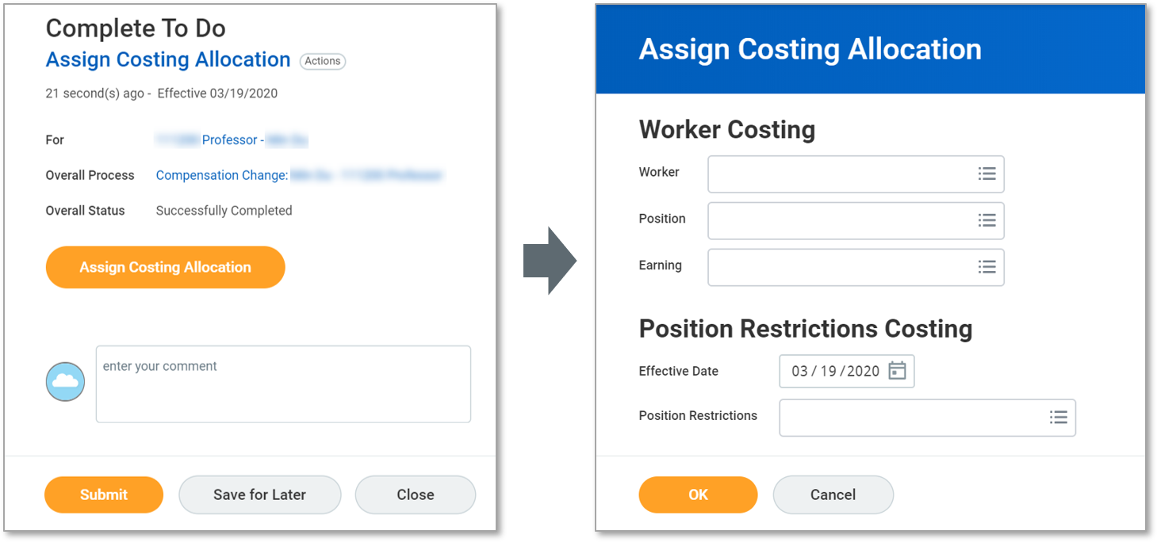
Assign Costing Allocation To Do’s

Slide 52
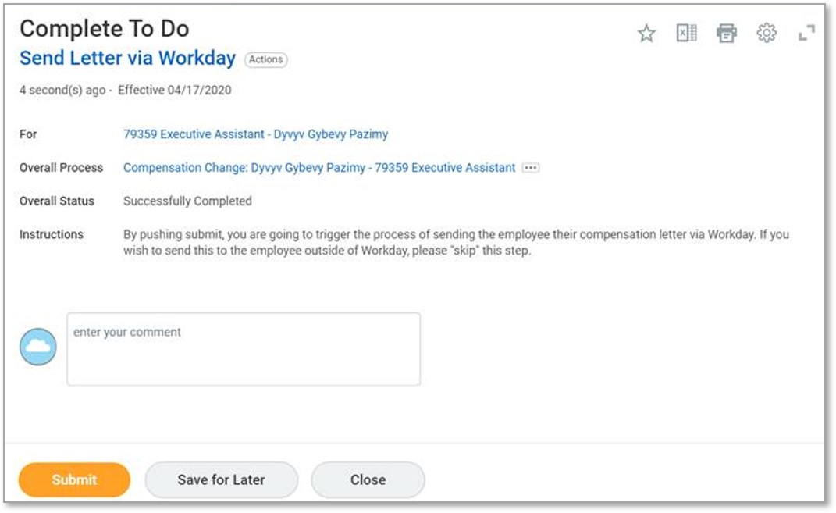
Review Documents (1 of 2)
Screenshot of the complete to do. The example complete to do displayed is send letter via Workday.

Slide 53
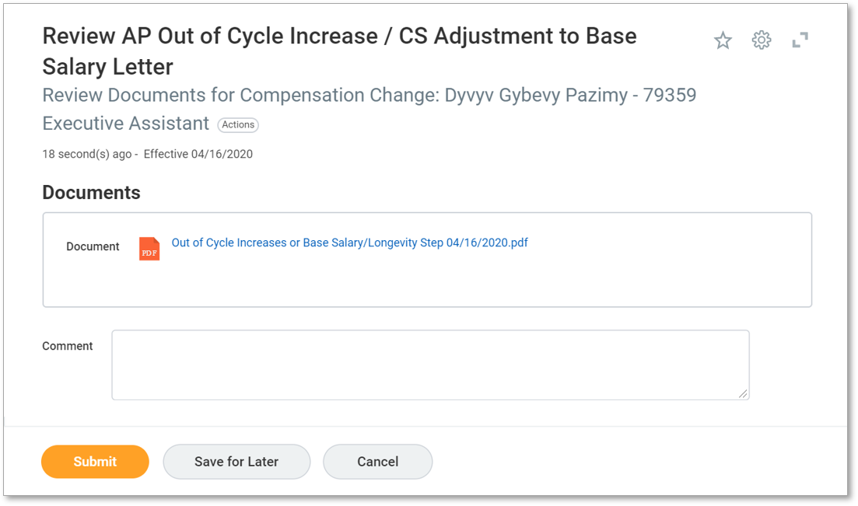
Review Documents (2 of 2)
Screenshot of the Review AP out of cycle increase/CS adjustment to base salary letter.

Slide 54
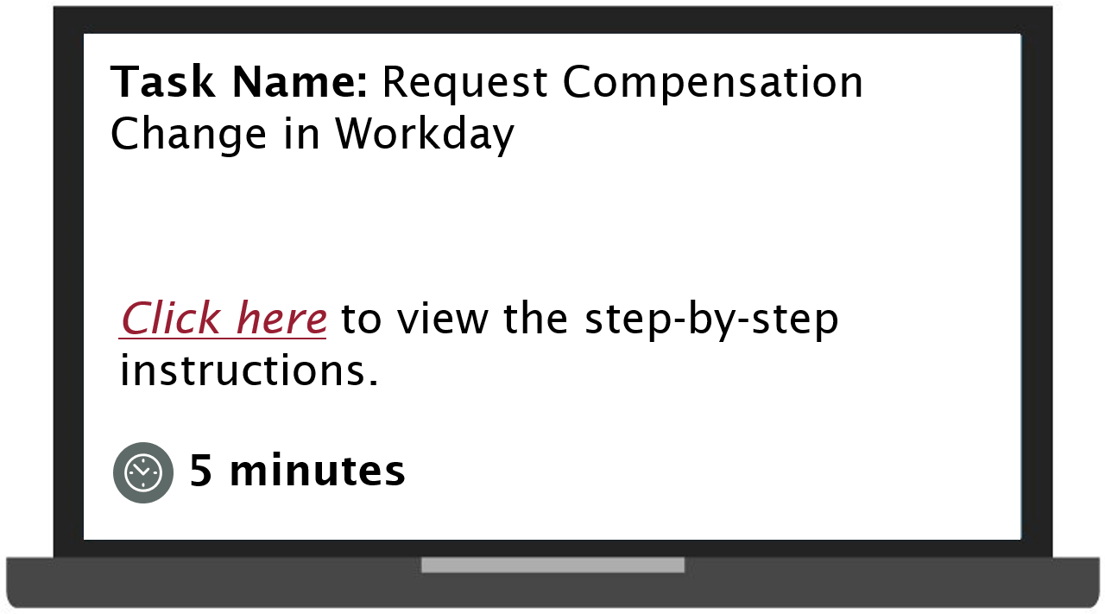
Demonstration 4.1
Task: request compensation change in Workday. Select to view the step-by-step instructions. Duration 5 minutes.

Slide 55
Lesson 4 Summary
Now that you have completed this lesson, you should be able to:
Explain the Request Compensation Change process

Slide 56
Lesson Five
Request
One-Time Payment
Lesson 5

Slide 57
Lesson 5 Objectives
After completing this lesson, you will be able to:
Explain the Request One-Time Payment process in Workday

Slide 58
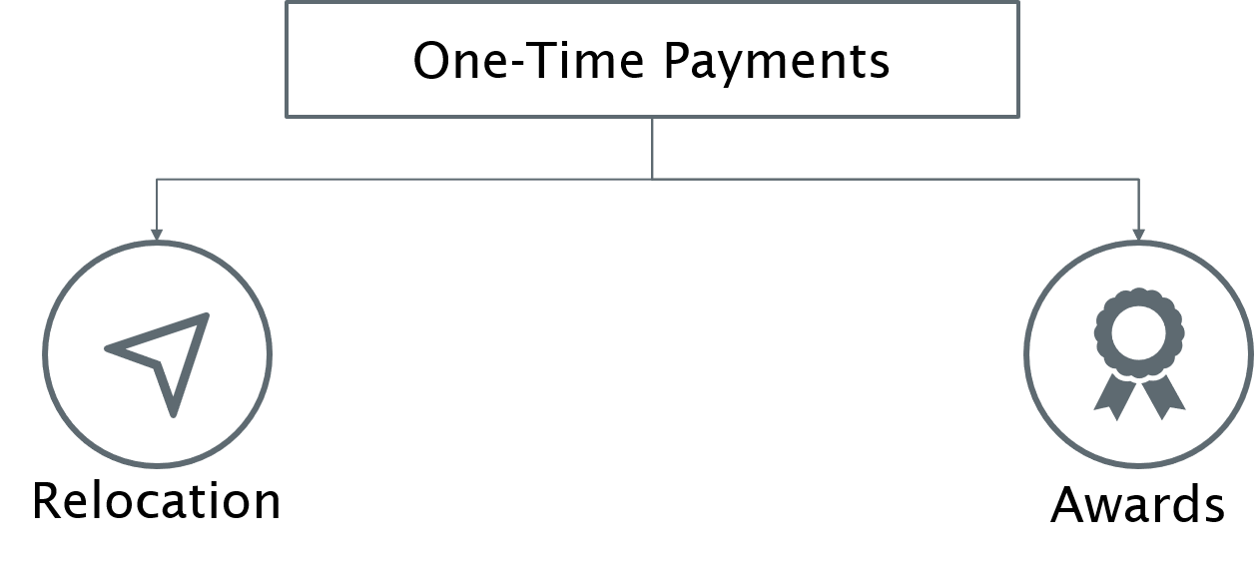
Request One-Time Payment
One time payments can be issued to employees as
Relocation
Awards

Slide 59
One-Time Payment (1 of 6)
This process is used to issue one-time payment to an employee, such as an award. Multiple one-time payments can also be issued to an employee.
This business process can be initiated as a standalone process or as a part of another process, such as the Hire process.

Slide 60
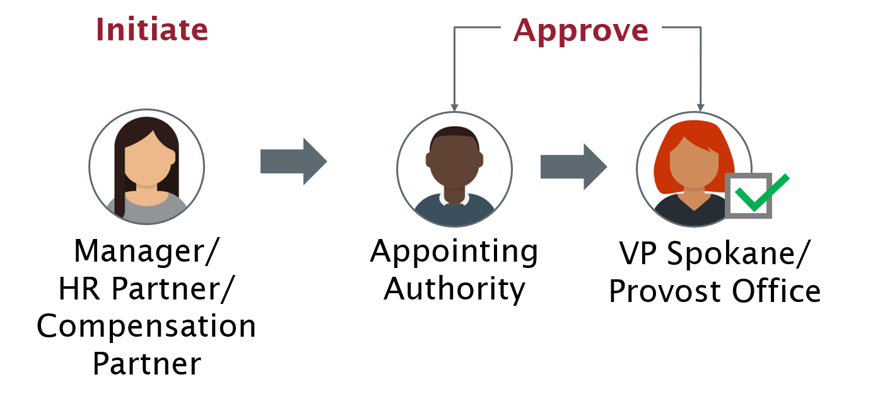
One-Time Payment (2 of 6)
Initiate: Manager, HR Partner, or Compensation Partner
Approve: Appointing Authority or VP Spokane/Provost Office

Slide 61
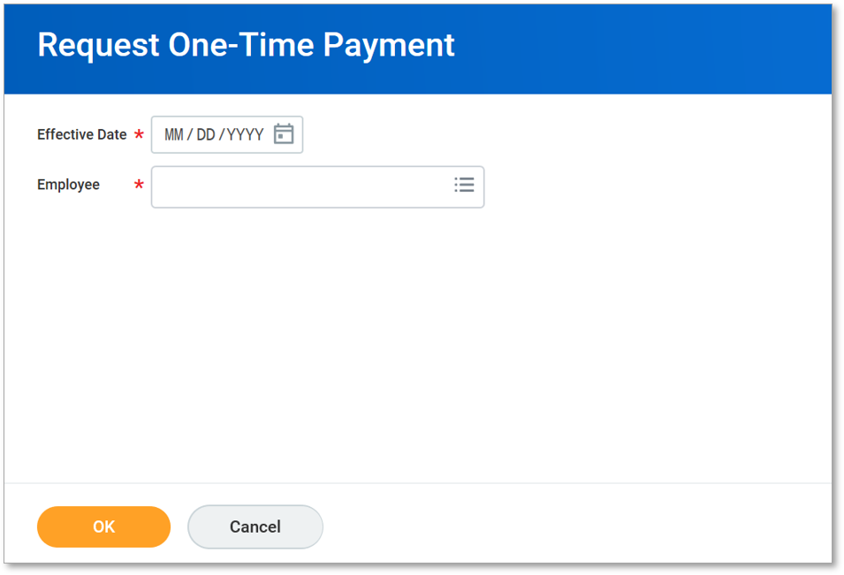
One-Time Payment (3 of 6)
Screenshot of the request one time payment. The required fields effective date and employee are displayed. To request one-time payment for an employee:
Access the Request One-Time Payment task by typing Request One-Time Payment in the Search field
Select the Effective Date to issue the one-time payment
Select the required Employee
Select the OK button

Slide 62
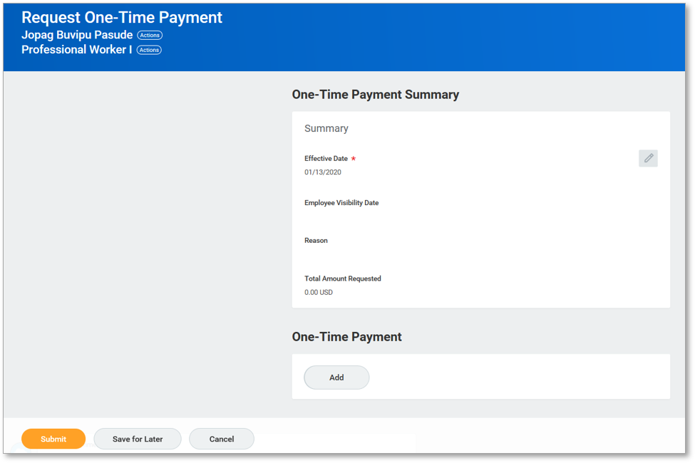
One-Time Payment (4 of 6)
Screenshot of the request one time payment. Select the edit icon to make the required edits. The effective date field is required.

Slide 63
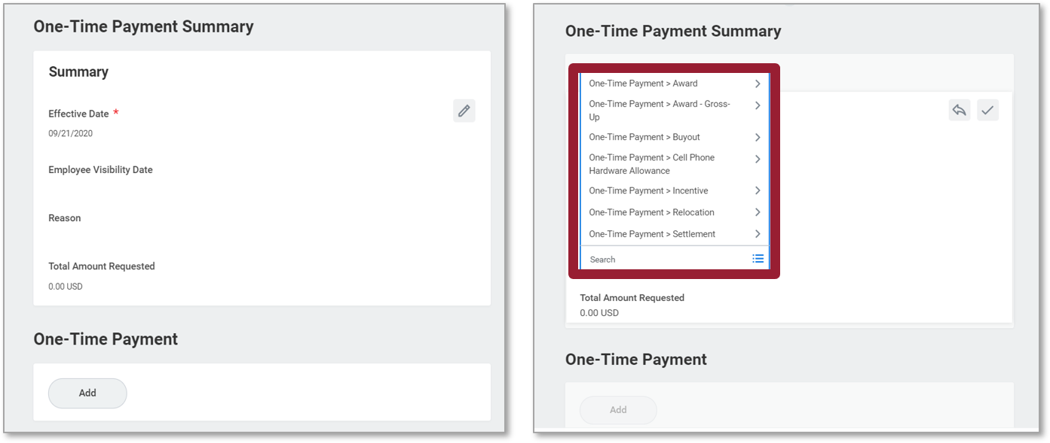
One-Time Payment (5 of 6)
Screenshot of one time payment summary.

Slide 64
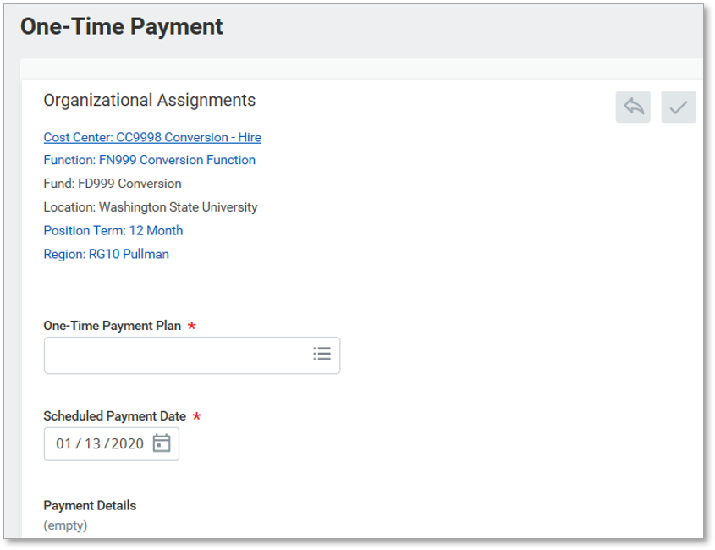
One-Time Payment (6 of 6)
Screenshot of the one time payment displaying the organizational assignments. The following required fields are shown one time payment plan and scheduled payment date.

Slide 65
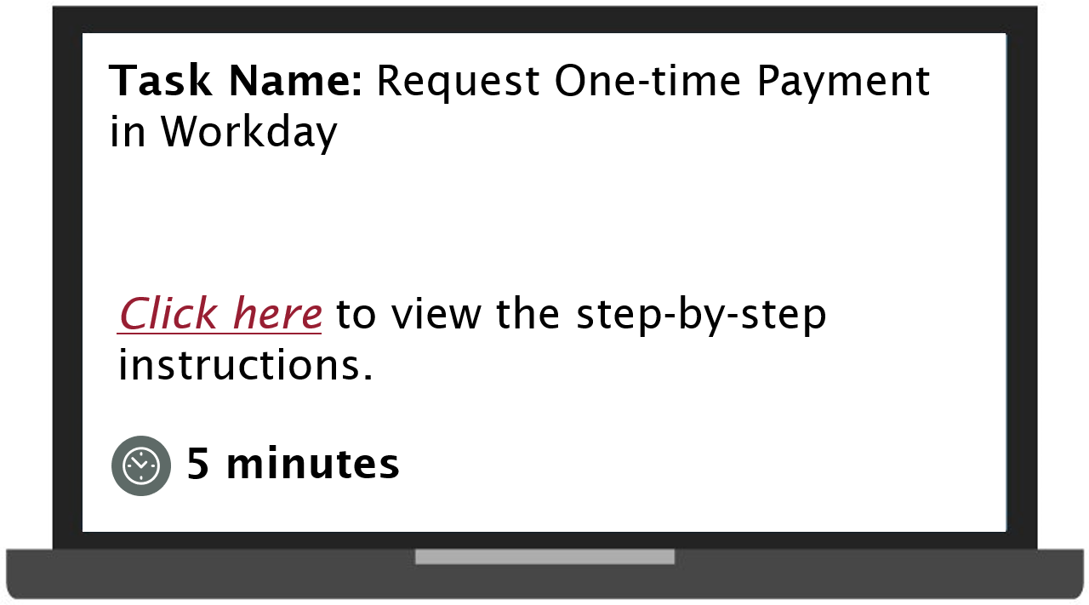
Demonstration 5.1
Task: request one time payment in Workday. Select to view the step-by-step instructions. Duration 5 minutes.

Slide 66
Lesson 5 Summary
Now that you have completed this lesson, you should be able to:
Explain the Request One-Time Payment process in Workday

Slide 67
Lesson Six
Period Activity Pay
Lesson 6

Slide 68
Lesson 6 Objectives
After completing this lesson, you will be able to:
Explain the Period Activity Pay process

Slide 69
Period Activity Pay Process (1 of 2)
This process is used to assign and manage the activities performed by employees over a defined period of time.
This business process is used for faculty, coaches and graduates - it functions as a replacement for Faculty Time Card to pay these employee types for specific activities over a period of time.

Slide 70
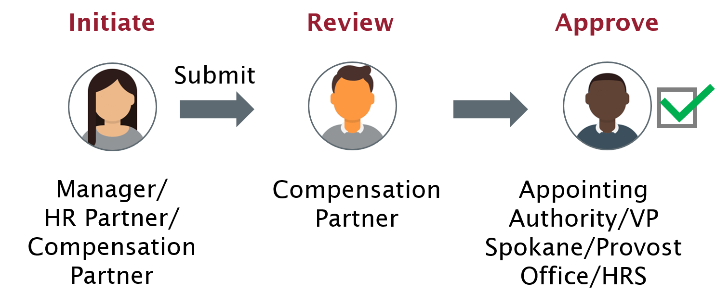
Period Activity Pay Process (2 of 2)
Initiate: Manager, HR Partner, or Compensation Partner
Review: Compensation Partner
Approve: Appointing Authority, VP Spokane, Provost Office, or HRS

Slide 71
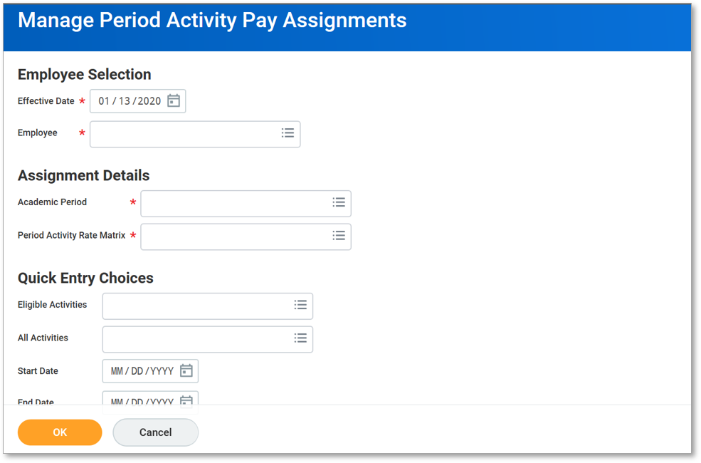
Assign Period Activity Pay (1 of 2)
Screenshot of the manage period activity pay assignments. To assign period activity pay in Workday:
Type Period Activity Pay in the Search field to access the required task
Provide details in the mandatory fields, including Effective Date, Employee, Academic Period, and Period Activity Rate Matrix
Select the OK button

Slide 72
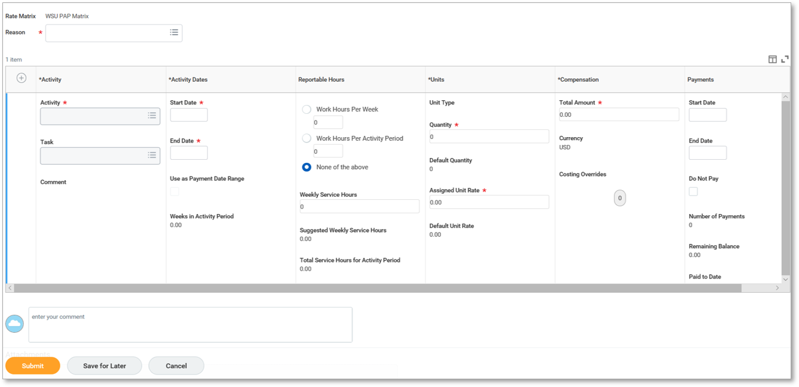
Assign Period Activity Pay (2 of 2)
Screenshot of the manage period activity pay assignments with the rate matrix and reason fields. This slide is in continuation to the previous slide.
Provide details in the mandatory fields, including Activity, Start Date, End Date, Quantity, Assigned Unit Rate, and Total Amount
Select the Submit button

Slide 73
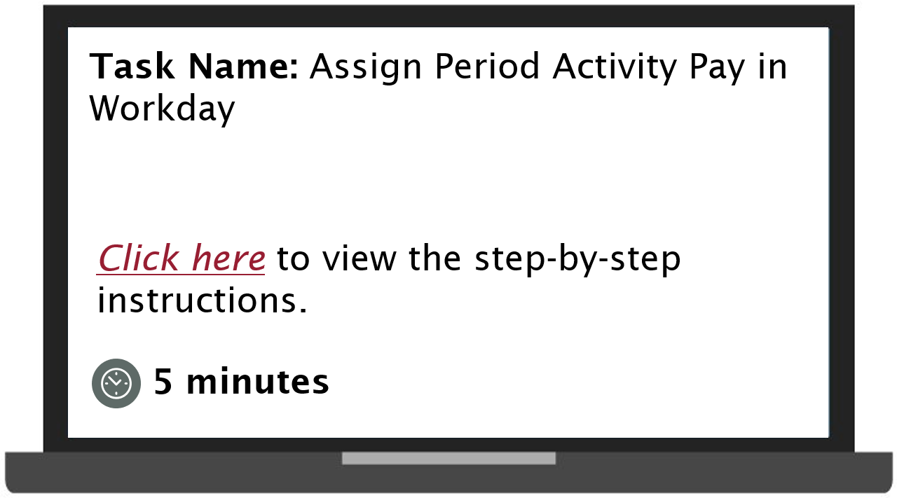
Demonstration 6.4
Task: assign period activity pay in Workday. Select to view the step-by-step instructions. Duration 5 minutes.

Slide 74
Lesson 6 Summary
Now that you have completed this lesson, you should be able to:
Explain the Period Activity Pay process

Slide 75
Lesson Seven
Workday Reports
Lesson 7

Slide 76
Lesson 7 Objectives
After completing this lesson, you will be able to:
List the compensation-related reports in Workday

Slide 77
Compensation Reports (1 of 2)
Standard Reports:
Compensation Changes
Compensation Plan Assignments with Actual End Dates
Compensation Plan Expected End Date Audit
Direct Reports Compensation Summary
Employee Compensation Audit
Employee Compensation Step Progression Audit

Slide 78
Compensation Reports (2 of 2)
Standard Reports:
Employees with Compensation for Additional Jobs Audit - Indexed
Employee Visibility Date Audit
In Progress Compensation Changes
One-Time Payment History
Pay Range Analysis

Slide 79
Lesson 7 Summary
Now that you have completed this lesson, you should be able to:
List the compensation-related reports in Workday

Slide 80
Additional Resources (1 of 2)
Helpful resources are available to perform Workday related tasks:
WSU Knowledge Base
  Workday Compensation Guide: Change Default Compensation
  Change Default Compensation: Video
  Workday Compensation Guide: Request One-Time Payment
  Workday Compensation Guide: Request Compensation Change

Slide 81
Additional Resources (2 of 2)
WSU Knowledge Base
  Request Compensation Change: Video
  Workday Compensation Guide: Period Activity Pay
  Period Activity Pay: Video
  Workday Recruiting Guide: Manage Job Application
  Propose Compensation Hire: Video

Slide 82
Knowledge Check 1
Identify the scenarios where one-time payments are offered?
Select all that apply.
Relocation
Department Transfer
Awards
Resignation

Slide 83
Knowledge Check 1 Answer
Relocation
Department Transfer
Awards
Resignation

Slide 84
Knowledge Check 2
Default Compensation for a position can be changed at any time without affecting the worker’s compensation.
State True or False.
True
False

Slide 85
Knowledge Check 2 Answer
True
False

Slide 86
Knowledge Check 3
Who amongst the following can initiate the Period Activity Pay process?
Select all that apply.
HR Partner
Manager
Compensation Partner
HRS

Slide 87
Knowledge Check 3 Answer
HR Partner
Manager
Compensation Partner
HRS

Slide 88
Course Summary
You should now be able to:
Explain the Change Default Compensation process
Explain the Propose Compensation Hire process
Explain the Request Compensation Change process
Explain the Request One-Time Payment process
Explain the Manage Period Activity Pay Assignment process
List the compensation-related reports

Slide 89
Workday Support
Knowledge Base
ModHelp/Workday Support
Training Catalog
Modernization Website
Change Network Directory

Slide 90
Course Evaluation
Please take a moment to complete a brief survey providing us feedback on today’s training session. Your feedback will help us improve Workday training materials.
https://wsu.co1.qualtrics.com/jfe/form/SV_3ql1sztsFwp0zn7

Slide 91
You have successfully completed the Workday Compensation course!
Questions? Please contact support.workday.wsu.edu

