Slide 1
Workday Payroll Accounting
FIN-PAY101; VILT

Slide 2
Ground Rules
To ensure a positive, productive environment, please adhere to the following guidelines throughout the duration of the session:
Keep your microphone muted unless prompted by your trainer or moderator, and use the Zoom Chat feature to ask questions.
If you have a question you would prefer not be discussed during the session, or a highly detailed or individual use-case based question, please submit a ticket to support.workday.wsu.edu.
Please be considerate of the language and tone of Zoom chat interactions and questions. During sessions, aim for an inclusive, positive, and constructive dialogue. We’re learning to use Workday together!

Slide 3
Course Overview
Course Description
Audience
This course will provide information on how to assign costing allocation and create payroll accounting adjustments in Workday.
This course is for:
Cost Center Accountant
Cost Center Manager
Appointing Authority
Central Payroll Partner
HR Partner
Grant Manager

Slide 4
Course Agenda (1 of 2)
Lesson # | Lesson Name | Duration
Lesson 1 | Payroll Accounting Overview | 10 mins
Lesson 2 | Assign Costing Allocation | 20 mins
Lesson 3 | Payroll Accounting Adjustments | 25 mins

Slide 5
Course Agenda (2 of 2)
Lesson # | Lesson Name | Duration
Lesson 4 | Workday Reports | 20 mins
Q&A and Course Wrap-up |  | 15 mins

Slide 6
Course Objectives
After completing this course, you will be able to:
Explain the Assign Costing Allocation process in Workday
Explain the Create Payroll Accounting Adjustments process in Workday

Slide 7
Lesson One
Payroll Accounting Overview
Lesson 1

Slide 8
Lesson 1 Objectives
After completing this lesson, you will be able to:
Explain the Payroll process in the Workday system
Identify the key terms used in the Payroll Accounting process
Identify the Workday roles in Payroll Accounting

Slide 9
Payroll Overview
Payroll has the most widespread dependencies on other components in Workday
Payroll impacts both HCM and Finance including:
Pay calculations
Eligibility
Rates
Accounting rules

Slide 10
Payroll Processes
Assign costing Allocations
Payroll accounting adjustments

Slide 11
Key Terms (1 of 5)
Term | Definition
Cost Center | Cost Center identifies financial responsibility for a managed budgeted entity at a level similar to departments or units in legacy systems. Cost centers should have manager/director oversight, operate at $250K annually in expense, include employee salaries, and generally have multiple gifts, grants and/or programs associated with them. Learn more on our Foundation Data Model (FDM) page.

Slide 12
Key Terms (2 of 5)
Term | Definition
Costing Allocations | These define which Cost Centers an employee's expenses are charged. Costing Allocations override the employee's default Cost Center.
Pay Components | These are an earning (such as base salary or bonus) or a deduction (such as federal withholding taxes or medical) that applies to a employee's gross-to-net pay calculation or tax liability.

Slide 13
Key Terms (3 of 5)
Term | Definition
Payroll Period Schedule | Defines when and how often to process payroll. It also defines payment dates and forward accruals using a Period Start Date, Period End Date, and Payroll Payment Date. Period schedules can be associated with any run category or pay group with the same payment frequency.

Slide 14
Key Terms (4 of 5)
Term | Definition
Period Schedule | Defines the accrual frequency for a time off plan, such as annual or monthly (unless the plan has a custom frequency), and the start and end date of each reporting period. The period controls reporting of both accruals and time off requests.

Slide 15
Key Terms (5 of 5)
Term | Definition
Run Category | Run categories are associated with pay groups and period schedules. Run Categories include employee status (Active, Terminated, On Leave), pay components to calculate automatically for on cycle and off cycle runs, whether a supplemental tax rate applies, and the minimum net pay.

Slide 16
Payroll Accounting Roles (1 of 2)
Role Name | Description
Central Payroll Partner | This role performs Payroll processing activities including pay calculations, reporting on payroll to the Central Payroll Process Lead, approve payroll processes.
Cost Center Manager | A Cost Center Manager views payroll data for employees. He/she is the approval authority of Payroll accounting process where employer costs are allocated or assigned.

Slide 17
Payroll Accounting Roles (2 of 2)
Role Name | Description
Grant Finance Analyst | A Grant Finance Analyst views payroll journal data for grants.
Grant/Gift/ Program /Project Manager | This role views payroll data for employees. It is also an approval authority of Payroll accounting processes where employer costs are allocated or assigned.

Slide 18
Lesson 1 Summary
Now that you have completed this lesson, you should be able to:
Explain the Payroll process in the Workday system
Identify the key terms used in the Payroll Accounting process
Identify the Workday roles in Payroll Accounting

Slide 19
Lesson Two
Assign Costing Allocation
Lesson 2

Slide 20
Lesson 2 Objectives
After completing this lesson, you will be able to:
Describe the Assign Costing Allocation process in Workday

Slide 21
Costing Allocation
Costing allocations occur when payroll calculations run and the payroll operational accounting journal are generated
Costing allocations may be assigned at various levels, with priority orders defined by Workday
Each position must have a default organizational assignment.

Slide 22
Costing Allocation Process
The accountant (cost center) initiates and sends to the cost center manager to approve. Based on the work tag.

Slide 23
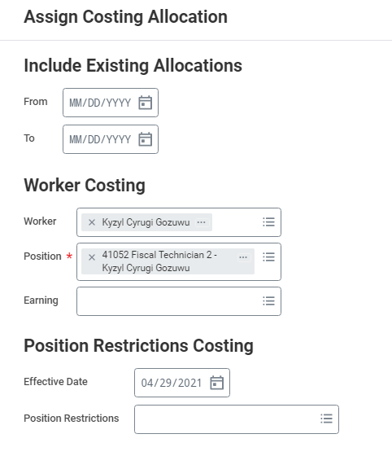
Assign Costing Allocation

Slide 24
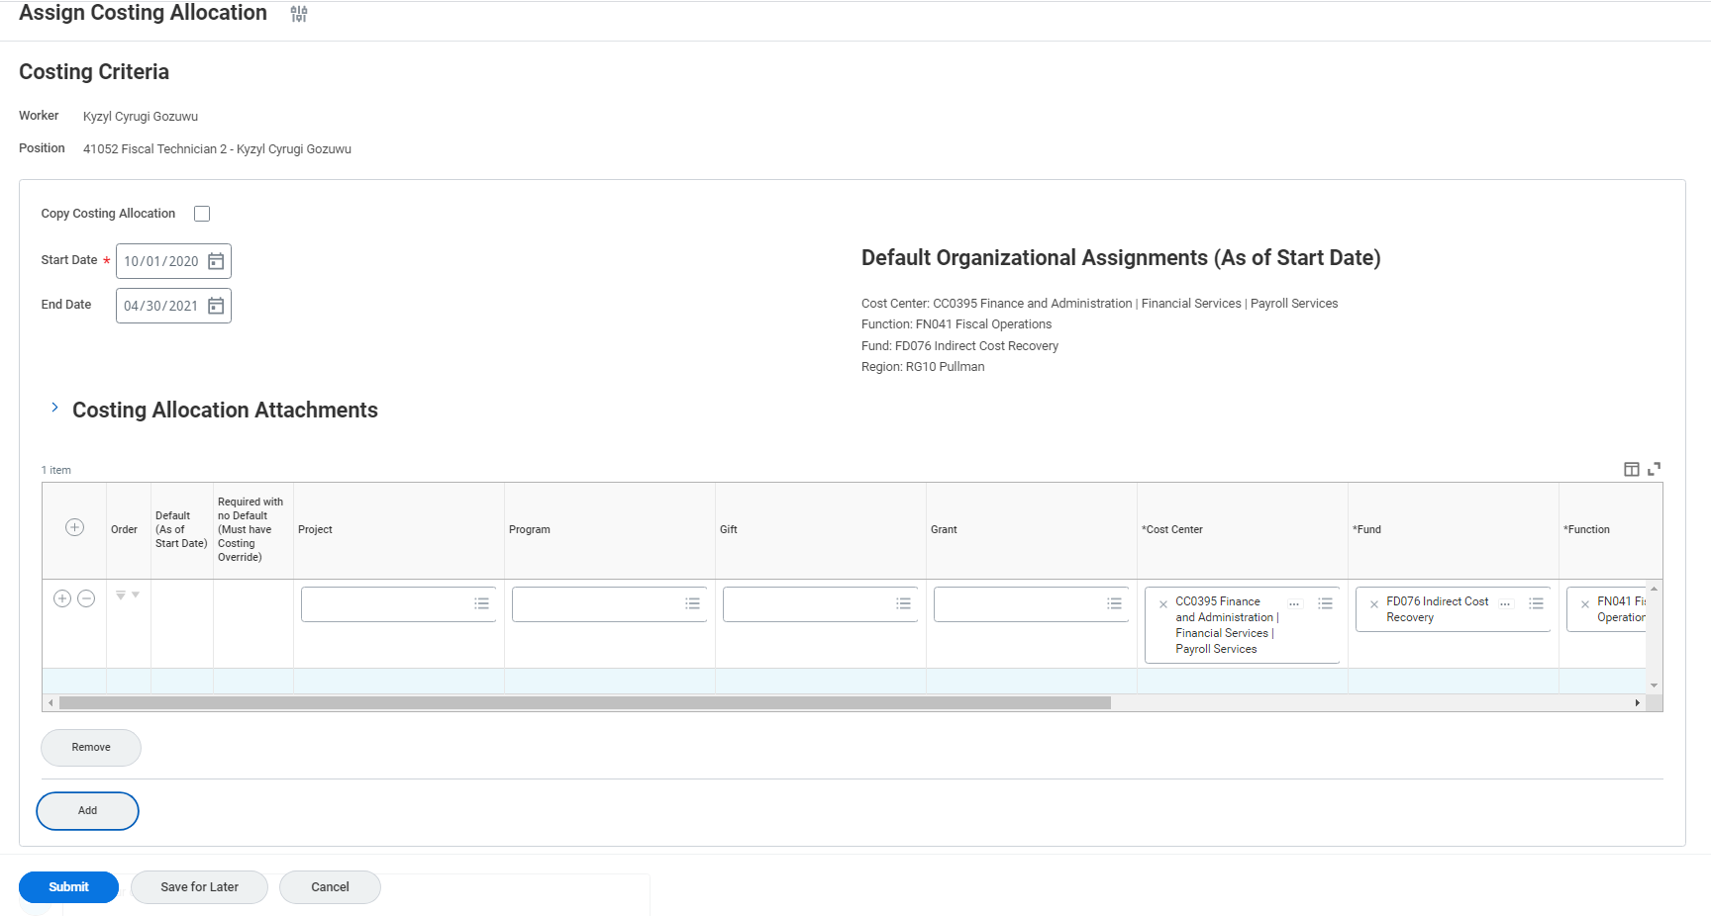
Ending a Costing Allocation

Slide 25
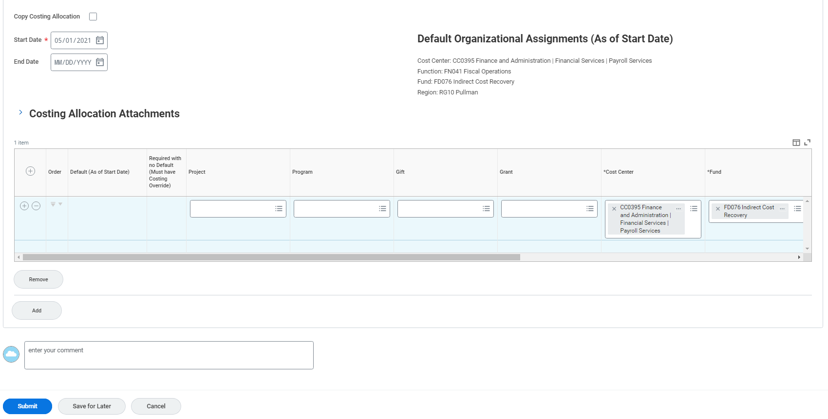
Assign Costing Allocation
Screenshot of the assign costing allocation screen.

Slide 26
Demonstration 2.1
Task Name: Assign Costing Allocation.

Slide 27
Lesson 2 Summary
Now that you have completed this lesson, you should be able to:
Describe the Assign Costing Allocation process in Workday

Slide 28
Lesson Three
Payroll Accounting Adjustments
Lesson 3

Slide 29
Lesson 3 Objectives
After completing this course, you will be able to:
Explain how to create Payroll Accounting Adjustments

Slide 30
Payroll Accounting Adj. (1 of 2)
Payroll Accounting Adjustment is used to re-classify payroll accounting journal line details post payroll completion
The re-classified accounting lines are seamlessly attached to adjustment journals from the payroll accounting journals to the financial journals

Slide 31
Payroll Accounting Adj. (2 of 2)
Grants management generates the greatest volume of payroll accounting adjustments
When Gift/Grant Worktags are involved, the respective Gift/Grant roles are directed to approve payroll accounting adjustments
Unapproved transactions are cancelled (permanently) or sent back to the initiator with notes to correct and resubmit

Slide 32
Payroll Accounting Adj. Process
The accounting (cost center), grant financial analyst initiates the payroll accounting adjustment process. The gift, grant, program, project, or cost center manager approves the adjustment.

Slide 33
Create Payroll Accounting Adj.
Screenshot of the create payroll accounting adjustments screen. The following fields are required employee, pay groups, company, and change reason.

Slide 34
Demonstration 3.1
Task Name: Perform a Payroll Accounting Adjustment.

Slide 35
Lesson 3 Summary
Now that you have completed this lesson, you should be able to:
Explain how to create Payroll Accounting Adjustments

Slide 36
Lesson Four
Workday Reports
Lesson 4

Slide 37
Useful Reports
Standard Reports:
CR PAY All Expiring Payroll Costing Allocations by Employee (aka Funding)
CR FIN Payroll Accounting Detail
CR PAY Payroll Accounting Journal Details - In Progress Payroll (PEARS)
For a list of additional reports, see Helpful reports for Department Payroll Personnel

Slide 38
Additional Resources
Helpful resources are available to perform Workday related tasks:
Assign Costing Allocation
Assign Costing Allocation Video (Skillsoft)
Create Payroll Accounting Adjustments
Create Payroll Accounting Adjustments Video (Skillsoft)

Slide 39
Course Summary
You should now be able to:
Explain the Assign Costing Allocation process in Workday
Explain the Create Payroll Accounting Adjustments process in Workday

Slide 40
Course Evaluation
Please take a moment to complete a brief survey providing us feedback on today’s training session. Your feedback will help us improve Workday training materials.
https://wsu.co1.qualtrics.com/jfe/form/SV_3ql1sztsFwp0zn7

Slide 41
Workday Support
Workday Service Desk
Training Catalog
Modernization Website
Change Network Directory

Slide 42
You have successfully completed the Workday Payroll Accounting course!
Questions? Please contact support.workday.wsu.edu

