Slide 1
Manage Budget
FIN107; Practice Lab

Slide 2
Ground Rules (1 of 3)
To ensure a positive, productive training environment, please adhere to the following rules throughout the duration of the training session:
Mute your microphones to eliminate distractions.
To ask questions, use the “raise hand” feature or submit your questions via the Zoom chat window. Questions will be moderated and addressed during the training session.

Slide 3
Ground Rules (2 of 3)
If you have a question you would prefer not be discussed during the training, you may submit a ticket to support.workday.wsu.edu.
Please be considerate of the language and tone of Zoom chat interactions and questions. During sessions, aim for an inclusive, positive, and constructive dialogue as we all learn to use Workday together.

Slide 4
Ground Rules (3 of 3)
Please remember that the most important goal of your training session is to learn the material as presented by your trainer.
Keep in mind that Workday business processes were designed and built with standardization in mind. Your trainer does not have control over process design or workflow. If you have questions or concerns about process design please submit a ticket to support.workday.wsu.edu.

Slide 5
Course Overview
Course Description
Audience
This course will provide information on how to manage Financial budget in Workday.
This course is for:
Budget Manager
Controller
Accountant Cost Center
Cost Center Manager
Program Manager

Slide 6
Course Agenda (1 of 2)
Lesson # | Lesson Name | Duration
Lesson 1 | Budget Overview | 15 mins
Lesson 2 | Budget Planning | 15 mins
Lesson 3 | Budget Amendments | 45 mins

Slide 7
Course Agenda (2 of 2)
Lesson # | Lesson Name | Duration
Lesson 4 | Budgetary Roll Forward/Close | 15 mins
Lesson 5 | Budgetary Reports | 15 mins
Course Wrap-up |  | 5 mins

Slide 8
Course Objectives
After completing this course, you will be able to:
Explain the Budget Planning process
Create the Budget Amendments
Explain the Budgetary Roll Forward/Close process

Slide 9
Lesson One
Budget Overview
Lesson 1

Slide 10
Lesson 1 Objectives
After completing this lesson, you will be able to:
Identify the key terms used in the Budget Management process
Describe the key changes as a result of implementing Workday
Identify the Workday roles involved in Budget Management
Explain the Budget Creation process

Slide 11
Key Terms (1 of 2)
Term | Definition
Budget Structure | A Budget Structure defines the type of budget.
Budget Plan Template | A Budget Plan Template is a spreadsheet used to create and submit a budget.
Budget Amendment | The Budget Amendment process allows to make any changes to the approved Budget in Workday.

Slide 12
Key Terms (2 of 2)
Term | Definition
Budget Amendment Type | Budget Amendment Type defines the type of change made to the approved budget. Some of the amendment types are: Core: One-time/Temporary Core: Ongoing Core: True-Up Core: Auxiliary Core: Cost Center Accountant Use Core: F&A Allocation

Slide 13
Key Process Changes
WSU will now budget for revenue
Increased visibility of the general ledger and income statement
Standardized template available for the departments to enter budget line details
Introduction of core budgeting structure and non-core budgeting structure

Slide 14
Department Budget Roles (1 of 2)
Role Name | Description
Accountant (Cost Center) | An Accountant (Cost Center) initiates budget amendments for the cost center.
Cost Center Manager (Cost Center) | A Cost Center Manager (Cost Center) reviews and approves budget amendments for the cost center.

Slide 15
Department Budget Roles (2 of 2)
Role Name | Description
Grant/Project/ Program Manager | A Grant/Project/Program Manager reviews and approves budget amendments.

Slide 16
Central Unit Budget Roles
Role Name | Description
Controller | A Controller approves the initial budget plan.
Budget Manager | A Budget Manager approves budget amendments for salary changes and can create budget amendments.

Slide 17
Core Budget (1 of 2)
Includes the following funds:
FD001: General Fund
FD076: Indirect Cost Recovery
FD080: Administrative Fees and Interest.
Remaining end of year Core Plan balances will roll into the next fiscal year to the specific Worktag combination as “Rolled in from Prior Year” Plan

Slide 18
Core Budget (2 of 2)
Cost Centers will plan Core Funds with expense ledgers only
Budget Amendments cannot be processed to or from the Non-Core Plan Structure

Slide 19
Non-Core Budget (1 of 2)
Includes all other Funds with the exception of Gift and Grant funds
Cost Centers will load plan values for both revenues and expenses
Areas would manage expenses against revenues throughout the year
Remaining Plan balances will not roll forward at the end of year

Slide 20
Non-Core Budget (2 of 2)
Revenues less expenses at the end of the fiscal year will be rolled to Ledger Account 3010: Beginning Balance Fund Balance with the combination of Worktags used in the previous year
Budget Amendments cannot be processed to or from the Core Plan Structure

Slide 21
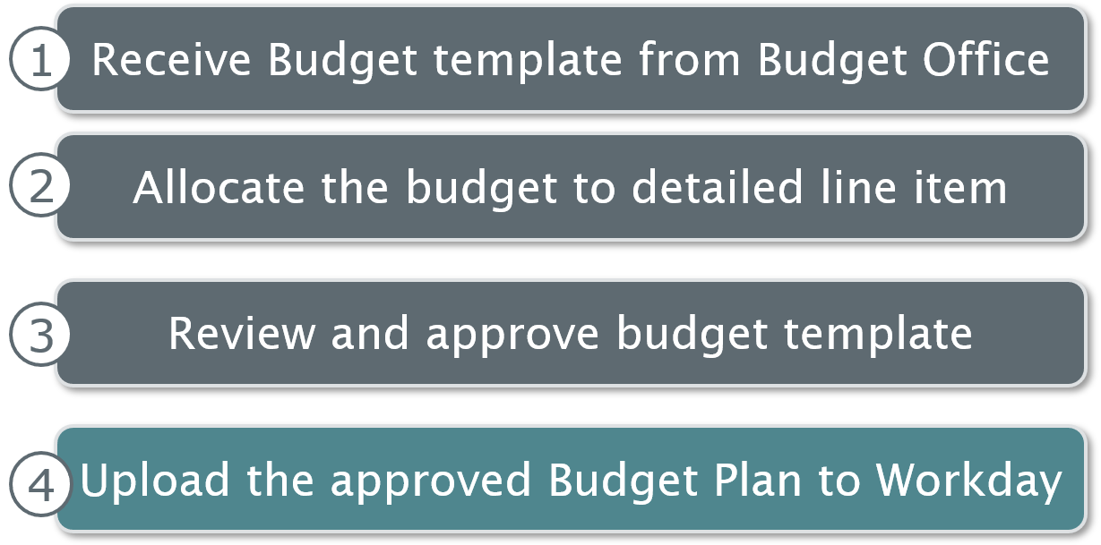
Budget Creation Process
Receive budget template from budget office
Allocate the budget to detailed line item
Review and approve budget template
Upload the approved budget plan to Workday

Slide 22
Lesson 1 Summary
Now that you have completed this lesson, you should be able to:
Identify the key terms used in the Budget Management process
Describe the key changes as a result of implementing Workday
Identify the Workday roles involved in Budget Management
Explain the Budget Creation process

Slide 23
Lesson Two
Budget Planning
Lesson 2

Slide 24
Lesson 2 Objectives
After completing this lesson, you will be able to:
Explain the steps performed in the Budget Planning process outside and within Workday

Slide 25
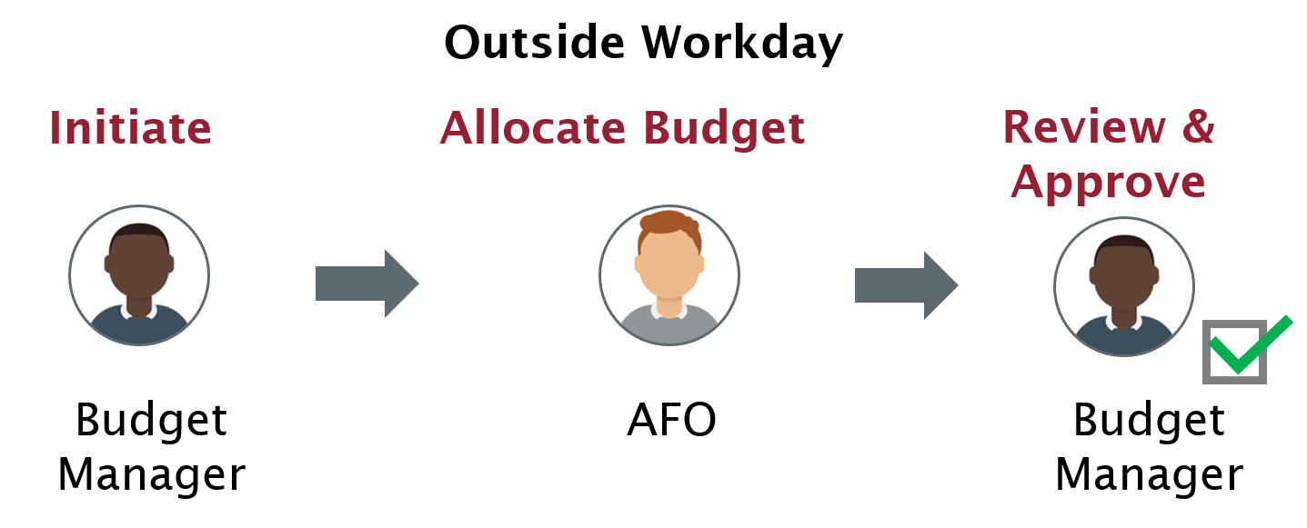
Budget Planning Process
The budget manager initiates the budget planning process. The budget manager sends it to the accountant (cost center) who allocates the budget. The accountant sends it for review and approval to the cost center manager

Slide 26
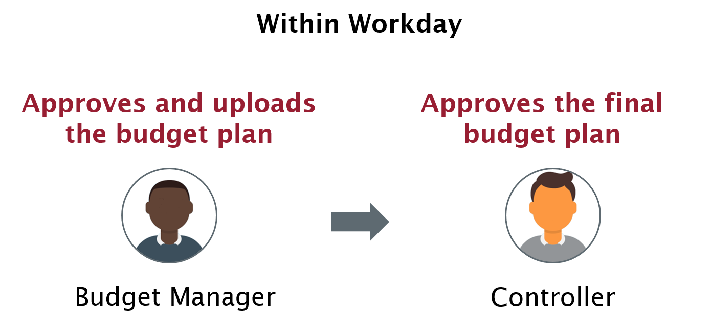
Budget Approval
Budget manager approves and uploads the budget plan. Sends to the controller who approves the final budget plan.

Slide 27
Lesson 2 Summary
Now that you have completed this lesson, you should be able to:
Explain the steps performed in the Budget Planning process outside and within Workday

Slide 28
Lesson Three
Budget Amendments
Lesson 3

Slide 29
Lesson 3 Objectives
After completing this lesson, you will be able to:
Explain the Budget Amendment process
List the roles involved in the Budget Amendment process
Create Budget Amendments

Slide 30
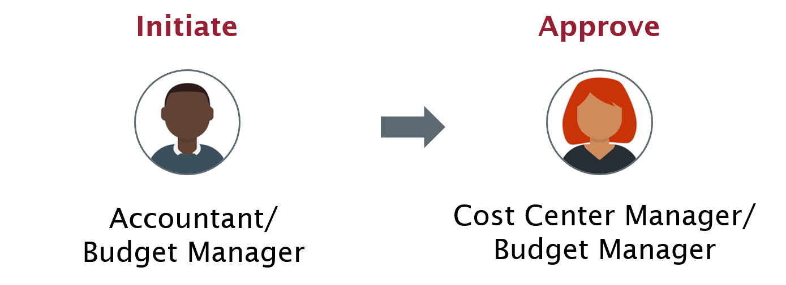
Budget Amendment Process
The accountant/budget manager initiates the budget amendment process. Sends to the cost center manager/budget manager for approval.

Slide 31


Budget Amendment (1 of 2)
Scenario 1:
As an Accountant (Cost Center), I can submit a financial budget amendment and route it for approval.
As a Cost Center Manager, I can review and approve the financial budget amendment.

Slide 32

Budget Amendment (2 of 2)
Scenario 2:
As a Budget Manager, I can decline/approve a budget amendment that hits the salaries GL account.
Scenario 3:
As a Cost Center Manager, I can run the Budget to Actuals report for my cost center hierarchy.

Slide 33
Budget Amendment Types (1 of 4)
Amendment Type | Description
Core: Auxiliary | Budget amendments done for self-sustaining funded cost centers.
Core: Cost Center Accountant Use | Funding allocation between cost centers within a cost center hierarchy (CCH) or from one CCH to another CCH.
Core: F&A Allocations | Quarterly distributions of F&A earnings to area cost centers.

Slide 34
Budget Amendment Types (2 of 4)
Amendment Type | Description
Core: One-Time or Temporary | Budget allocation from the Budget Office intended for fixed funding period(s) only.
Core: Ongoing | Budget allocation that is intended to be funded for multiple periods.

Slide 35
Budget Amendment Types (3 of 4)
Amendment Type | Description
Core: Supplemental Funding | Legislative changes to WSU appropriations.
Core: Re-Allocation | Budget recapture from CCH and Cost Center
Core: True-Up | Final adjustments to the initial budget allocations done earlier in fiscal year by the Budget Office.

Slide 36
Budget Amendment Types (4 of 4)
Amendment Type | Description
Non-Core: Adjustment | Used by Non Core Fund Managers to amend budget.
Non-Core: New Worktag | New dimensions added mid year.
Non-Core: Budget Correction | Corrections made to the Non Core budget.

Slide 37
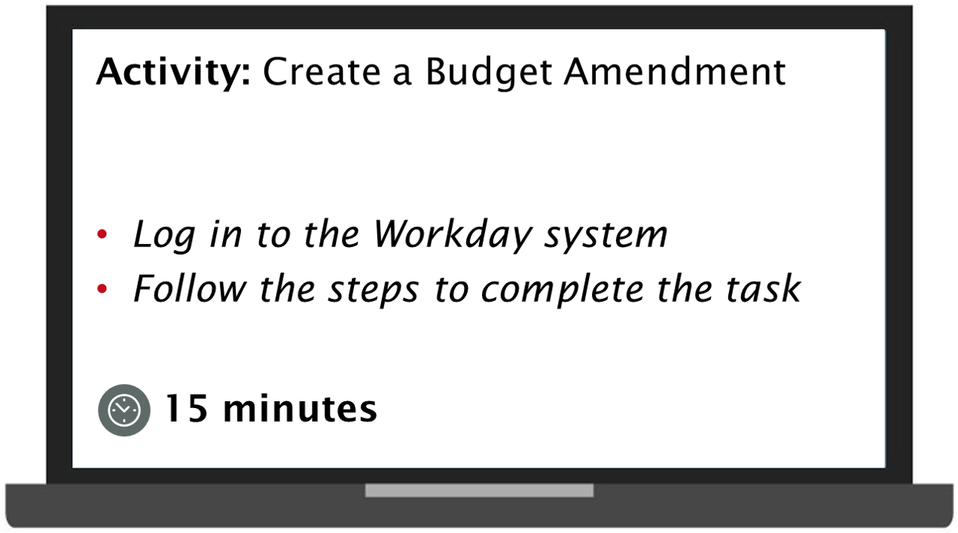
Practice 3.1
Activity create a budget amendment
Log in to the Workday system
Follow the steps to complete the task
This task will take 15 minutes.

Slide 38
Lesson 3 Summary
Now that you have completed this lesson, you should be able to:
Explain the Budget Amendment process in Workday
List the roles involved in the Budget Amendment process in Workday
Create the Budget Amendments in Workday

Slide 39
Lesson Four
Budgetary Roll Forward/Close
Lesson 4

Slide 40
Lesson 4 Objectives
After completing this lesson, you will be able to:
Explain the Budgetary Roll Forward/Close process in Workday

Slide 41
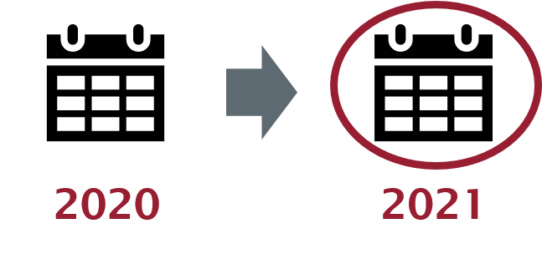
Budgetary Roll Forward
Budgetary Roll Forward/Close functionality enables you to:
Roll forward the unspent budget for specific cost centers, funds, or other Worktag types from the completed ledger year to the next year
Close unspent budget
Applies to core funds only

Slide 42
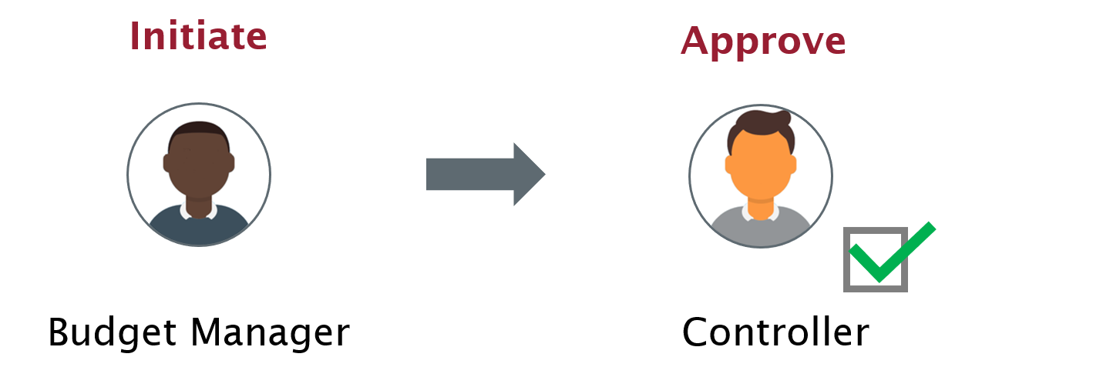
Budgetary Roll Forward Process

Slide 43
Lesson 4 Summary
Now that you have completed this lesson, you should be able to:
Explain the Budgetary Roll Forward/Close process in Workday

Slide 44
Lesson Five
Budgetary Reports
Lesson 5

Slide 45
Budgetary Report
You can run the Budget vs. Actuals report in Workday for personal use, weekly distribution to department chairs, or other interested parties
You can run the budget reports as per the business requirement, such as on a daily or weekly basis
The reports can be added to your dashboard

Slide 46
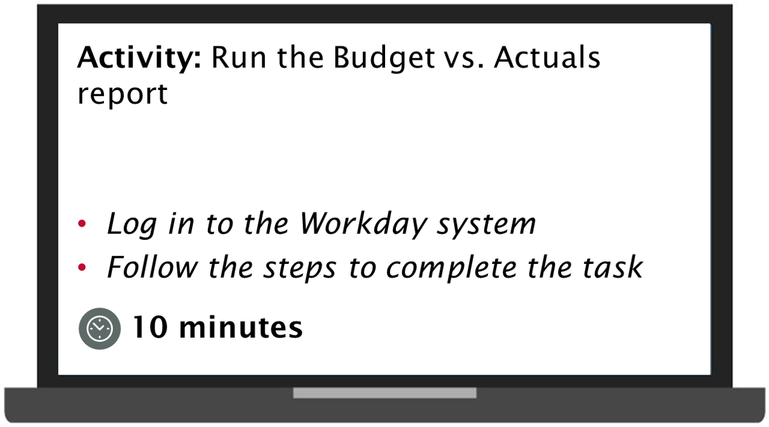
Practice 5.1
Activity run the budget vs actual report.
Log in to the Workday system
Follow the steps to complete the task
This task will take 10 minutes.

Slide 47
Additional Resources
WSU Knowledge Base
Workday Budgets Guide: Create Budget Amendment
Workday Grants Guide: Award Budget to Actuals Dashboard Reports

Slide 48
Knowledge Check 1
Can you move budget between core and non-core budget structure?
State true or false.
True
False

Slide 49
Knowledge Check 1 Answer
True
False

Slide 50
Knowledge Check 2
Once the AFO approves the budget, which of the following role uploads the budget details in the Workday system?
Select the correct answer from the options below.
Cost Center Manager
Budget Manager
Controller

Slide 51
Knowledge Check 2 Answer
Cost Center Manager
Budget Manager
Controller

Slide 52
Knowledge Check 3
Accountants can make amendments to an existing budget in Workday?
State true or false.
True
False

Slide 53
Knowledge Check 3 Answer
True
False

Slide 54
Knowledge Check 4
You can roll forward the unspent budget in the Core Structure from the completed ledger year to the next year.
State true or false.
True
False

Slide 55
Knowledge Check 4 Answer
True
False

Slide 56
Course Summary
You should now be able to:
Explain the Budget Planning process
Create the Budget Amendments
Explain the Budgetary Roll Forward/Close process

Slide 57
Course Evaluation
Please take a moment to complete a brief survey providing us feedback on today’s training session. Your feedback will help us improve Workday training materials.
https://wsu.co1.qualtrics.com/jfe/form/SV_3ql1sztsFwp0zn7

Slide 58
Workday Support
Knowledge Base
ModHelp/Workday Support
Training Catalog
Modernization Website
Change Network Directory

Slide 59
You have successfully completed the Workday Manage Budget course!
Questions? Please contact support.workday.wsu.edu

