Slide 1
Workday for Asset Accounting
Finance; ILT

Slide 2
Document Information
Document Information
Document Name | Asset Accounting
Program Name | Modernization
Document Author | Shikha Warikoo
Document Version | Final
Document Status | Approved
Document Edit History
Version | Date | Summary of Modifications | Prepared / Revised By
1 | 01/02/2020 | Draft 1 Development | Shikha Warikoo
2 | 01/07/2020 | Functional Review | Ed/Gurparshad
3 | 01/13/2020 | WSU Review | Gerik Kimble

Slide 3
Ground Rules (1 of 3)
To ensure a positive, productive training environment, please adhere to the following rules throughout the duration of the training session:
Mute your microphones to eliminate distractions.
To ask questions, use the “raise hand” feature or submit your questions via the Zoom chat window. Questions will be moderated and addressed during the training session.

Slide 4
Ground Rules (2 of 3)
If you have a question you would prefer not be discussed during the training, you may submit a ticket to support.workday.wsu.edu.
Please be considerate of the language and tone of Zoom chat interactions and questions. During sessions, aim for an inclusive, positive, and constructive dialogue as we all learn to use Workday together.

Slide 5
Ground Rules (3 of 3)
Please remember that the most important goal of your training session is to learn the material as presented by your trainer.
Keep in mind that Workday business processes were designed and built with standardization in mind. Your trainer does not have control over process design or workflow. If you have questions or concerns about process design please submit a ticket to support.workday.wsu.edu.

Slide 6
Course Overview
Course Description
Audience
This course will provide information on how to manage assets in Workday.
This course is for:
Business Asset Accountant (Company)
Business Asset Tracking Specialist (Cost Center)
Business Asset Accounting Manager (Company)
Surplus Coordinator (Company)
Cost Center Manager (Cost Center)

Slide 7
Course Agenda
Module # | Lesson Name | Duration
Lesson 1 | Asset Lifecycle Management | 45 mins
Lesson 2 | Workday Reports | 15 mins
Course Wrap-up |  | 15 mins

Slide 8
Course Objectives
After completing this course, you will be able to:
Register an asset
Issue an asset
Transfer an asset
Dispose an asset

Slide 9
Lesson One
Asset Lifecycle Management
Lesson 1

Slide 10
Lesson 1 Objectives
After completing this lesson, you will be able to:
Identify the key terms used in the Asset Accounting process in Workday
List the key changes as a result of implementing Workday
Identify the Workday roles in Asset Accounting
Explain the types of asset categories in Workday
Explain the stages of the asset lifecycle

Slide 11
Key Terms
Term | Definition
Depreciation | Record of the wear and tear that items are subjected to over a period of time, ending in the retirement of an asset
Impairment | Loss or damage to business assets due to unforeseen circumstances
Amortization | Allocating the cost of an intangible asset over a period of time
Disposal | Elimination of an asset from the business record

Slide 12
Key Process Changes
Seamless process from invoice payment to the Asset Registration process
Journals are posted based on the depreciation schedule
Asset information is recorded in the system during the Asset Registration process
Departments can now review all the assets for a specific area or department

Slide 13
Workday Roles (1 of 4)
Role Name | Description
Business Asset Accountant (Company) | It is the primary central office initiator role that performs central business asset accounting functions and has the ability to perform tracking functions.

Slide 14
Workday Roles (2 of 4)
Role Name | Description
Business Asset Tracking Specialist (Cost Center) | It is the primary departmental initiator role that performs business asset tracking functions for assigned organizations, including registering, issuing, removing, and disposal of assets. This role is also the primary approver for conditional approvals involving Small and Attractive Assets.

Slide 15
Workday Roles (3 of 4)
Role Name | Description
Business Asset Accounting Manager (Company) | This role is the primary approver for all Business Asset Accounting and Tracking functions for assigned organizations. This role does not act as a primary initiator for any business processes. This role is also the primary approver for conditional approvals involving Capital Assets.

Slide 16
Workday Roles (4 of 4)
Role Name | Description
Surplus Coordinator (Company) | It is primarily a view-all access role to perform Asset Disposal functions.
Cost Center Manager (Cost Center) | It is the primary approver for asset transfers across Cost Centers.

Slide 17
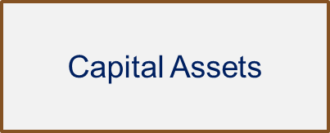
Types of Assets
Items with a value of more than $5,000 are considered to be capital assets.
Items with a value of less than $5,000 and tracked by individual departments.
Items with a value of less than $5,000 but must be tracked by WSU; inventory tags are required.
Small and Attractive - Departmental
Small and Attractive – University Inventory

Slide 18
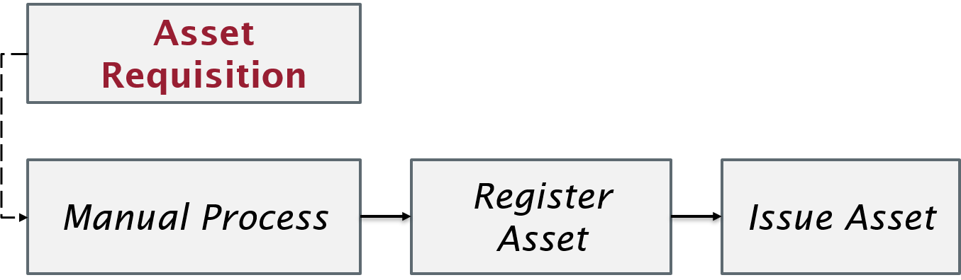
Asset Registration (1 of 2)
Manually process of registering an asset. Asset requisition entered manually, register asset and issue asset.

Slide 19

Asset Registration (2 of 2)
Automated method of registering an asset, the details of an asset are recorded automatically in the system through the supplier invoice, receipts, or supplier contract. This is the preferred method of recording assets.

Slide 20
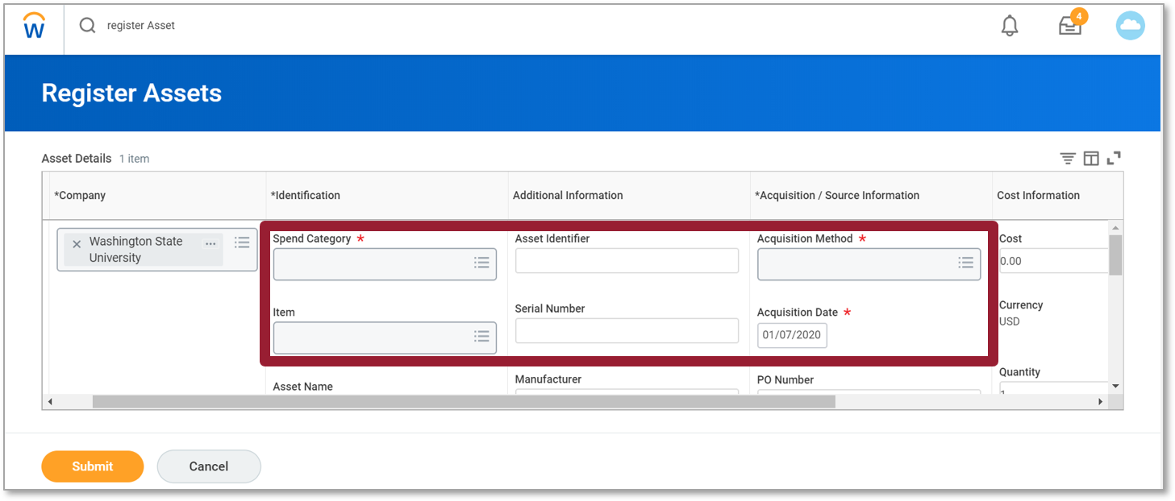
Register Asset
The screenshot is the register asset screen. The spend category, item, asset identifier, serial number, acquisition method, and acquisition date fields are highlighted.

Slide 21
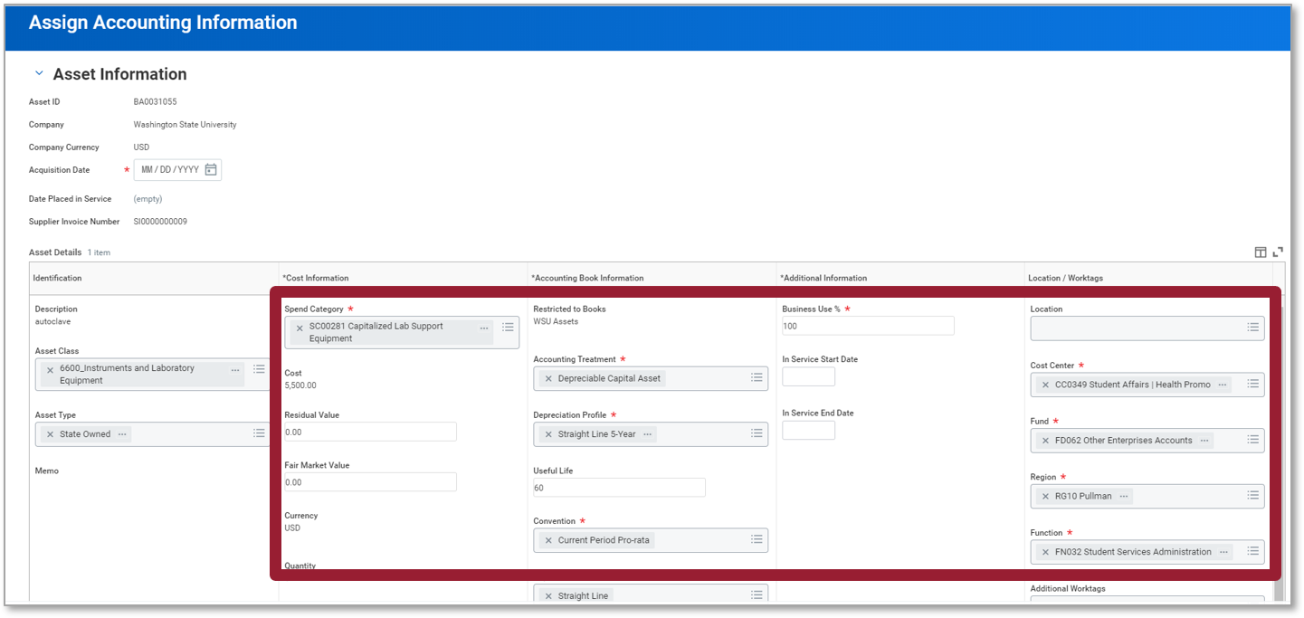
Assign Asset Accounting
The screenshot of the assign asset accounting screen. The asset information section is on the left side. The following fields are highlighted spend category (required field), cost, residual value, fair market value, currency, quantity, restricted to books, accounting treatment (required field), depreciation profile (required field), useful life, convention (required field), business use (required field), in service start date, in service end date, location, cost center (required field), fund (required field), region (required field), and function (required field).

Slide 22
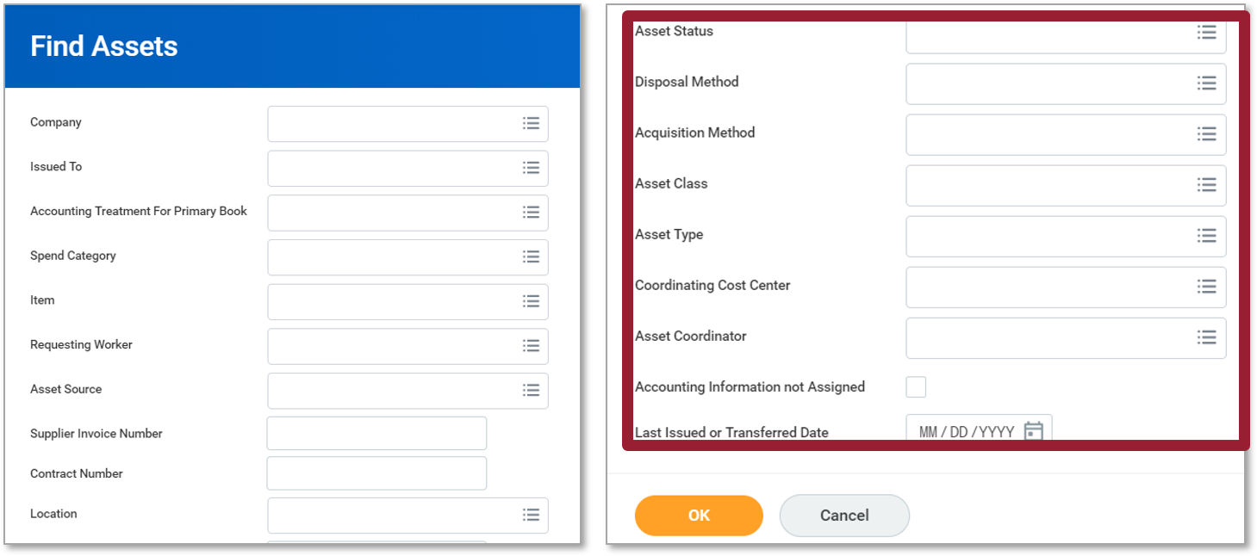
Find an Asset
The find assets screen is displayed. The highlighted sections are assets status, disposal method, acquisition method, asset class, asset type, coordinating cost center, asset coordinator, accounting information not assigned, and last issued or transferred date.

Slide 23
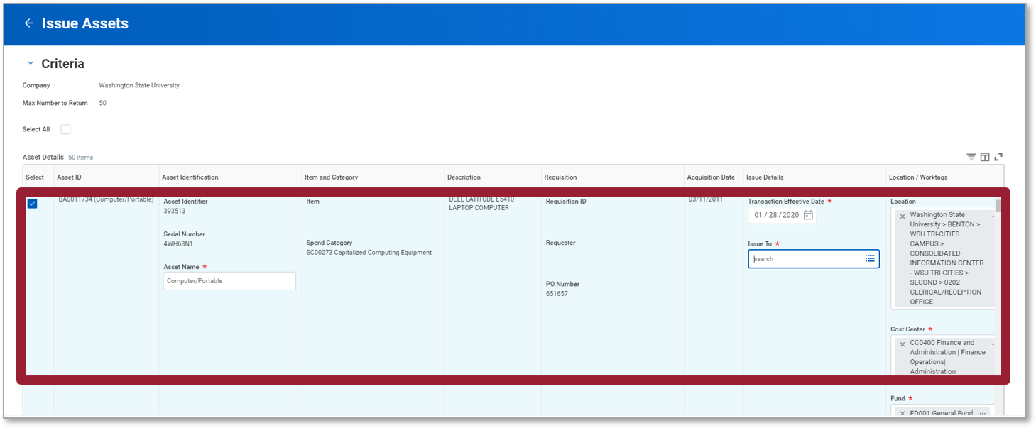
Asset Issue
The screenshot is the issue assets screen. Criteria is displayed. In the table select is checked, asset ID, asset identification, item and category, description, requisition, acquisition date, issue details, and location and worktags fields are highlighted.

Slide 24
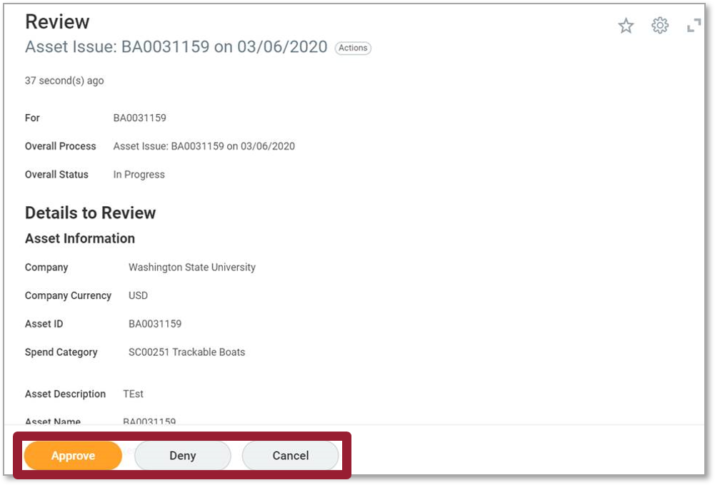
Issue Asset Task in Inbox
The screenshot is the issue asset task in inbox screen. The review information displays for, overall process, overall status. Under the details to review the asset information is shown. The approve, deny, and cancel buttons are highlighted.

Slide 25
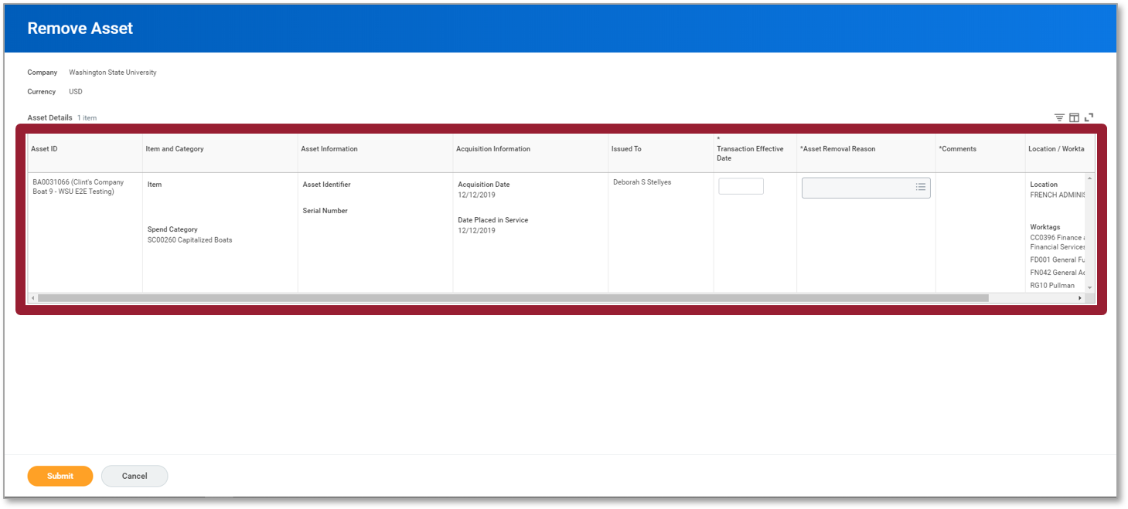
Asset Removal
The screenshot is the remove asset screen. The screen displays information on the company, currency, and asset details at the top of the page. The middle of the page shows a table that is highlighted. With in the table are the following categories asset ID, item and category, asset information, issued to, transaction effective date, asset removal reason, comments, and location and worktas.

Slide 26
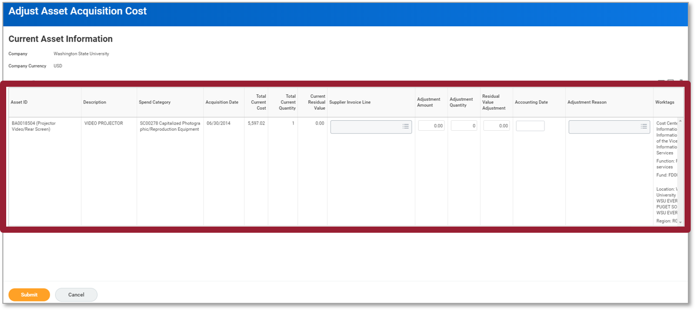
Adjust Asset Acquisition Cost
Screenshot of the adjust asset acquisition cost screen. This screen displays current asset information. The table in the center of the screen is highlighted. The following are the fields in the table asset ID, description, spend category, acquisition date, total current cost, total current quantity, current residual value, supplier invoice line, adjustment amount, adjustment quantity, residual value adjustment, accounting date, adjustment reason, and worktags.

Slide 27
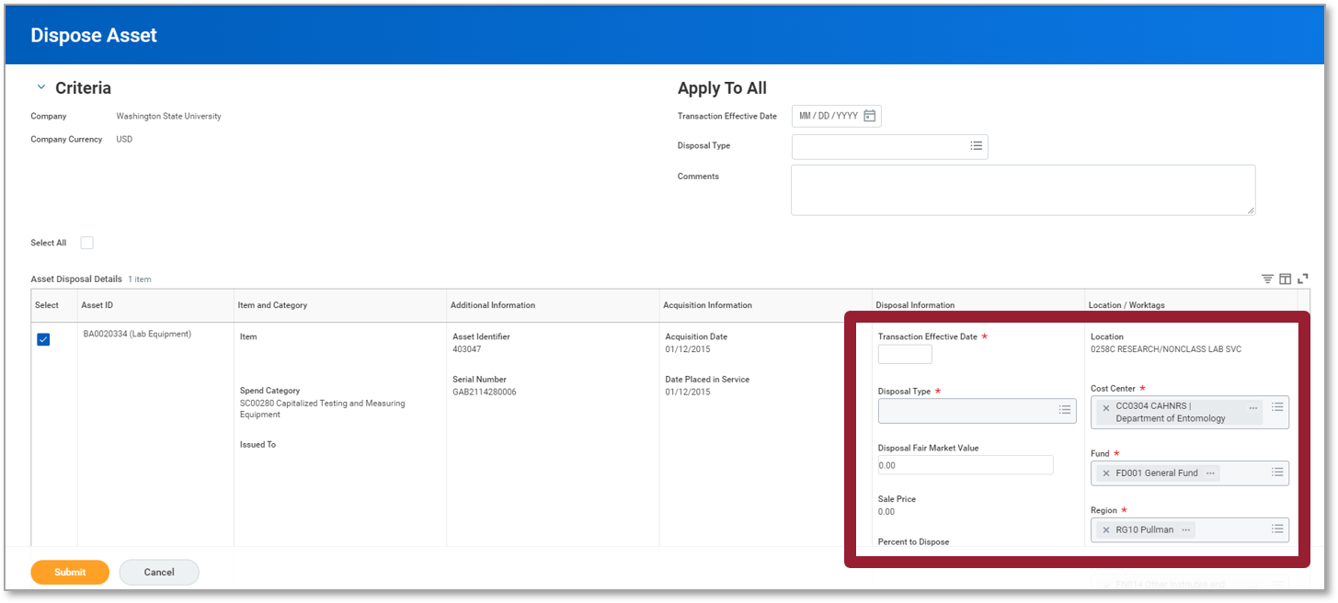
Asset Disposal
The screenshot is the asset disposal screen. The left side of the screen is the criteria section. The right side of the screen is the apply to all section. The highlighted section includes the following fields transaction effective date, disposal type, disposal fair market value, sale price, percent to dispose, location, cost center, fund, and region.

Slide 28
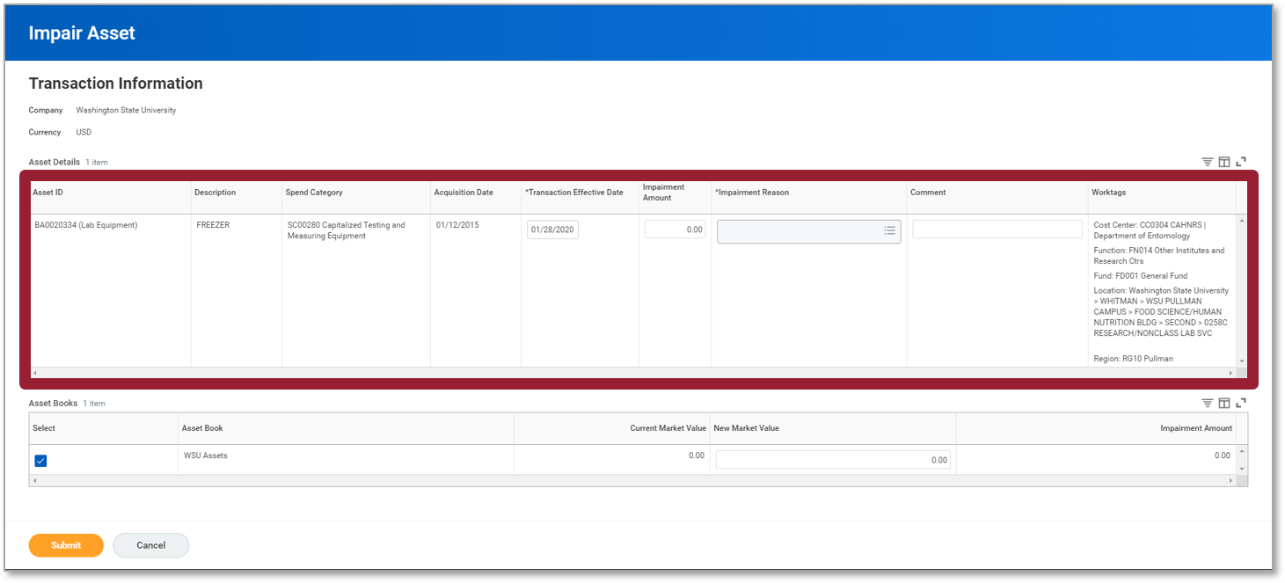
Asset Impairment
The impair asset screenshot displays the transaction information. The asset details in the center of the page are highlighted. The fields highlighted are asset ID, description, spend category, adjustment date, transaction effective date, impairment amount, impairment reason, comment, and worktags.

Slide 29
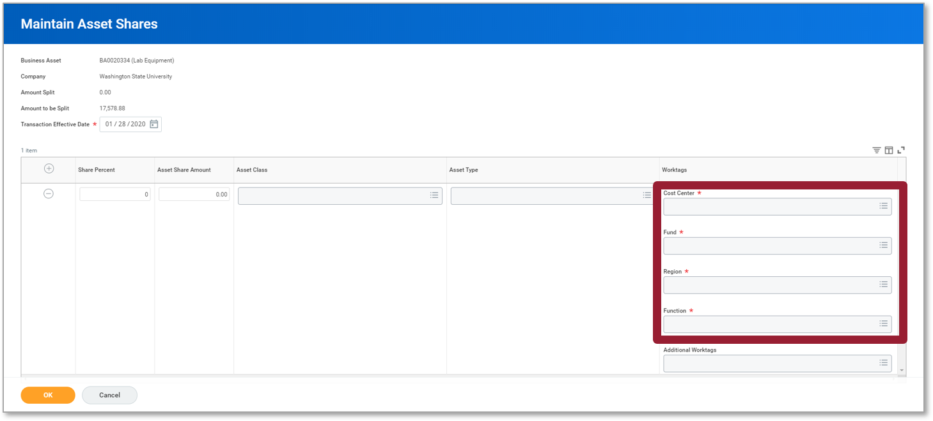
Asset Share
The screenshot is the asset share screen. The maintain asset shares information section includes business asset, company, amount split, amount to be split and transaction effective date. The highlighted fields are cost center, fund, region, and function. The highlighted fields are also required.

Slide 30
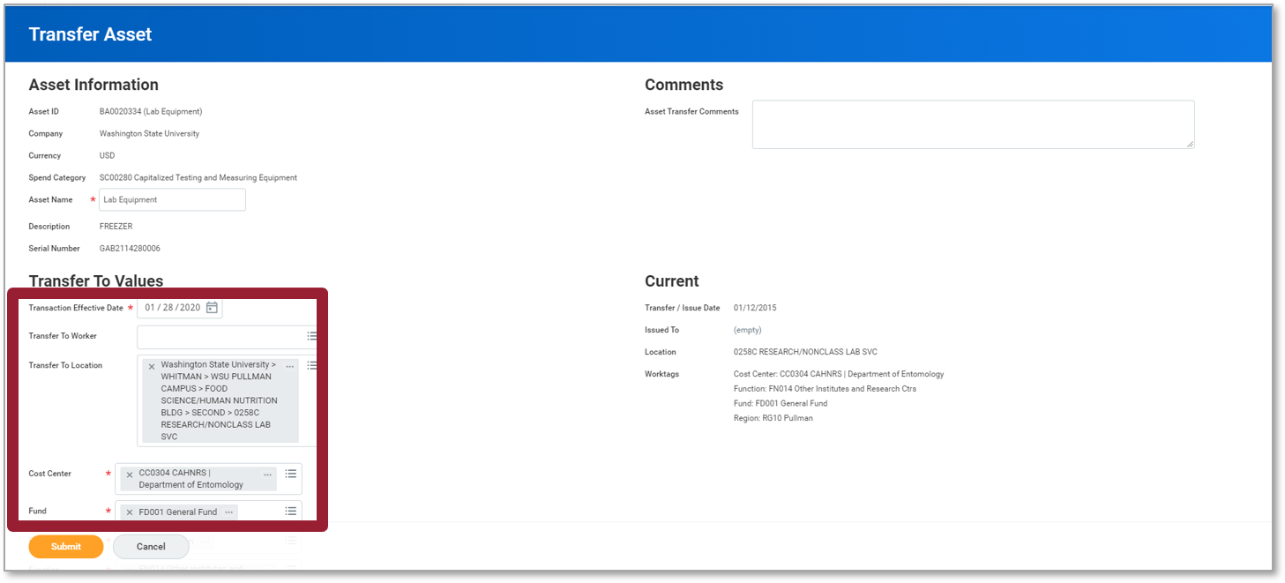
Asset Transfer
Screenshot of the transfer asset screen. The asset information section is on the top left side of the screen. Transfer to values section is highlighted and is located on the bottom left side. The fields highlighted are transaction effective date, transfer to worker, transfer to location, cost center, and fund. The comments section is on the top right side of the screen. The current section is located at the bottom right of the screen.

Slide 31
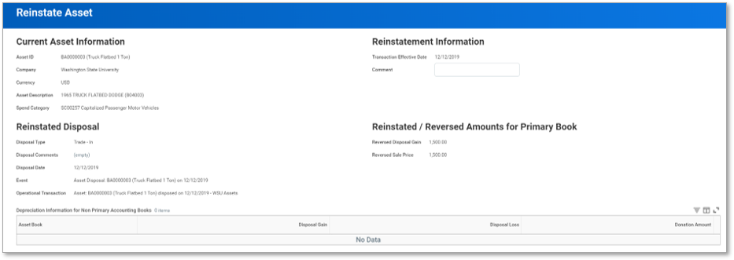
Asset Reinstatement
The screenshot is the reinstate asset screen. The top left side of the screen is the current asset information section. Reinstated disposal section is on the bottom left side. The reinstatement information section is on the top right side and the reinstated/reversed amounts for primary book section is located on the bottom right side.

Slide 32
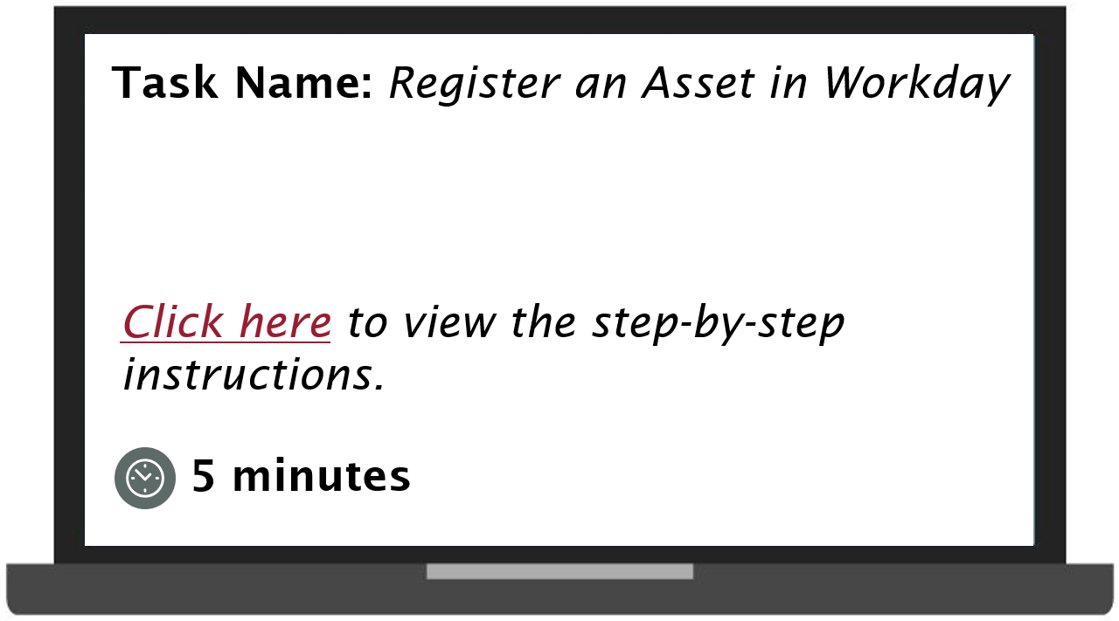
Demonstration 1.1
Task name register an asset in workday. Select to view the step by step instructions. Demonstration will take 5 minutes.

Slide 33
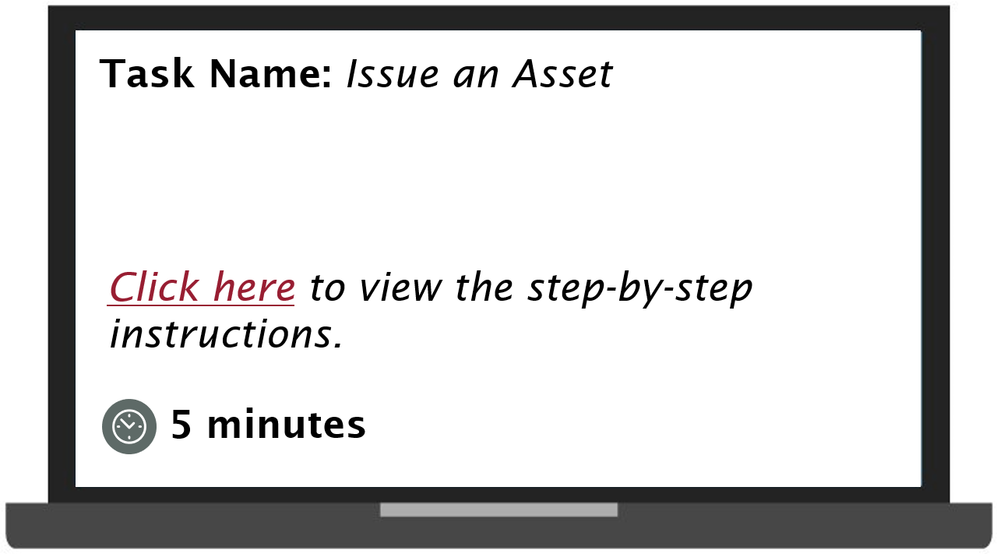
Practice 1.1
Task name issue an asset. Select to view the step by step instructions. The practice will last 5 minutes.

Slide 34

Practice 1.2
Task name transfer an asset. Select to view the step by step instructions. This practice will last 5 minutes.

Slide 35

Practice 1.3
Task name dispose an asset. Select to view the step by step instructions. This practice will take 5 minutes.

Slide 36
Lesson 1 Summary
Now that you have completed this lesson, you should be able to:
Identify the key terms used in the Asset Accounting process in Workday
List the key changes as a result of implementing Workday
Identify the Workday roles in Asset Accounting
Explain the types of asset categories in Workday
Explain the stages of the asset lifecycle

Slide 37
Asset Accounting Reports
Find Assets
Assets Net Book Value
CR AST Asset Costs by Cost Center Hierarchy
My Direct Reports’ Assets
Capital Assets Without Accounting Information Assigned

Slide 38
Additional Resources
Helpful resources are available to perform Workday related tasks:
WSU Knowledge Base
Workday Assets Guide: Register Asset
Workday Assets Guide: Issue Asset
Workday Assets Guide: Transfer Asset
Workday Assets Guide: Dispose Asset
Workday Assets Guide: Share Asset
Workday Assets Guide: Remove Asset

Slide 39
Knowledge Check 1
Which of the following role can initiate the request to issue an asset in Workday?
Select the correct answer from the options given below.
Business Asset Accountant
Business Asset Tracking Specialist
Business Asset Accounting Manager
Cost Center Manager

Slide 40
Knowledge Check 1 Answer
Business Asset Accountant
Business Asset Tracking Specialist
Business Asset Accounting Manager
Cost Center Manager

Slide 41
Knowledge Check 2
Which of the following role can approve the request to share a capital asset in Workday?
Select the correct answer from the options given below.
Business Asset Accountant
Business Asset Tracking Specialist
Business Asset Accounting Manager
Cost Center Manager

Slide 42
Knowledge Check 2 Answer
Business Asset Accountant
Business Asset Tracking Specialist
Business Asset Accounting Manager
Cost Center Manager

Slide 43
Course Summary
You should now be able to:
Register an asset
Issue an asset
Transfer an asset
Dispose an asset

Slide 44
Course Evaluation
Please take a moment to complete a brief survey providing us feedback on today’s training session. Your feedback will help us improve Workday training materials.
https://wsu.co1.qualtrics.com/jfe/form/SV_3ql1sztsFwp0zn7

Slide 45
Workday Support
Knowledge Base
ModHelp/Workday Support
Training Catalog
Modernization Website
Change Network Directory

Slide 46
You have successfully completed the Workday for Asset Accounting course!
Questions? Please contact support.workday.wsu.edu

