Slide 1
Workday Accounts Receivable
FIN104; ILT

Slide 2
Ground Rules (1 of 3)
To ensure a positive, productive training environment, please adhere to the following rules throughout the duration of the training session:
Mute your microphones to eliminate distractions.
To ask questions, use the “raise hand” feature or submit your questions via the Zoom chat window. Questions will be moderated and addressed during the training session.

Slide 3
Ground Rules (2 of 3)
If you have a question you would prefer not be discussed during the training, you may submit a ticket to support.workday.wsu.edu.
Please be considerate of the language and tone of Zoom chat interactions and questions. During sessions, aim for an inclusive, positive, and constructive dialogue as we all learn to use Workday together.

Slide 4
Ground Rules (3 of 3)
Please remember that the most important goal of your training session is to learn the material as presented by your trainer.
Keep in mind that Workday business processes were designed and built with standardization in mind. Your trainer does not have control over process design or workflow. If you have questions or concerns about process design please submit a ticket to support.workday.wsu.edu.

Slide 5
Accounts Receivable
Course Description
Audience
This course will provide information on the customer accounts receivable process in Workday.
This course is for:
Customer Billing Specialist (Company Constrained)
Accounts Receivable Specialist (Company Constrained)
Accounts Receivable Manager (Company)

Slide 6
Course Agenda (1 of 1)
Lesson # | Lesson Name | Duration
Lesson 1 | Accounts Receivable Overview | 15 mins
Lesson 2 | Cash Sale and Reporting | 25 mins
Course Wrap-up |  | 5 mins

Slide 7
Course Objectives
After completing this course, you will be able to:
Create a cash sale
Report on customer payments

Slide 8
Lesson One
Accounts Receivable Overview
Lesson 1

Slide 9
Lesson 1 Objectives
After completing this lesson, you will be able to:
Identify the key terms used in the Accounts Receivable process
Describe the key changes as a result of implementing Workday
Identify the Workday roles in Accounts Receivable

Slide 10
Introduction to Receivables
Workday considers customers to be a type of business entity and you can record sales and create receivables accounting

Slide 11
Key Terms (1 of 1)
Term | Definition
Cash Sale | It is the recording of a payment without an associated invoice. Note: ‘Cash Sale’ does not only mean cash. Check and No Money is recorded here.
Customer Deposit | Use this task when you've made a bank deposit and want to record it in Workday. Note: Performed by the Accounts Receivable Specialist in the Bursar’s Office.

Slide 12
Key Process Changes (1 of 3)
Creation of customers in Workday is centralized
Approval workflow and signatories are standardized
Track receivables and payments from non-sponsored programs

Slide 13
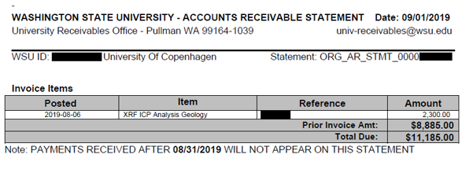
Key Process Changes (2 of 3)
General accounts receivable, the process of creating a balance on a customer’s account, will continue to be performed in myWSU.
myWSU will continue to house all student financial information.

Slide 14
Key Process Changes (3 of 3)
Grants billing and receipting functions will be moved to Workday
Workday will replace the Cash Deposit Report from BPPM 30.53 using the Record Cash Sale task

Slide 15
Workday Roles (1 of 2)
Term | Definition
Customer Billing Specialist | This role performs customer and receivables processes at a department level.
Accounts Receivable Specialist (Company) | This role performs customer and receivables activities at a Central Unit level. These activities include record and apply payment, deposits, refund, overpayments, and bad debt write-off.

Slide 16
Workday Roles (2 of 2)
Term | Definition
Accounts Receivable Manager | This role oversees the work performed by Accounts Receivable Specialists. It also approves refunds if they are greater than or equal to $10,000 and approves any write-off of bad debts.

Slide 17
Lesson 1 Summary
Now that you have completed this lesson, you should be able to:
Identify the key terms used in the Accounts Receivable process
Describe the key changes as a result of implementing Workday
Identify the Workday roles in Accounts Receivable

Slide 18
Lesson Four
Cash Sale and Reporting
Lesson 2

Slide 19
Lesson 2 Objectives
After completing this lesson, you will be able to:
Explain the concept of Cash Sale in Workday
Perform the steps to record a cash sale
Run the important Accounts Receivable reports

Slide 20
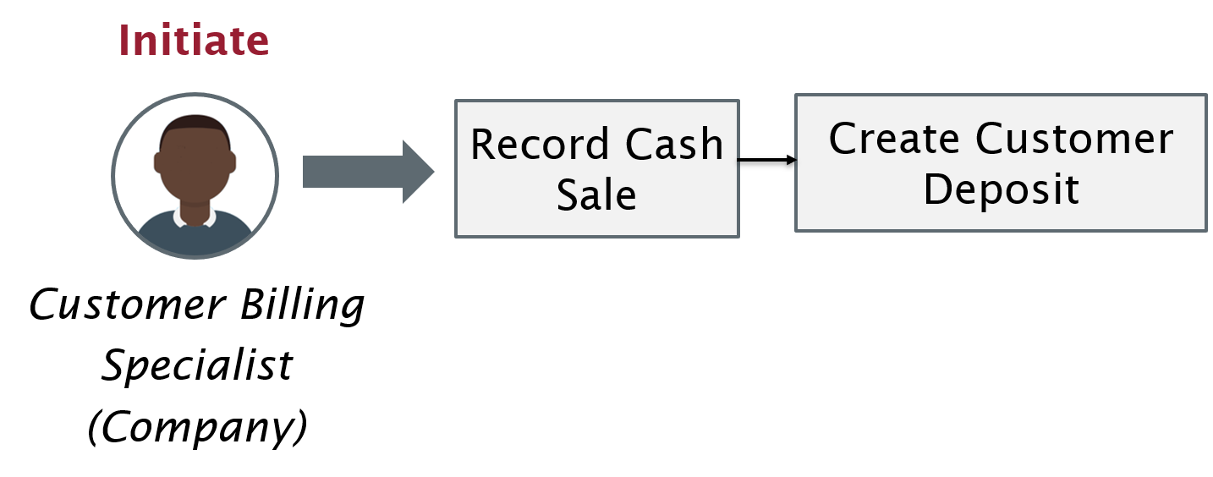
Cash Sale
Cash Sale is utilized when no invoice exists in the system. This is an primary way of recording revenue for daily deposits.

Slide 21
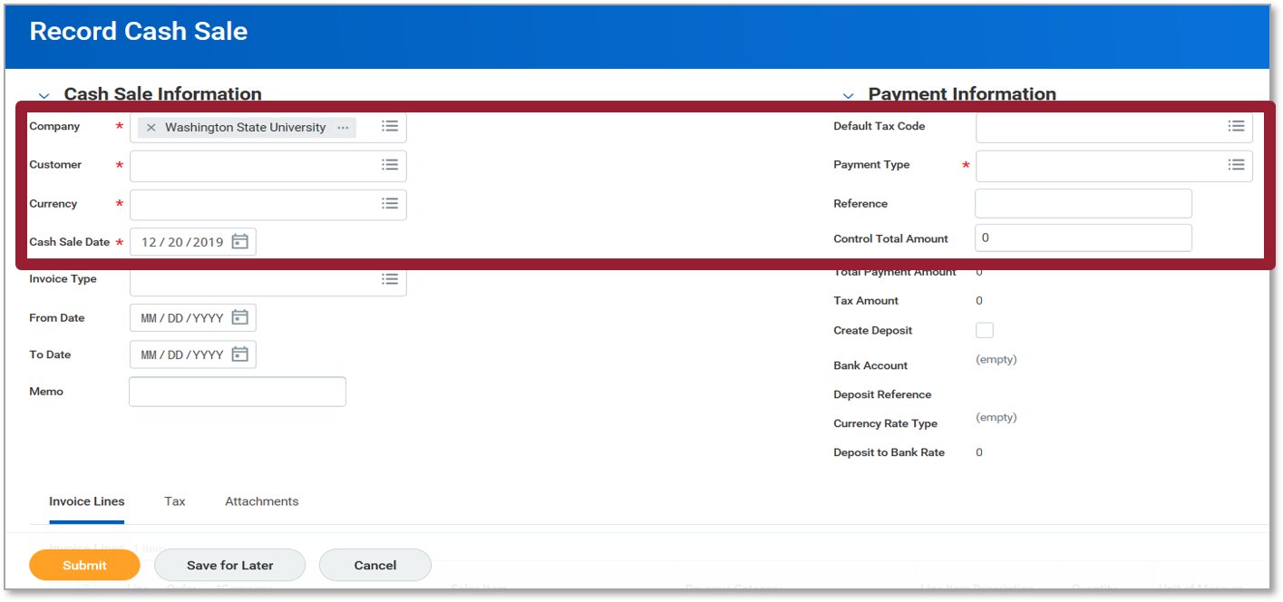
Record Cash Sale (1 of 2)
The screenshot of the record cash sale screen. The cash sale information section is on the left side of the screen and highlights the company, customer, currency, and cash sale date fields. The payment information section is on the right side of the screen and highlights the following fields default tax code, payment type, reference, control total amount.

Slide 22
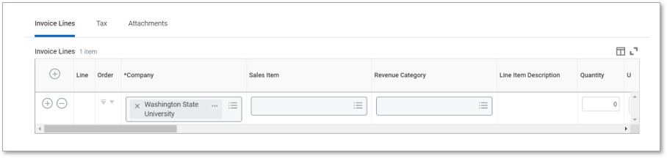
Record Cash Sale (2 of 2)
Screenshot of the invoice lines screen.

Slide 23
Change Cash Sale (1 of 1)
If the Cash Sale was already submitted but needs to be adjusted before deposited the Customer Billing Specialist can do so.
Run “Customer Payment Detail” report to find the cash sale.
Using the related action button select Change under the Cash Sale menu.

Slide 24
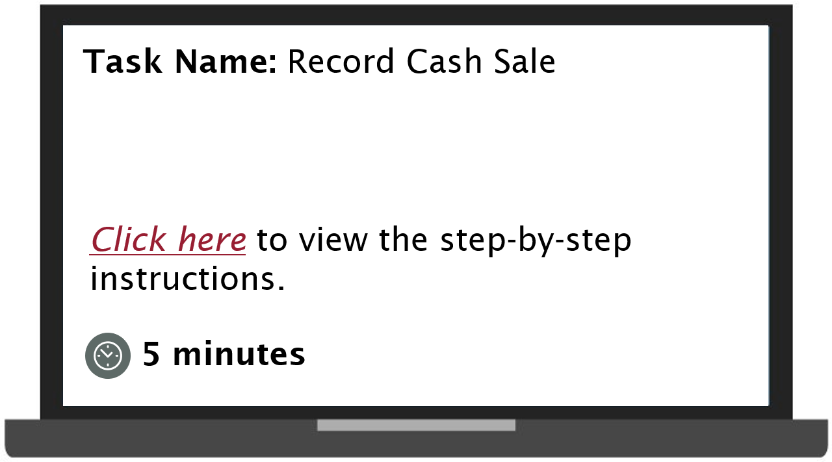
Demonstration 3.1

Slide 25
Useful Reports
View Customer
Customer Balance Details
Find Customer Payments
Customer Payment Detail

Slide 26
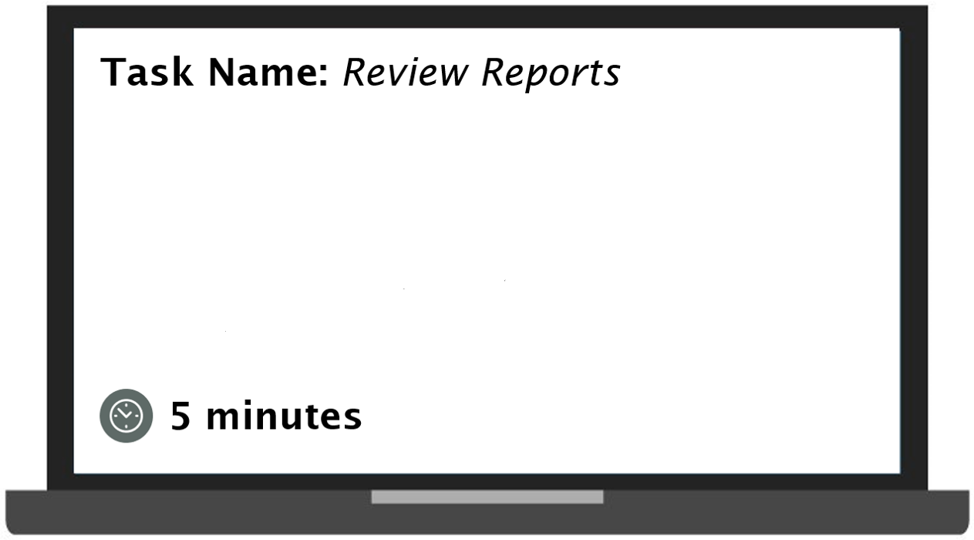
Demonstration 3.2
Task Name review reports
Select here to view the step-by-step instructions. 5 minutes.

Slide 27
Lesson 3 Summary
Now that you have completed this lesson, you should be able to:
Explain the concept of Cash Sale in Workday
Perform the steps to record a cash sale
Run the important Accounts Receivable reports

Slide 28
Knowledge Check 1
Accounts Receivable Specialist creates a customer deposit which can be categorized as:
Cash
Check
Expected Cash

Slide 29
Knowledge Check 1 Answer
Cash
Check
Expected Cash

Slide 30
Knowledge Check 2
Customer Refunds need to be approved.
State True or False
True
False

Slide 31
Knowledge Check 2 Answer
True
False

Slide 32
Knowledge Check 3
Bad Debt write-off is approved by the Controller if the Grant Worktag exists.
State True or False
True
False

Slide 33
Knowledge Check 3 Answer
True
False

Slide 34
Additional Resources
Helpful resources are available to perform Workday related tasks:
WSU Knowledge Base
Workday Revenue Guide: Record Cash Sale

Slide 35
Course Summary
You should now be able to:
Create a cash sale
Report on customer payments

Slide 36
Course Evaluation
Please take a moment to complete a brief survey providing us feedback on today’s training session. Your feedback will help us improve Workday training materials.
https://wsu.co1.qualtrics.com/jfe/form/SV_3ql1sztsFwp0zn7

Slide 37
Workday Support
Knowledge Base
ModHelp/Workday Support
Training Catalog
Modernization Website
Change Network Directory

Slide 38
You have successfully completed the Workday Accounts Receivable course!
Questions? Please contact support.workday.wsu.edu

