Slide 1
Workday Accounting Journals
FIN102; ILT

Slide 2
Ground Rules (1 of 3)
To ensure a positive, productive training environment, please adhere to the following rules throughout the duration of the training session:
Mute your microphones to eliminate distractions.
To ask questions, use the “raise hand” feature or submit your questions via the Zoom chat window. Questions will be moderated and addressed during the training session.

Slide 3
Ground Rules (2 of 3)
If you have a question you would prefer not be discussed during the training, you may submit a ticket to support.workday.wsu.edu.
Please be considerate of the language and tone of Zoom chat interactions and questions. During sessions, aim for an inclusive, positive, and constructive dialogue as we all learn to use Workday together.

Slide 4
Ground Rules (3 of 3)
Please remember that the most important goal of your training session is to learn the material as presented by your trainer.
Keep in mind that Workday business processes were designed and built with standardization in mind. Your trainer does not have control over process design or workflow. If you have questions or concerns about process design please submit a ticket to support.workday.wsu.edu.

Slide 5
Course Overview
Course Description
Audience
This course will provide information on the accounting journals process in Workday.
This course is for:
Accountant (Company)
Accounting Manager (Company)
Business Asset Accountant
Budget Manager
Gift/Grant/Program/Project Managers
Sponsored Programs Manager

Slide 6
Course Agenda (1 of 2)
Lesson # | Lesson Name | Duration
Lesson 1 | Accounting Journal Overview | 20 mins
Lesson 2 | Create Accounting Journals | 45 mins
Lesson 3 | Create Accounting Adjustments | 30 mins

Slide 7
Course Agenda (2 of 2)
Lesson # | Lesson Name | Duration
Lesson 4 | Workday Reports | 15 mins
Course Wrap-up |  | 5 mins

Slide 8
Course Objectives
After completing this course, you will be able to:
Create Accounting Journals
Create Accounting Journal Reversals
Create Accounting Adjustments

Slide 9
Key Terms
Review the handout provided listing key terms and examples related to Accounting Journals.

Slide 10
Key Process Changes
Reduction in paper forms such as ETRs
Shift from central to area-level responsibility for cost transfers and manual journals
Standard processes for creating accounting journals, accounting journal-reversals, and accounting adjustments
Budget can also create accounting journals
Use of Debit/Credit instead of Transaction codes

Slide 11
Knowledge Check 1
In Workday, areas will have the ability to initiate accounting adjustments (ETRs in legacy).
What impact do you anticipate this will have on your role? What changes will you need to prepare for?

Slide 12
Lesson One
Accounting Journal Overview
Lesson 1

Slide 13
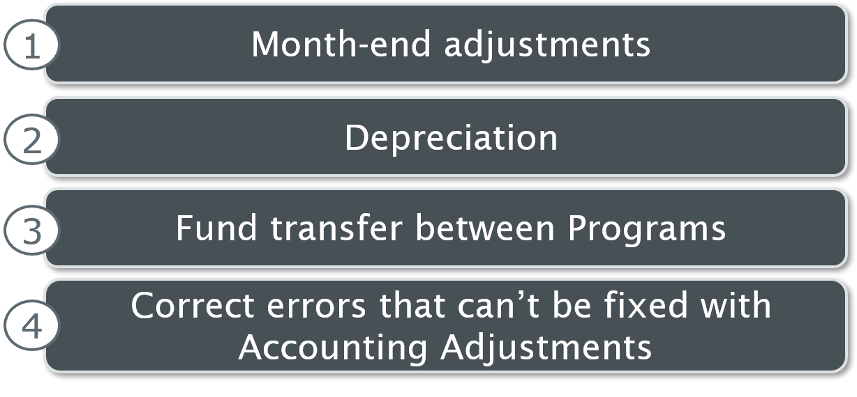
Manual Accounting Journals
Manual Accounting Journals are usually created for the following scenarios:
Month end adjustments
Depreciations
Fund transfer between programs
Correct errors that can’t be fixed with accounting adjustments

Slide 14
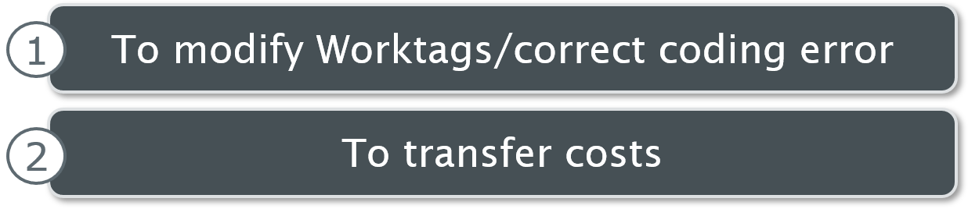
Accounting Adjustment
Accounting Adjustments are usually created for the following scenarios:
1. To modify worktags/correct coding error
2. To transfer cost

Slide 15
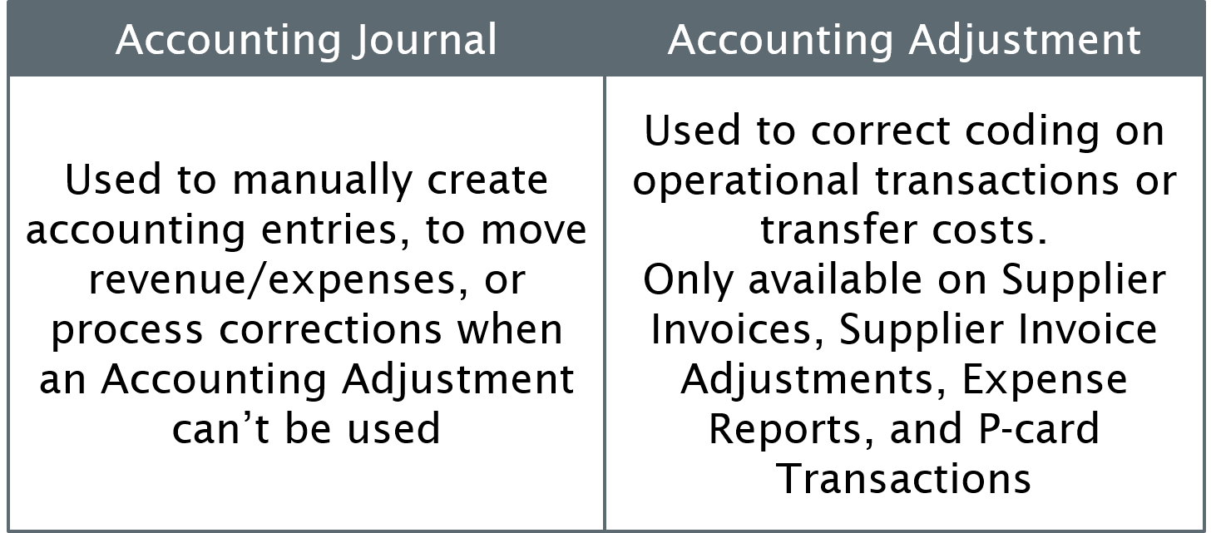
Accounting Journal vs. Adjustment
Accounting journal is used to manually create accounting entries, to move revenue or expenses, or process corrections when an accounting adjustment cannot be used. Accounting adjustment is used to correct coding on operational transactions or transfer costs. Only available on supplier invoices, supplier invoice adjustments, expense reports, and P-card transactions.

Slide 16
Knowledge Check 2
‘It’s discovered that an expense was coded to the wrong Program ID on an inbound integration.’ Which of the following accounting tasks will be performed for the above mentioned scenario?
Select the correct answer from the options given below.
Accounting Journal
Accounting Adjustment

Slide 17
Knowledge Check 2 Answer
Accounting Journal
Accounting Adjustment

Slide 18
Knowledge Check 3
‘A Grant expense was posted with the wrong budget date on an Expense Report.’ Which of the following accounting tasks will be performed for the above mentioned scenario?
Select the correct answer from the options given below.
Accounting Journal
Accounting Adjustment

Slide 19
Knowledge Check 3 Answer
Accounting Journal
Accounting Adjustment

Slide 20
Knowledge Check 4
‘You need to transfer revenue from one Program to another within your Cost Center.’ Which of the following accounting tasks will be performed for the above mentioned scenario?
Select the correct answer from the options given below.
Accounting Journal
Accounting Adjustment

Slide 21
Knowledge Check 4 Answer
Accounting Journal
Accounting Adjustment

Slide 22
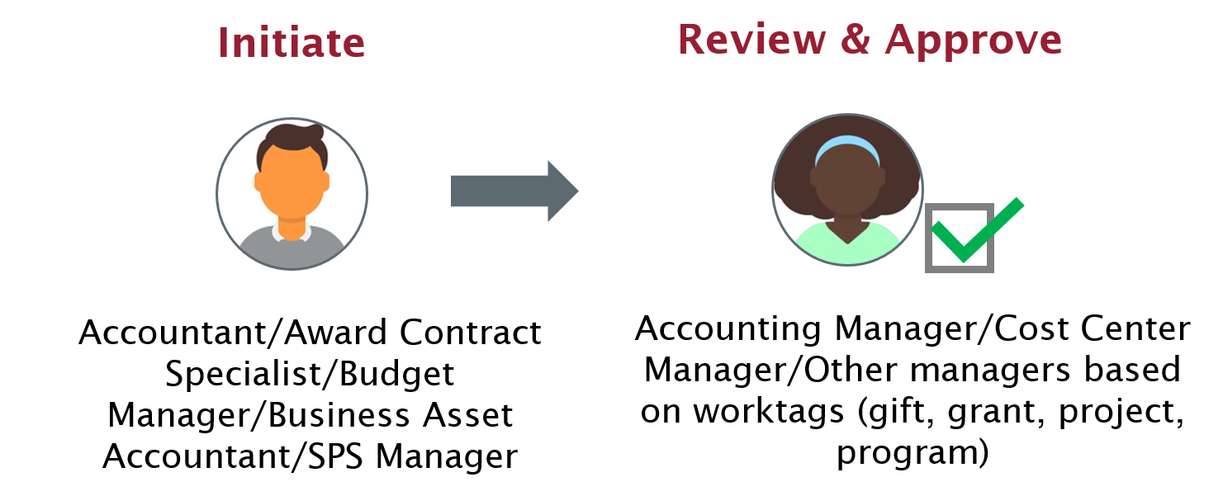
Create Accounting Journal Flow
The create accounting journal flow is initiated by accountant, award contract specialist, budget manager, business asset accountant, and sponsored programs manager. Reviewed and approved by accounting, cost center, gift, grant, project, and program manager based on the worktag.

Slide 23
Area Accounting Journal Roles (1 of 2)
Role | Description | Initiate | Approve
Cost Center Accountant | Initiates journals for cost center | X
Grant Manager | Initiates cost transfers for grants. Approves cost transfers and manual journals on Grants | X | X

Slide 24
Area Accounting Journal Roles (2 of 2)
Role | Description | Initiate | Approve
Cost Center Manager | Approves the journal impacting a cost center |  | X
Program/ Gift/Project Manager | Approves accounting journals and adjustments with Program/Gift/Project Worktags |  | X

Slide 25
Central Accounting Journal Roles (1 of 3)
Role | Description | Initiate | Approve
Accountant (Company) | Initiates journals for company and approves journals from the cost centers needing additional approval | X
Accounting Manager (Company) | Provides final approval on all manual journals |  | X

Slide 26
Central Accounting Journal Roles (2 of 3)
Role | Description | Initiate | Approve
Budget Manager | Initiates journals to manage expenses by budget | X
Award Contract Specialist | Initiates journals involving Grants | X

Slide 27
Central Accounting Journal Roles (3 of 3)
Role | Description | Initiate | Approve
Sponsored Programs Manager | Approves journals initiated by the Grant Manager or Award Contract Specialist involving Grants | X | X

Slide 28
Lesson Two
Create Accounting Journals
Lesson 2

Slide 29

Create Accounting Journal
Scenario 1:
As a Budget Manager, I want to create a fund transfer journal entry and route for approval.
As an Accounting Manager (Company), I can review and approve a fund transfer journal entry.

Slide 30
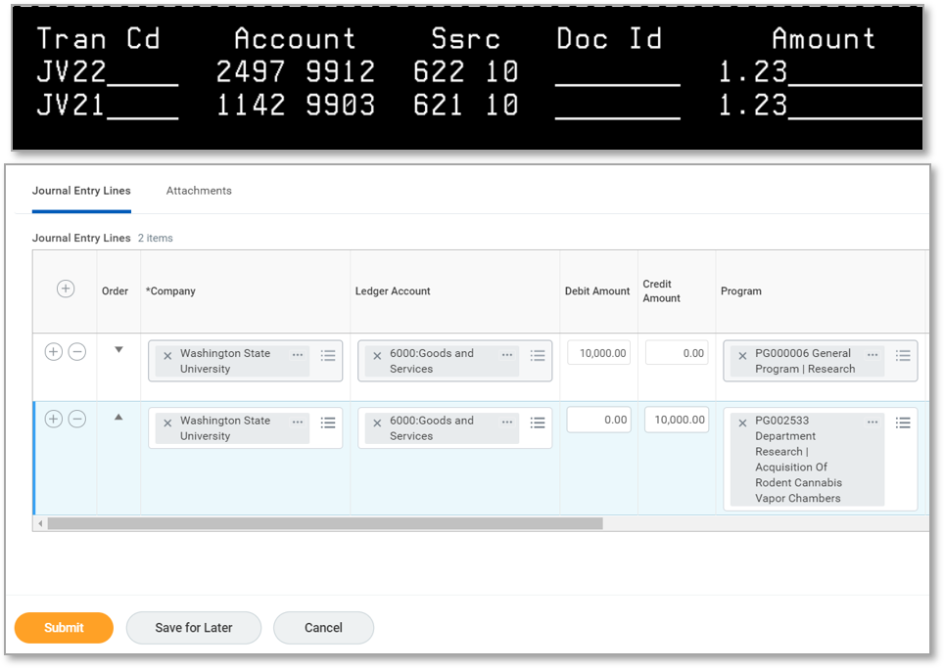
Key Changes
AIS JVs
Workday Accounting Journals

Slide 31
Debit / Credit
Debit
Increases the balance in an Expense ledger account
Decreases the balance in a Revenue ledger account
Similar to JV91 or JV21 in AIS
Credit
Decreases the balance in an Expense ledger account
Increases the balance in a Revenue ledger account
Similar to JV92 or JV22 in AIS
Control total should = $0 (Debits = Credits)

Slide 32
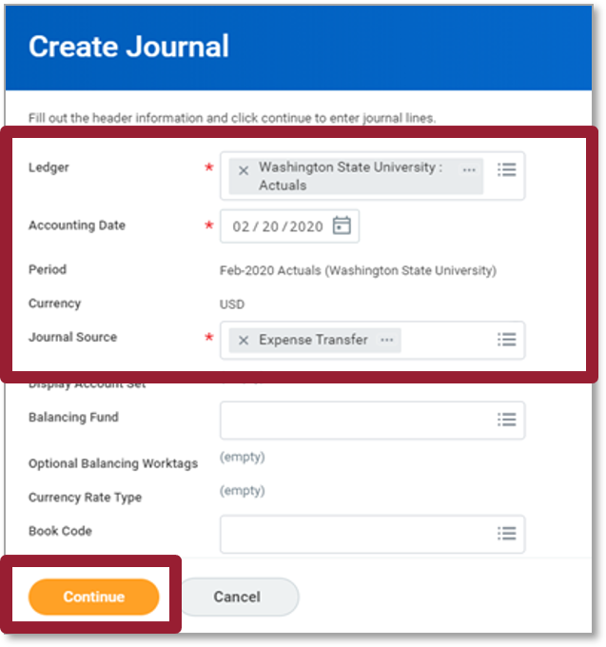
Create Accounting Journal (1 of 4)
The screenshot is of the create journal screen. The following fields are highlighted ledger (required field), accounting date (required field), period, currency, and journal source (required field). The continue button is highlighted.

Slide 33
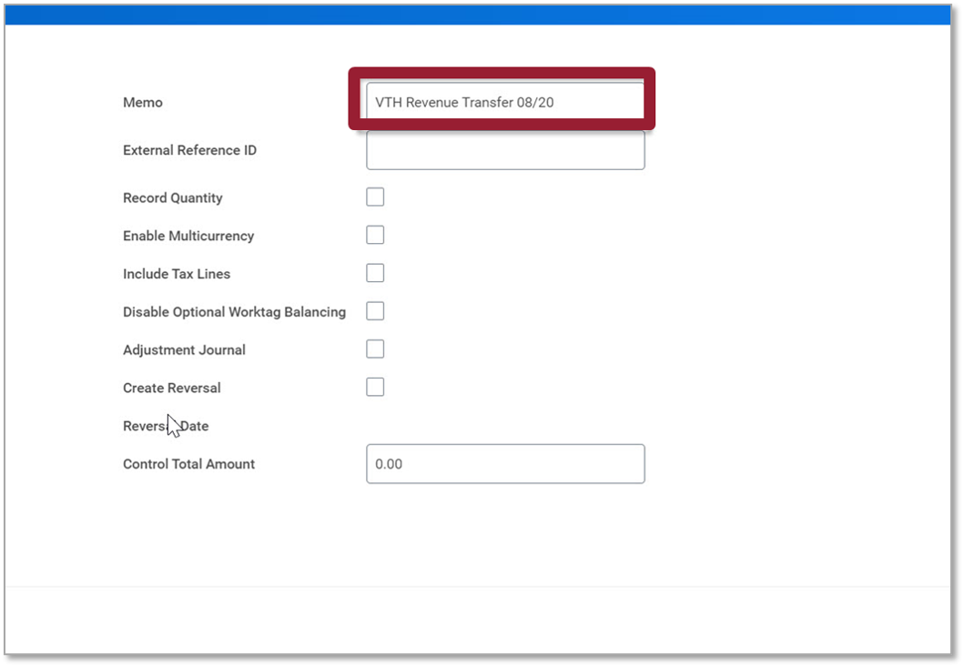
Create Accounting Journal (2 of 4)
Screenshot of the Memo List

Slide 34
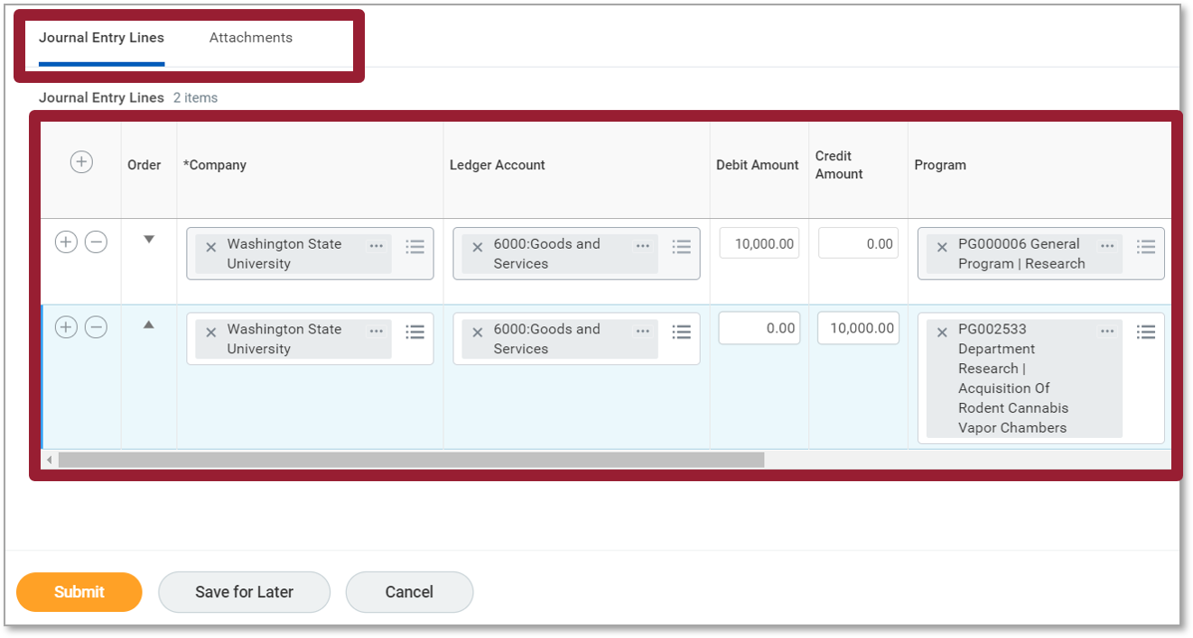
Create Accounting Journal (3 of 4)
Screenshot of the journal entry lines tab screen. The table displays the add row icon, order, company, ledger account, debit amount, credit amount, and program fields.

Slide 35
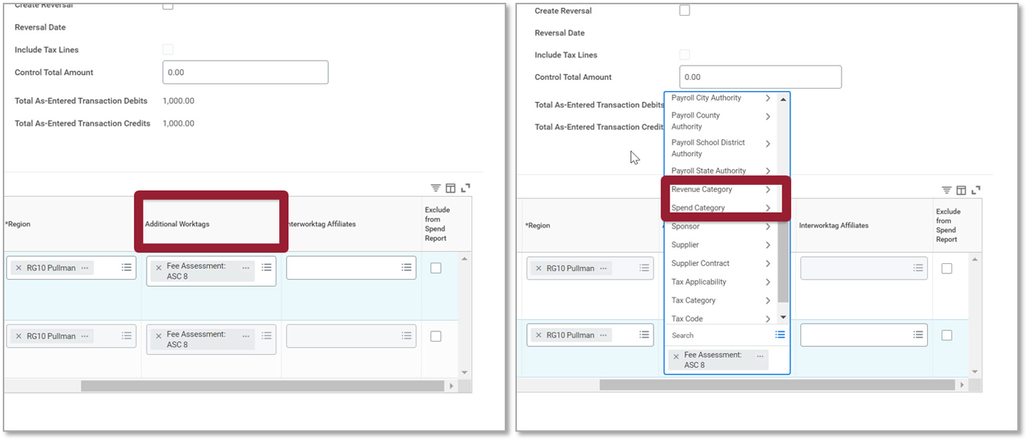
Create Accounting Journal (4 of 4)
Screenshot of showing the Additional worktags.

Slide 36
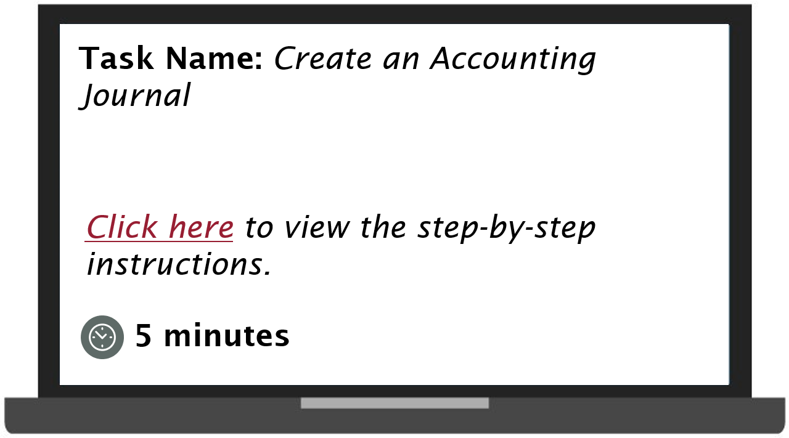
Demonstration 2.1
Task name create an accounting journal. Select here to view the step by step instructions. This task will take 5 minutes.

Slide 37
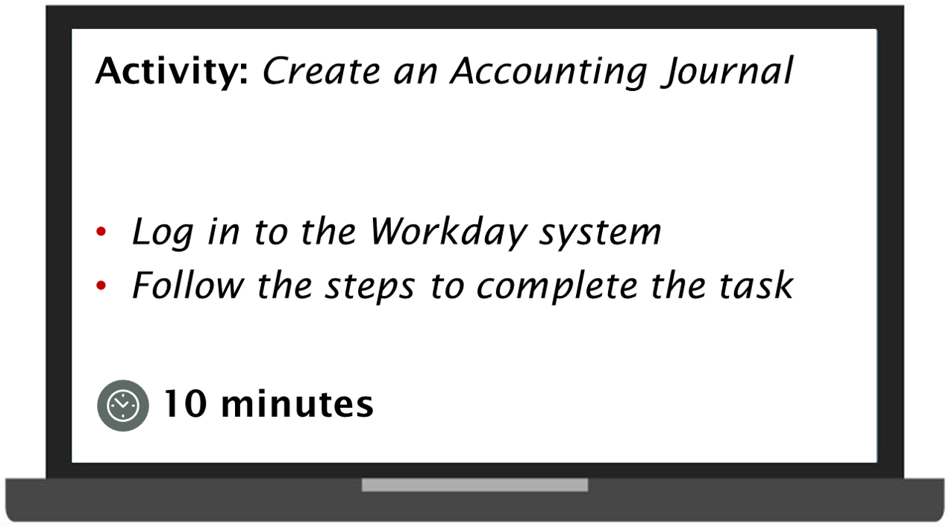
Practice 2.1
Activity to create an accounting journal. Log in to the Workday system. Follow the steps to complete the task. The task will take 10 minutes.

Slide 38

Journal Entry Reversal (1 of 2)
Scenario 1:
As an Accountant (Cost Center), I want to reverse a journal entry and route for approval.
As an Accounting Manager (Cost Center/Gift/Grant/Project/Program), I can approve reversal of a journal entry.
As an Accounting Manager, I can provide the final approval on reversal of a journal entry.

Slide 39
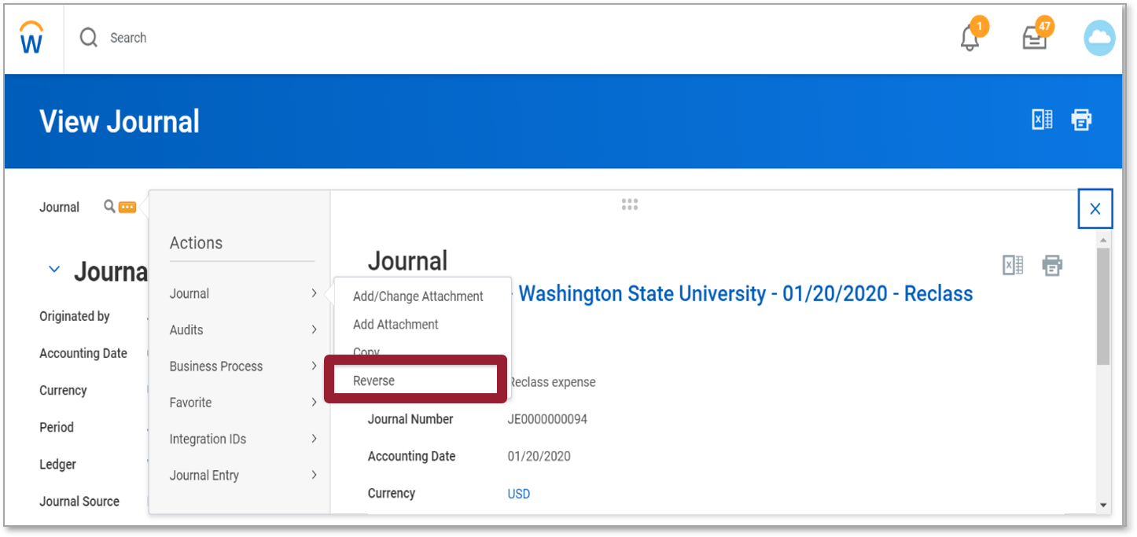
Journal Entry Reversal (2 of 2)
The view journal screenshot displays the journal dropdown on the left side of the screen. The reverse field is highlighted.

Slide 40
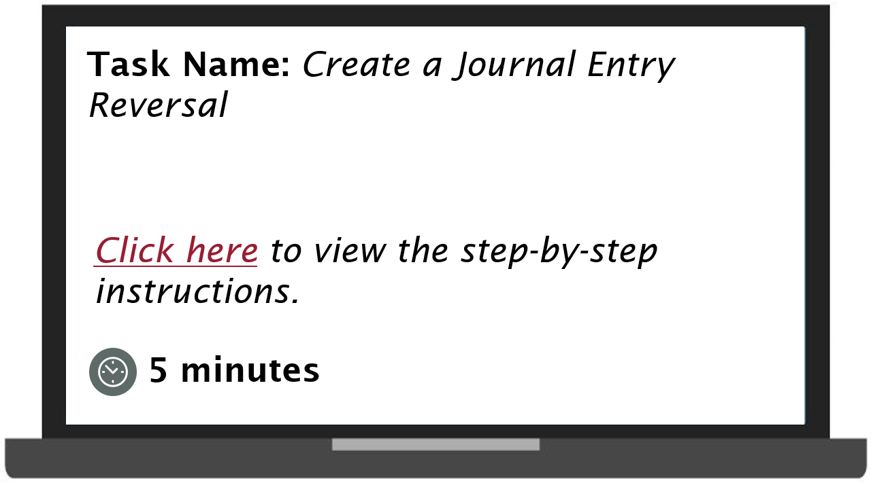
Demonstration 2.2
Task name create a journal entry reversal. Select to view the step by step instructions. This task will take 5 minutes.

Slide 41
Take a break!
We will resume in 10 minutes

Slide 42
Lesson Three
Create Accounting Adjustments
Lesson 3

Slide 43
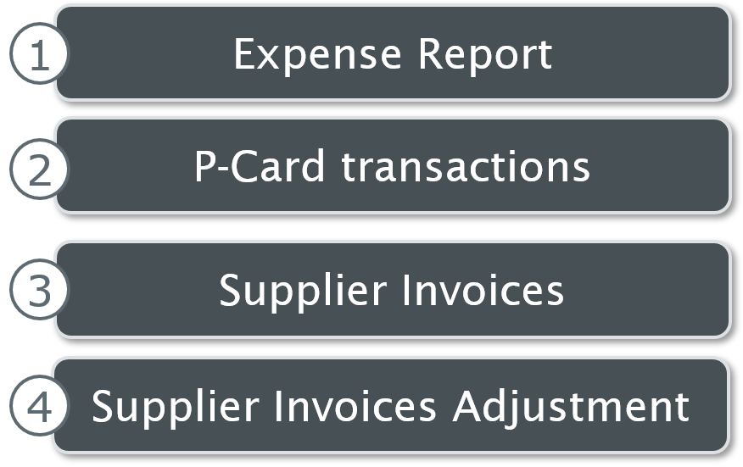
Accounting Adjustments
Accounting Adjustments are performed to reclassify cost for the following financial transactions:
1. Expense report
2. P-Card transactions
3. Supplier Invoices
4. Supplier Invoices Adjustment

Slide 44
Things to Remember
A Supplier Invoice or Expense Report must always be in a paid status
Each document line can be adjusted; the amount of each document line cannot be split
All Accounting Adjustments goes through an approval queue
Review of the correct Worktags at the time of Requisition, Request, or Expense Report allocation helps prevent accounting adjustment

Slide 45
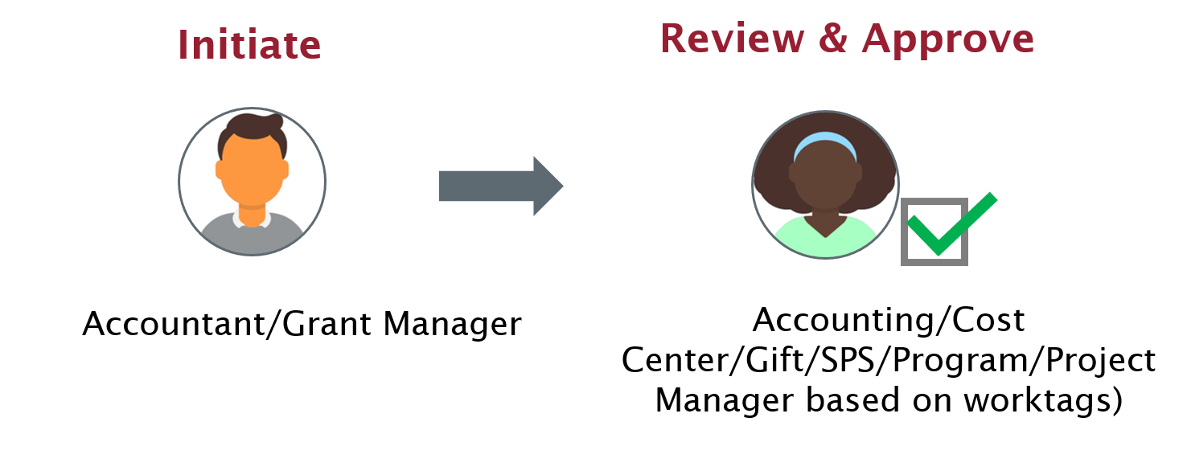
Accounting Adjustment Flow
Accounting adjustment flow is initiated by accounting or grant manger. It is reviewed and approved by the accounting, cost center, gift, SPS, or project manager based on worktags.

Slide 46

Accounting Adjustment Scenario
Scenario 1:
As a Grant Manager, I want to make an Accounting Adjustment to a supplier invoice with a Grant Worktag and route it for approval to the Sponsored Programs Manager
As a Sponsored Programs Manager, I can review and send back an Accounting Adjustment

Slide 47
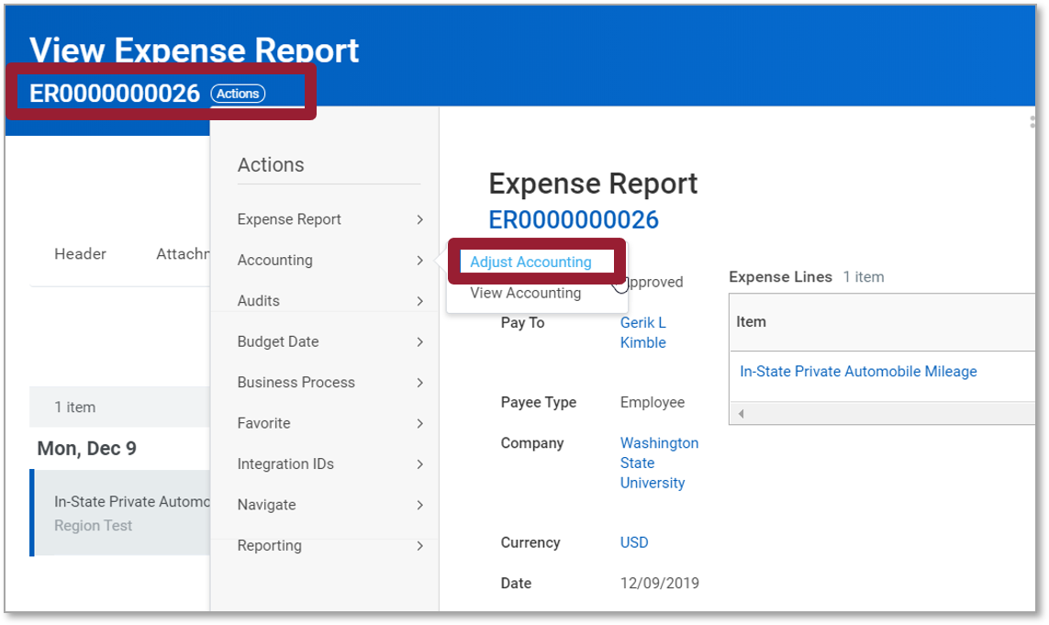
Create Accounting Adj. (1 of 4)
The screenshot of the view expense report screen. The transaction number is highlighted. Under the expense report view the adjust accounting field is highlighted.

Slide 48
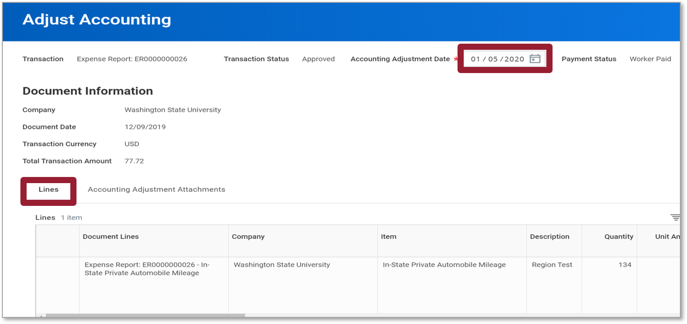
Create Accounting Adj. (2 of 4)
Screenshot of adjust accounting screen. Transaction details are displayed. The accounting adjustment date is highlighted and is located top of the screen. The lines tab is highlighted.

Slide 49
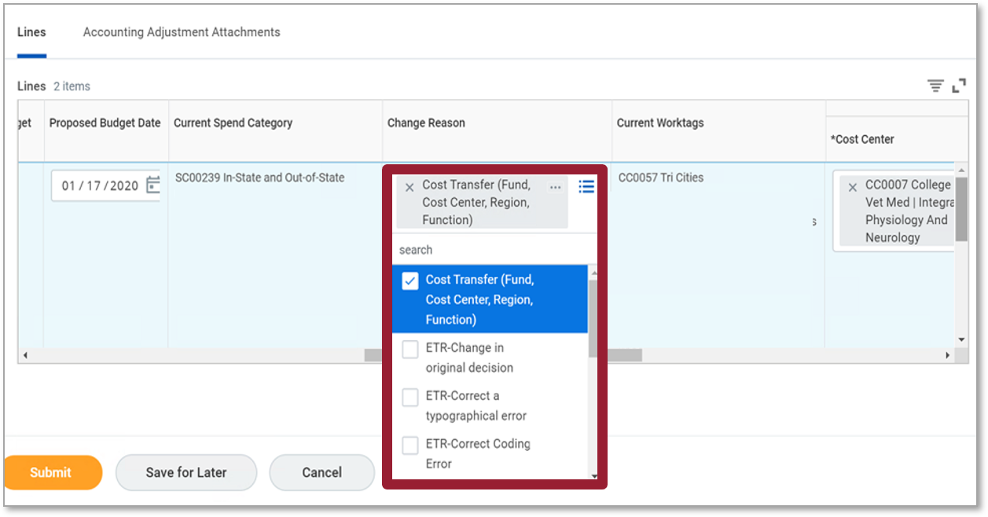
Create Accounting Adj. (3 of 4)
The screenshot of the lines tab. The fields under the change reason column are highlighted.

Slide 50
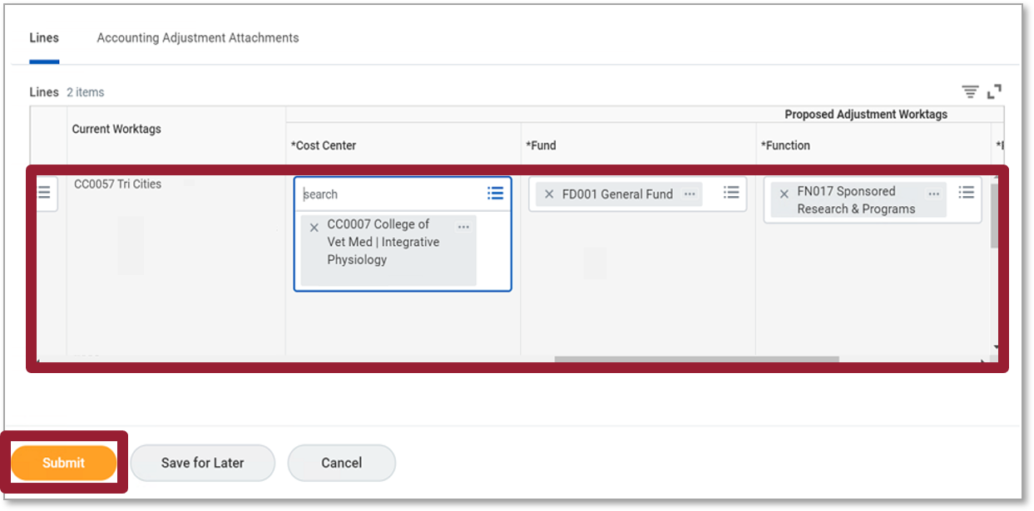
Create Accounting Adj. (4 of 4)
The screenshot of the lines tab screen. The following fields are highlighted current worktags, cost center, fund, and function.

Slide 51
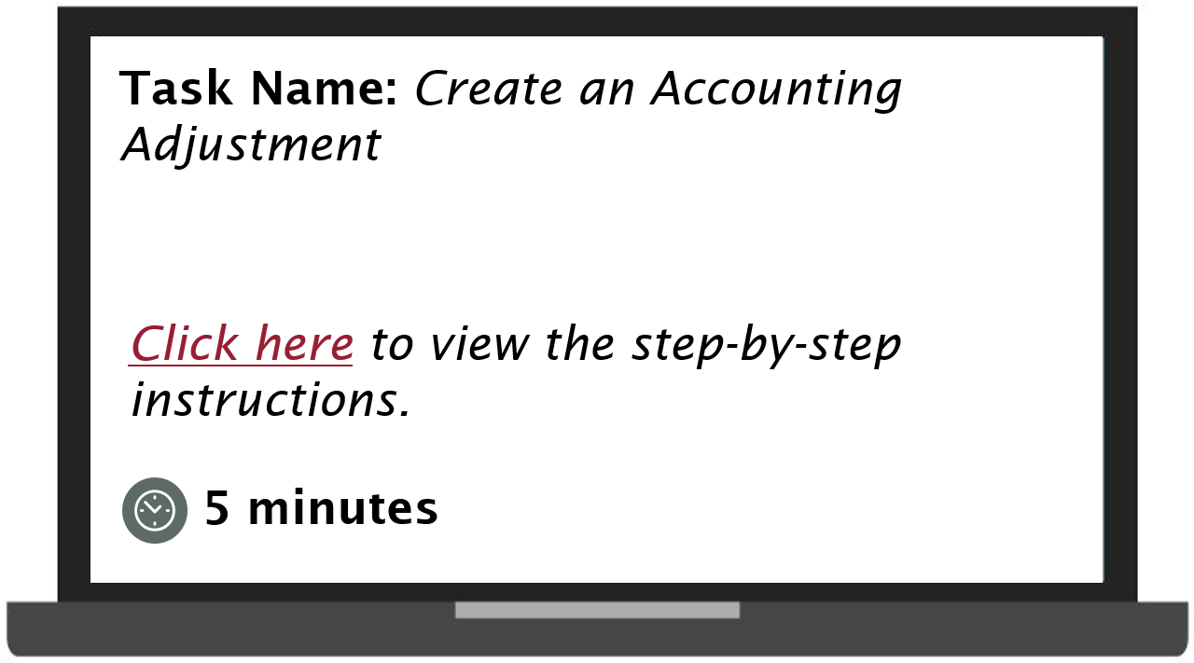
Demonstration 3.1
Task name create an accounting adjustment. Select to view the step by step instructions. Duration of task is 5 minutes.

Slide 52
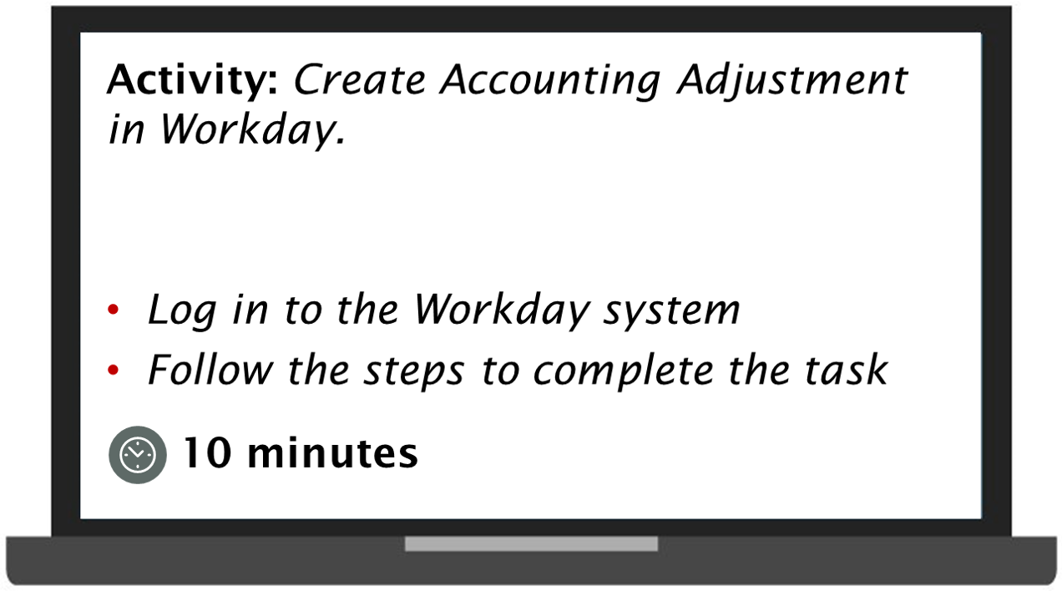
Practice 3.1
Activity create accounting adjustment in Workday. Log in to the Workday system. Follow the steps to complete the task. Duration of task 5 minutes.

Slide 53
Lesson Four
Workday Reports
Lesson 4

Slide 54
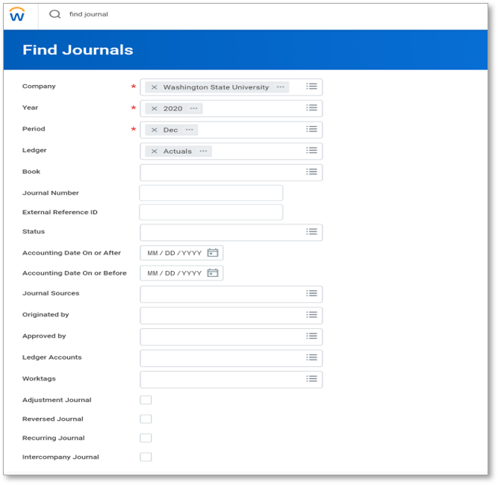
Run Reports
The screenshot of the find journals screen. The following fields are required company, year, and period.

Slide 55
Useful Reports
You can view the following accounting reports:
Event Accounting Summary – View posted journals by journal source
Find Accounting Adjustments
Find Journals
Find Recurring Journal Template
Ledger Account Activity Summary by Source
Trial Balance

Slide 56
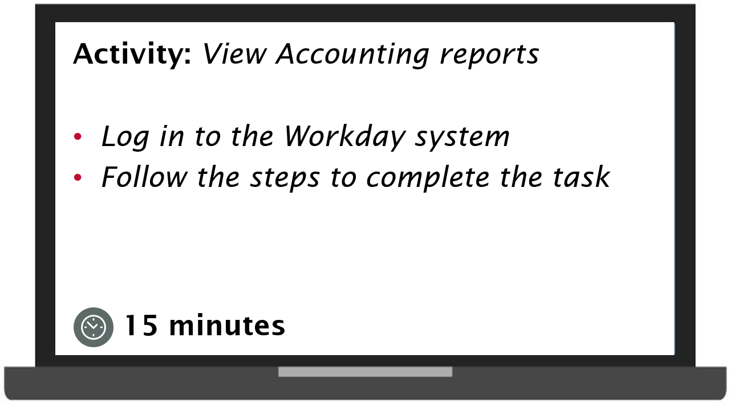
Practice 4.1
Activity view accounting reports. Log in to the Workday system. Follow the steps to complete the task. Duration of activity is 15 minutes.

Slide 57
Knowledge Check 5
In which of the following scenarios, Manual Accounting Journals are usually not created?
Select the correct answer from the options given below.
Depreciation
Month end adjustment
Revenue transfer
Ad Hoc bank transaction

Slide 58
Knowledge Check Answer
Depreciation
Month end adjustment
Revenue transfer
Ad Hoc bank transaction (because this will be an operational journal)

Slide 59
Additional Resources (1of 2)
Helpful resources are available to perform Workday related tasks:
WSU Knowledge Base
Workday Accounting Guide: Create Accounting Journals
Workday Accounting Guide: Accounting Journal – Reversal
Workday Accounting: Accounting Journal Reversal Video
Workday Accounting Guide: Accounting Adjustment - Cost Transfer

Slide 60
Additional Resources (2 of 2)
Helpful resources are available to perform Workday related tasks:
OBIEE Crosswalk

Slide 61
Course Summary
You should now be able to:
Create Accounting Journals
Create Accounting Journal Reversals
Create Accounting Adjustments

Slide 62
Course Evaluation
Please take a moment to complete a brief survey providing us feedback on today’s training session. Your feedback will help us improve Workday training materials.
https://wsu.co1.qualtrics.com/jfe/form/SV_3ql1sztsFwp0zn7

Slide 63
Workday Support
Knowledge Base
ModHelp/Workday Support
Training Catalog
Modernization Website
Change Network Directory

Slide 64
You have successfully completed the Workday Accounting Journal course!
Questions? Please contact support.workday.wsu.edu

