Slide 1
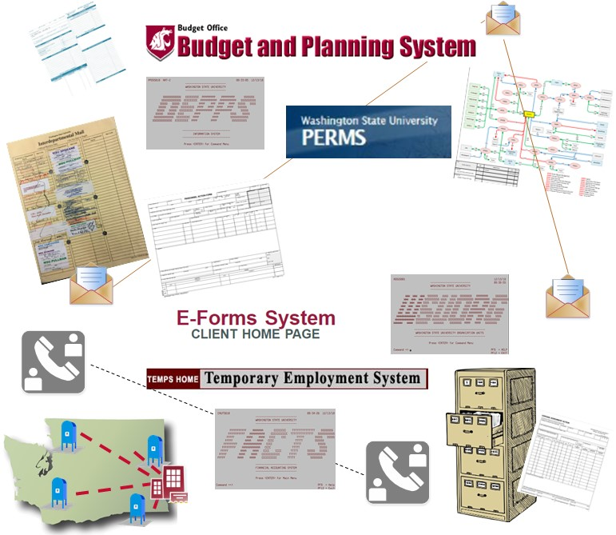
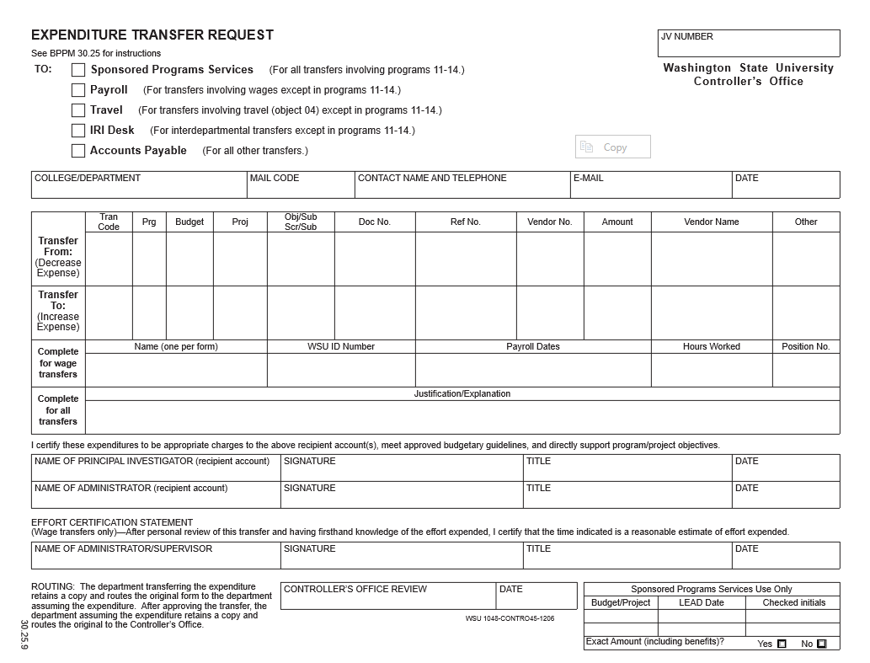
Project Scope
CURRENT STATE
FUTURE STATE
HR
Benefits administration
Compensation
Onboarding
Personnel administration
Position classification
Recruiting
Time, labor and leave
HR and Finance
Reporting and business analytics
Finance
Accounts payable
Accounts receivable
Asset management
Budget management
Endowment accounting
General ledger and accounting
Payroll processing
Position budgeting
Post-Award Grants Mgmt.
Procurement
Travel accounting
Treasury and banking
Notes:
Theresa Elliot-Cheslek (2 mins)
As we look ahead, all of these processes will be transformed to Workday.
Examples of the benefits of being in one system: better collaboration across campuses, less manual work, better data visibility, etc.
For new systems, reiterate ongoing support and training to prepare users
Discuss specific finance and HR systems that Workday is replacing
Project team will ensure a smooth transitions for systems being replaced
What is in scope for the project how each area fits into the overall project
a few of the major functional activities that are in scope.

Slide 2
Building Workday for WSU
Discovery Sessions
Business Process Design Sessions
Data Gathering
Activities
Reporting
FDM &
Cost Center Hierarchy
Role to Position Mapping
Supervisory Organization
Business Processes
Workday Financials
Workday Human Capital Management (HCM)
Notes:
Theresa Elliot-Cheslek (90 seconds)
Walk through project structure emphasizing the collaborative approach:
The project team is collaboratively working across traditional organizational boundaries and functions to ensure that information is shared as it becomes available, keeping the future of WSU at the forefront of their work

Slide 3
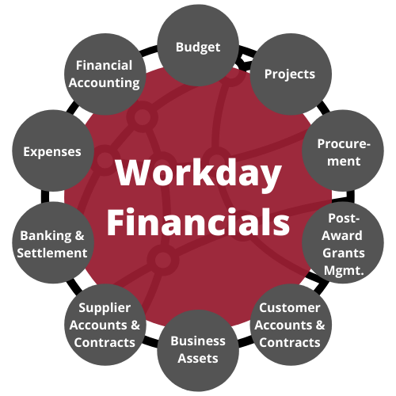
Workday Financials for WSU
Workday Financials encompasses:
Budget
Financial Accounting
Expenses
Banking and Settlement
Supplier Accounts & Contracts
Business Assets
Customer Accounts & Contracts
Post-Award Grants Management
Procurement
Projects
Notes:
Theresa Elliot-Cheslek (90 seconds)
Walk through project structure emphasizing the collaborative approach:
The project team is collaboratively working across traditional organizational boundaries and functions to ensure that information is shared as it becomes available, keeping the future of WSU at the forefront of their work

Slide 4
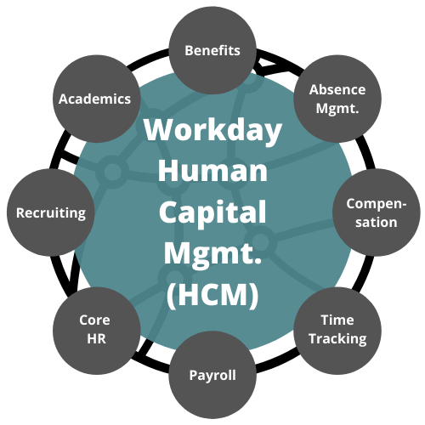
Workday Human Capital Management (HCM) for WSU
Workday Human Capital Management encompasses:
Benefits
Academics
Recruiting
Core HR
Payroll
Time Tracking
Compensation
Absence Management
Notes:
Theresa Elliot-Cheslek (90 seconds)
Walk through project structure emphasizing the collaborative approach:
The project team is collaboratively working across traditional organizational boundaries and functions to ensure that information is shared as it becomes available, keeping the future of WSU at the forefront of their work

